Slide 1
IV. NUCLEAR BIOCHEMISTRY
§4.5 RNA Translation
§4.5a Genetic Code
§4.5b Ribosome Structure
§4.5c Translational Machinery

Slide 2
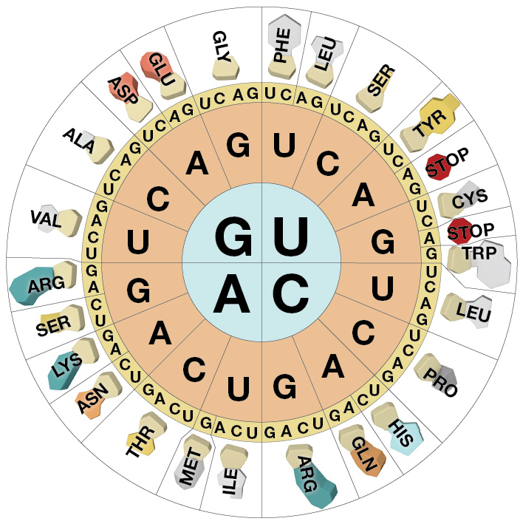
§4.5a Genetic Code

Slide 3
Synopsis 4.5a
In order to “translate” the genetic information (or genetic code) carried by mRNA into the synthesis of a polypeptide chain, it must first be decoded
Genetic code is a set of triplet of bases—each triplet is termed codon—corresponding to the contiguous sequence of mRNA without any spaces or punctuations
Each codon encodes one of the 20 amino acids in a polypeptide chain as well as a start signal and a stop signal
In order to decode the three-letter genetic code within a mRNA into a polypeptide chain, an adaptor is required—this role is delegated to the so-called “transfer RNA (tRNA)”

Slide 4
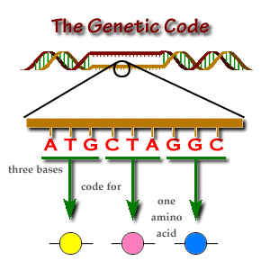
mRNA Codon
In order to serve as the link between DNA
and proteins, mRNA harbors a “code” in
the form of its nucleotide sequence
Such a code (or information) is divided
up into a continuous triplet of bases (or
words) without any punctuations!
Each triplet of bases within the contiguous
mRNA sequence is called the “codon”
Since mRNA is comprised of only four
bases (A/C/G/U), there is a total of 64
triplets or three-letter genetic codons—
ie there is a total of 64 possible variants
made up from 4 distinct letters arranged
in 3 different ways (4³ = 64)
How many unique 3-digit numerical codes can be obtained using all 10 numerical characters (0-9)? 10³! How many 3-letter words are possible using all 26 alpha characters? 26³!
Collectively, the 64 codons constitute what has come to be known as the “genetic code”—it is essentially “Genglish” made up of only 4-letter alphabet, 3-letter words, and 64 words!
DNA
mRNA
U
U
?
?
?
Amino acids
Met
Leu
Gly

Slide 5
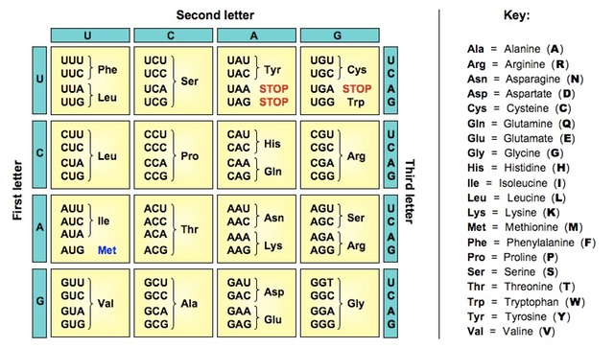
Codon Degeneracy and Nonrandomness
Since a polypeptide chain is comprised of 20
amino acids, each residue can be specified by
more than one codon (except for Met and
Trp)—ie the genetic code is degenerate!
Of the 64 codons, only 61 encode amino
acids—the other three serve as “nonsense”
or “stop” codons in that they do not specify
an amino acid but rather signal the end of
the polypeptide chain when encountered
by the ribosomal translational machinery
On the other hand, the AUG codon serves as
a “start” codon or “translation initiation site
(TIS)” for the synthesis of a polypeptide chain
Multiple codons specifying a unique amino
acid usually only differ at their third base (the
site of codon degeneracy)—such “nonrandom”
nature of the genetic code is evidence that it
must have evolved to minimize the deleterious effects of mutations!
How is the genetic code in the form of a contiguous trinucleotide sequence within mRNA decoded into amino acids vis-à-vis the synthesis of a polypeptide chain? Enter tRNA!

Slide 6
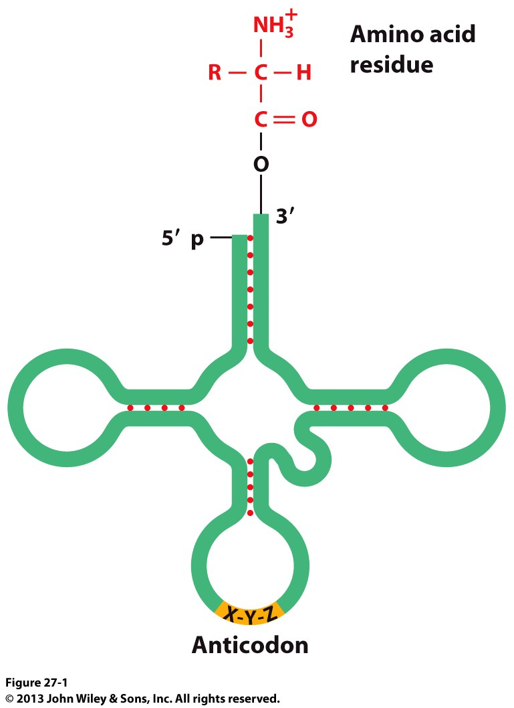
tRNA: 2D Cloverleaf Form
tRNA is the missing link between mRNA and protein synthesis
tRNA is a polymer (~ 80nt long) comprised
of three stem-loops and a solo stem called the “acceptor stem”—such structural motifs impart upon tRNA the so-called “cloverleaf” form @ secondary structural level!
One of the three stem-loops within tRNA harbors a
trinucleotide sequence that is complimentary to one
of the mRNA codons—such a complimentary triplet
of bases within tRNA is referred to as the “anticodon”, and the corresponding stem-loop the “anticodon arm”
On the other hand, the 3’-OH end of the acceptor stem of tRNA covalently attaches via an ester linkage to one of the 20 amino acids in a highly specific manner
For each of the 20 amino acids, there exists at least one cognate tRNA harboring an anticodon to match the corresponding codon in mRNA
tRNA
Ester linkage
Acceptor
stem
stem
stem
loop
loop
stem
stem
Anticodon
arm
loop
Clover leaf

Slide 7
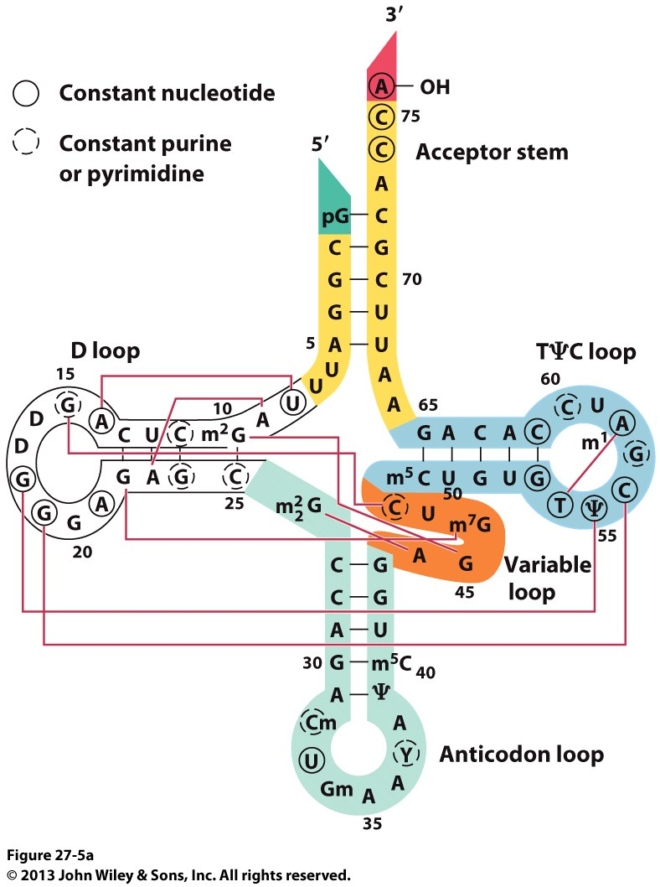
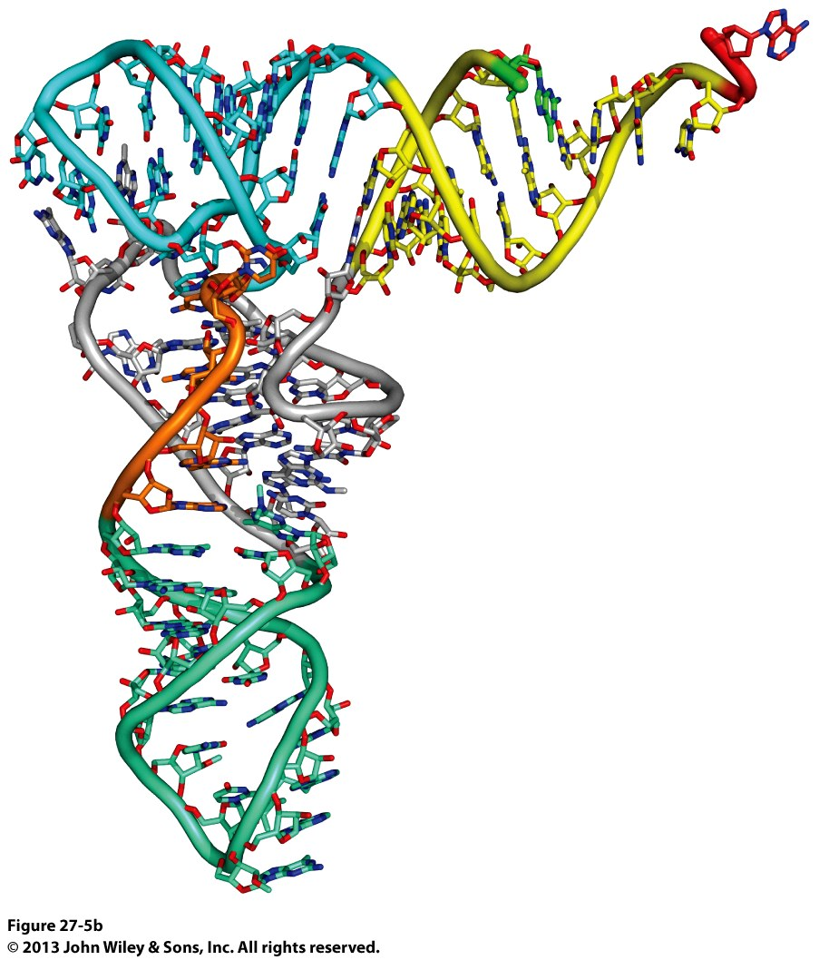
tRNA: 3D L-Shaped Form
2D Structure of a Typical tRNA
3D Structure of a Typical tRNA
The various secondary structural motifs constituting the 2D cloverleaf form of tRNA fold into a complex 3D structure resembling the letter L—such 3D shape is stabilized by extensive stacking interactions as well as non-Watson-Crick base pairing between bases in various stems
The 3D structure of tRNA is central to driving a specific pairing between an amino acid (aa) and a tRNA in what is called the aminoacyl-tRNA (aa-tRNA)—vide infra

Slide 8
tRNA: Translation of mRNA Codons
mRNA codons do not directly interact with their corresponding amino acids
Rather, a specific tRNA—carrying a cognate amino acid—base pairs via its anticodon with a corresponding mRNA codon
In so doing, tRNAs transfer or transport their cognate amino acids to a nascent polypeptide chain guided by the ribosomal translational machinery
mRNA

Slide 9
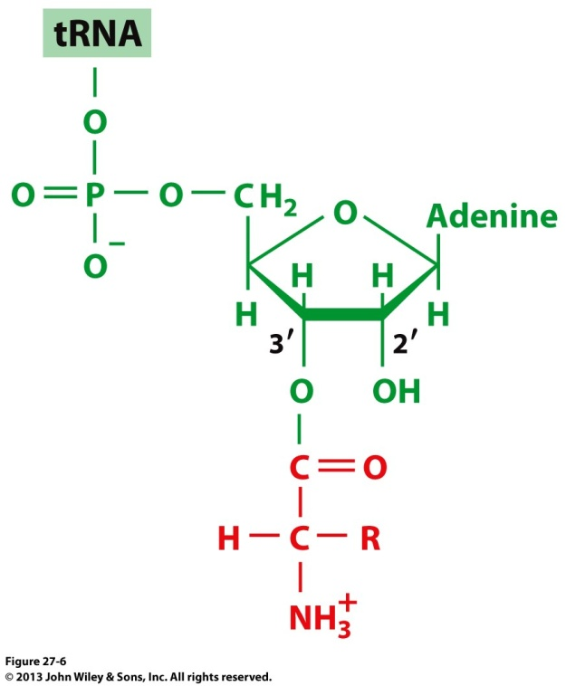
tRNA: Aminoacyl-tRNA (aa-tRNA)
The covalent attachment or esterification of a tRNA with
a specific amino acid (aa) for which it harbors an anticodon
generates the corresponding aminoacyl-tRNA (aa-tRNA)
conjugate in a process referred to as “aminoacylation”
How should the tRNA attached to the following amino
acids be nomenclatured (or named)? Arg, Glu, and Trp
On the other hand, tRNA cognates for corresponding
amino acids are usually post-superscripted with the
three-letter amino acid code—eg tRNA^{Arg}, tRNA^{Glu}, tRNA^{Trp}
What is the difference between tRNA^{Arg} and arginyl-tRNA? The tRNA^{Arg} is the uncharged (free) tRNA that has the capacity to bind Arg, whereas arginyl-tRNA is the tRNA^{Arg} in which Arg is covalently attached to its 3’-OH group—strictly, Arginyl-tRNA should be written as “arginyl- tRNA^{Arg}”
Each aa-tRNA conjugate enables amino acid to be added to a nascent polypeptide chain within the ribosomal translational machinery in an ordered manner as specified by the mRNA codon
How is the synthesis of aa-tRNA directed to ensure that only
the correct amino acid attaches to a specific tRNA harboring
its anticodon? Enter aminoacyl-tRNA synthetase (aaRS)
aa
Aminoacyl-tRNA (aa-tRNA)—eg:
Arginyl-tRNA
Glutaminyl-tRNA
Tryptophanyl-tRNA

Slide 10
tRNA: Aminoacyl-tRNA Synthetase (aaRS)
Aminoacyl-adenylate (aa-AMP)
Synthesis of aminoacyl-tRNA (aa-tRNA) is driven by aminoacyl-tRNA synthetase (aaRS) via the following two steps:
(1) Activation of a specific amino acid (aa) with ATP to generate the “high-energy” aminoacyl-adenylate (aa-AMP) intermediate:
aa + ATP <=> aa-AMP + PPi
(2) The aa-AMP intermediate subsequently reacts with a cognate tRNA (ie one that harbors the anticodon for the specific aa to be covalently attached):
aa-AMP + tRNA <=> aa-tRNA + AMP
In this manner, aaRS-catalyzed synthesis of aa-tRNA ensures that it harbors the correct anticodon for the amino acid it is carrying—aaRS thus serves as a “matchmaker” in that it matches a specific amino acid with its anticodon within the cognate tRNA by virtue of its ability to recognize their 3D structures!
There exists at least one tRNA for each amino acid—and so does at least one specific aaRS (eg arginyl-tRNA synthetase and so forth)—not only that but many “abundant” amino acids have more than one cognate tRNA/aaRS pairs!

Slide 11
tRNA: Codon Promiscuity
tRNA^{ala} (anticodon)
mRNA (codon)
Each aa-tRNA conjugate enables the amino acid to be added to a nascent polypeptide chain within the ribosomal translational machinery in an ordered manner solely on the basis of codon-anticodon complementary base pairing—the aminoacyl group of aa-tRNA has no say on this “match-making” process!
Although there are 61 functional mRNA codons (encoding only 20 amino acids), recognition of each mRNA codon does not necessarily require a unique tRNA—ie 61 cognate tRNAs
Rather, many tRNAs can base pair with more than one mRNA codon—eg tRNA^{Ala} harboring the IGC anticodon recognizes three (GCA/GCC/GCU) of the four mRNA codons for alanine (the fourth codon being GCG)
Thus, the actual number of tRNAs required for productive protein synthesis is much less than 61—but a minimum of 32 tRNAs are required to recognize all 61 mRNA codons according to “Wobble hypothesis”—vide infra
Paradoxically, the genomes of most eukaryotes encode over 100 tRNAs—many of these tRNAs encode non-standard amino acids while others are non-functional or represent pseudo-genes

Slide 12
tRNA: Wobble Hypothesis
Wobble base pairing between anticodon-codon pairs @ third position within the codon
The site of mRNA codon degeneracy at the third position is exquisitely mirrored by anticodons in tRNAs in that the latter harbor a modified base such as inosine (I) at the complementary position—ie the 5’-nucleotide in tRNA anticodon that base pairs with the 3’-nucleotide (the third position) in mRNA codon
Such nucleotide modification imparts upon tRNAs the ability to base pair with more than one mRNA codon by virtue of its ability to engage in non-Watson-Crick base pairing at the third position
Notably, non-Watson-Crick base pairing between tRNA and mRNA allows a greater degree of conformational freedom (at the third position of the codon) needed to accommodate the same tRNA within degenerate codons—such non-canonical pairing is referred to as “Wobble base pairing”
Simply put, the ability of anticodon to somewhat “wobble” at the third position of the mRNA codons accounts for its ability to recognize multiple mRNA codons specifying the same amino acid in what has come to be called the “Wobble hypothesis”

Slide 13
Exercise 4.5a
Explain why mRNA codons must consist of at least three nucleotides
Which codon serves as start signal?
Which codon serves as stop signal?
Describe the major structural features of tRNA. Why is it important for all tRNAs to have similar structures? How is ATP used to charge a tRNA?
Why do cells not need at least one tRNA for each codon?
Which base pairings account for wobble at the third codon–anticodon position?

Slide 14
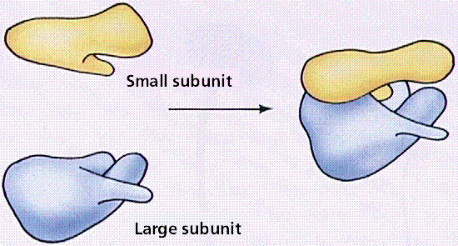
§4.5b Ribosome Structure
Ribosome

Slide 15
Synopsis 4.5b
Ribosome is a complex molecular machine that serves as the site of protein synthesis—ie translating mRNA into a polypeptide sequence
The ribosome is made up of two constituent ribonucleoprotein complexes called the 40S and 60S subunits
Each ribosomal subunit is a complex set of ribosomal RNAs (rRNAs) and proteins
The nomenclature of ribosomal subunits is based on their sedimentation coefficient measured in the units of Svedberg (S) —ie how quickly they sediment in an ultracentrifuge

Slide 16
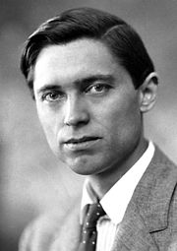
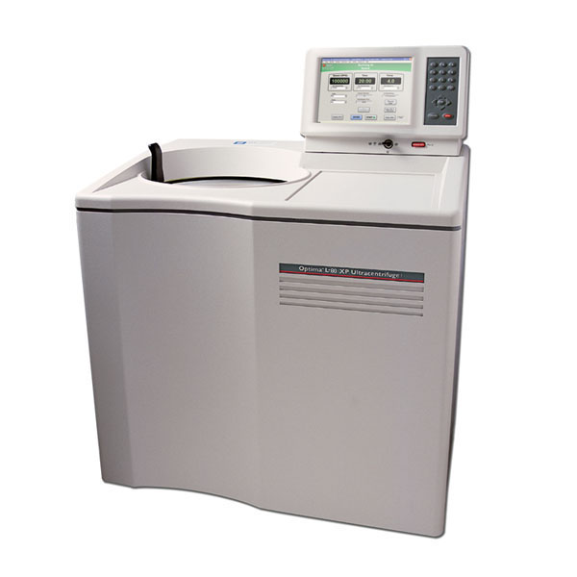
Ribosome: Sedimentation Coefficient
Ultracentrifuge
Ribosome
Theodor Svedberg
(1884-1971)
Located within the eukaryotic cytosol, the ribosome is made up of two constituent parts called the “small” and “large” subunits—each subunit is a complex set of rRNAs and proteins
The various components of the ribosome are described in terms of their sedimentation coefficient (c)—expressed in the non-SI units of Svedberg (S)—by the following relationship:
c = m/6πηr [1]
where m = mass of the particle
r = radius of the particle (a measure of its volume/surface area)
η = viscosity of the solution
Thus, c is dependent on both the mass and surface area of particles—it is indicative of how quickly they settle (or sediment) to the bottom of a liquid (in a tube) when it is spun down in an ultracentrifuge
In an ultracentrifuge, larger particles (of equal density) sediment faster and thus have a higher c—the higher the value of c the larger the particle and vice versa—in terms of SI units → 1S = 10⁻¹³s (or 100 fs)
Since c depends on both the mass and surface area, the sedimentation coefficients of two particles measured separately do not add up to the value obtained together as a complex!

Slide 17
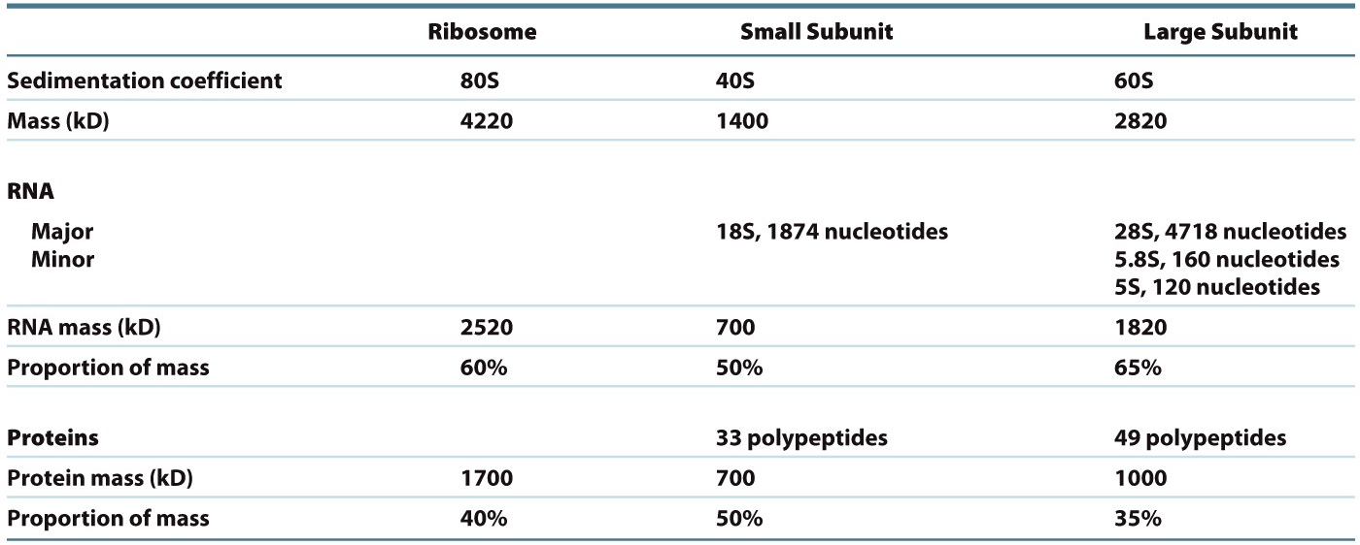
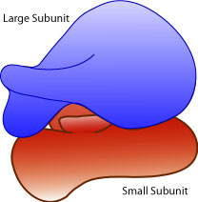
Ribosome: 40S and 60S Subunits (eukaryotes) (eukaryotes)
In terms of their sedimentation coefficients, the 80S eukaryotic ribosome consists of:
60S large subunit—comprised of three RNA polynucleotides (28S/5.8S/5S) and ~49 polypeptides
40S small subunit—comprised of a single RNA polynucleotide (18S) and ~33 polypeptides

Slide 18
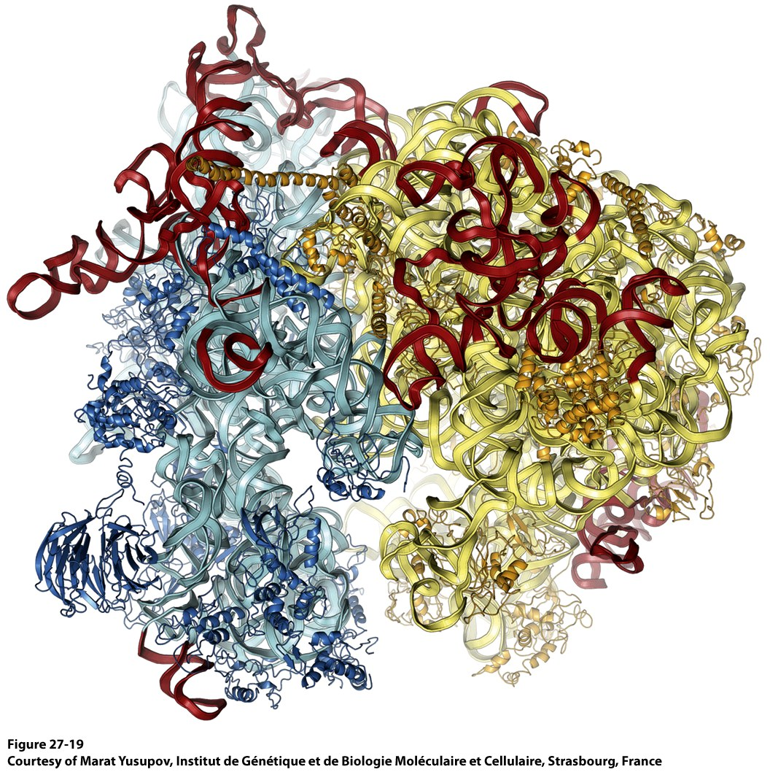
Ribosome: 3D Structure
60S/40S RNA
(unique to eukaryotes)
60S Proteins
40S RNA
60S RNA
40S Proteins

Slide 19
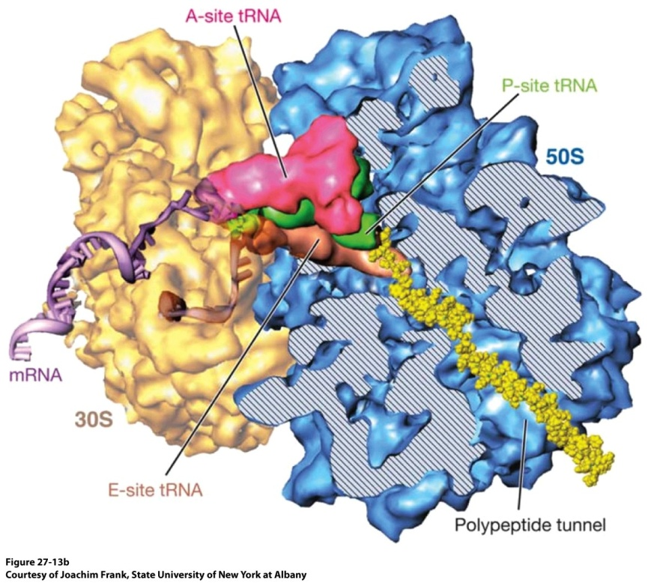
Ribosome:
tRNA Binding Sites
60S
40S
In addition to binding sites for mRNA transcript and the nascent polypeptide chain, the ribosome harbors three distinct sites for simultaneously accommodating three tRNAs at various stages:
(1) A-site for aminoacyl-tRNA (the incoming tRNA carrying an Amino acid)
(2) P-site for peptidyl-tRNA (the tRNA attached to the nascent Polypeptide)
(3) E-site for deacylated tRNA (the tRNA about to Exit after donating its amino acid)

Slide 20
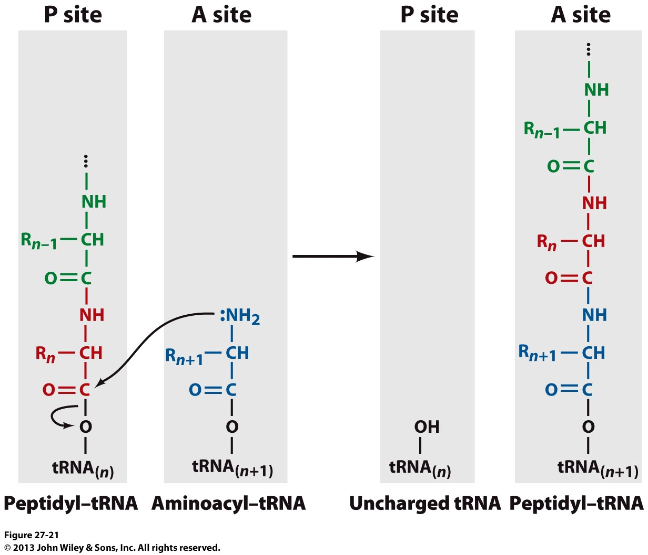
Ribosome: Peptidyl Transferase
The task of removing the aminoacyl
group of aminoacyl-tRNA and adding it
to a nascent polypeptide chain falls to
an RNA component (28S) of 60S subunit
called “peptidyl transferase”
Peptidyl transferase is a ribozyme—an
exclusively RNA-based catalyst (or a
ribonucleic acid enzyme)
Peptidyl transferase promotes nucleophilic
attack of the incoming amino group of
aminoacyl-tRNA (A-site) on the carbonyl
group of peptidyl-RNA (P-site), thereby
resulting in the:
(1) displacement of the tRNA of the peptidyl-tRNA (harboring n amino acids)
(2) formation of a new peptide bond with the incoming amino acid (transpeptidation)
(3) transfer of nascent polypeptide chain harboring n+1 amino acids to A-site
(4) translocation of uncharged/deacylated tRNA from P-site to E-site
(5) translocation of the new peptidyl-tRNA (harboring n+1 amino acids) to P-site
After the dissociation of deacylated tRNA from the E-site, the above reaction is repeated for the next aminoacyl-tRNA as dictated by the next codon in the mRNA sequence

Slide 21
Exercise 4.5b
Describe the positions and functions of the three tRNA-binding sites in the ribosome
Which base pairings account for wobble at the third codon–anticodon position?
Summarize the roles of initiation, elongation, and release factors in translation
How does the ribosome catalyze peptide bond formation?
How does the ribosome verify correct tRNA–mRNA pairing?

Slide 22
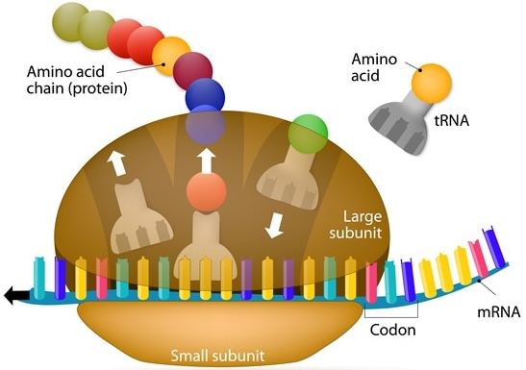
§4.5c Translational Machinery

Slide 23
Synopsis 4.5c
Translational machinery is the site where the genetic code within the mRNA is “decoded” or “translated” into a polypeptide chain—it is essentially comprised of a ribosome along with a plethora of other protein factors that guide the decoding of mRNA and the assembly of a polypeptide chain
mRNA transcript is read in the 5’ → 3’ direction
Polypeptide synthesis proceeds from the N- to C-terminus
RNA translation into the synthesis of a polypeptide chain can be divided into three major stages:
Initiation—requires eukaryotic initiation factors (eIFs)
Elongation—requires eukaryotic elongation factors (eEFs)
Termination—requires eukaryotic release factors (eRFs)
Multiple ribosomes can bind to a single mRNA transcript adopting a “beads-on-a-string” appearance called “polyribosome” or “polysome”

Slide 24
Translation Initiation: Overview
1
2
3
4
Eukaryotic translation initiation—that among a pool of common players such as the tRNA, mRNA and separate ribosomal subunits also requires a plethora of helper proteins called “eukaryotic initiation factors (eIFs)”—can be divided into eight stages:
Met-tRNA_{i}^{Met} Priming
Met-tRNA_{i}^{Met} Transport
mRNA Packaging
mRNA Attachment
mRNA Scanning
Initiation Codon Recognition
Ribosomal Subunit Association
Initiation Complex Formation
5
6
7
8

Slide 25
Translation Initiation: (1) Met-tRNA_{i}^{Met} Priming
eIF2
The AUG initiation codon is recognized by the
so-called initiator tRNA covalently attached to
its cognate Met residue (methionyl-RNA_{i}^{Met})—virtually
all eukaryotic proteins begin with Met residue though
this is sometimes cleaved off during post-translational
modification (PTM)
In order to recognize the AUG initiation codon,
metRNA_{i}^{Met} is first assembled into a ternary
complex with GTP-bound eIF2 so as to prepare
or “prime” it for transport to the ribosome
The GTP-eIF2-metRNA_{i}^{Met} complex subsequently translocates to the P-site within the 40S subunit of ribosome so as to transport the metRNA_{i}^{Met} in order to allow it to base pair (via its CAU anticodon) with the AUG initiation codon within mRNA
The ability of methionyl-tRNA_{i}^{Met} to recognize the AUG initiation codon arises from its ability to specifically bind to eIF2 and the P-site within the 40S subunit of ribosome—on the other hand, methionyl-tRNA^{Met} that recognizes AUG internal codons can only be accommodated within the A-site thus barring it from initiating protein synthesis (that must begin @ P-site—why?!)
However, both the initiator methionyl-tRNA_{i}^{Met} and internal methionyl-tRNA^{Met} are aminoacylated with Met residue by the same methionyl-tRNA synthetase (MetRS)
1
GTP-eIF2-metRNA_{i}^{Met} complex
Methionyl-tRNA_{i}^{Met}
(metRNA_{i}^{Met})

Slide 26
Translation Initiation: (2) Met-tRNA_{i}^{Met} Transport
40S-eIFs complex
Ribosome undergoes a constant recycling
process whereby it assembles prior to
initiation of each round of polypeptide
synthesis that terminates with the
dissociation of ribosomal subunits
Transportation of GTP-eIF2-metRNA_{i}^{Met}
complex to the ribosome so as to promote the
formation of the so-called 43S complex—or
preinitiation complex (PIC)—requires a pool
of separated 40S and 60S ribosomal subunits
Prior to the formation of PIC, the separated 40S subunit
of ribosome recruits eIF1, eIF1A and eIF3 (and presumably eIF5)
The 40S-eIFs complex subsequently serves as a docking platform for the recruitment of GTP-eIF2-metRNA_{i}^{Met} complex resulting in the formation of 43S complex (or PIC)
Within the 43S complex, methionyl-tRNA_{i}^{Met} binds to the P-site so as to essentially serve as a proto-peptidyl-tRNA—thus being in a position to receive the second amino acid from the next aa-tRNA as dictated by the mRNA codon following the initiating AUG codon
Working in sync with each other, the eIFs within the 43S complex induce a conformational change within the 40S ribosomal subunit so as to accommodate the pre-packaged mRNA transcript
eIF3
eIF1A
eIF1
eIF2
GTP-eIF2-metRNA_{i}^{Met} complex
1
2
eIF2
Methionyl-tRNA_{i}^{Met}
(metRNA_{i}^{Met})
eIF5
43S complex
eIF3

Slide 27
Translation Initiation: (3) mRNA Packaging
Although mRNAs harbor multiple AUG
codons, the first (or the leading)
AUG codon immediately following
the 5’-UTR sequence serves as the
initiation codon or translation
initiation site (TIS)—how is this
leading AUG codon distinguished
from internal AUG codons?
The AUG initiation codon, or TIS, is embedded within
the GCC(A/G)CCAUGG consensus sequence—a motif that
is recognized by the binding of various eIFs
In particular, the eIF4E-eIF4G-eIF4A (collectively called eIF4F) heterotrimeric complex plays a central role in the recognition of not only TIS at the 5’-end but also the poly(A) tail at the 3’-end of mRNA:
eIF4E binds to the 7-methylguanosine (m7G) @ the 5’-cap of mRNA
eIF4G binds to poly(A)-binding (PAB) protein, thereby circularizing the mRNA—presumably to “tether” eIF4F complex to the poly(A) tail so that it can remain bound to the mRNA for subsequent rounds of translation rather than falling off—thereby enhancing its processivity?!
The 5’-UTR of mRNAs usually possesses a stem-loop secondary structure that can impede their loading onto the ribosomes—how is this bottleneck overcome? Enter eIF4A
eIF4A is a DEAD-box RNA helicase that promotes the unwinding of 5’-UTR (in an ATP-dependent manner)—in the presence of eIF4B—to prepare the mRNA transcript for subsequent ribosomal attachment in the form of mRNA-eIFs complex
eIF4F
5’-UTR
eIF4B
3
5’
m7G
TIS
PAB
mRNA-eIFs complex
3’

Slide 28
Translation Initiation: (4) mRNA Attachment
eIF3
eIF1A
eIF1
eIF2
GTP-eIF2-metRNA_{i}^{Met} complex
1
2
Methionyl-tRNA_{i}^{Met}
(metRNA_{i}^{Met})
eIF2
eIF5
43S complex
eIF3
eIF4F
5’-UTR
eIF4B
3
5’
mRNA-eIFs
complex
4
m7G
TIS
PAB
3’
After the preparation of mRNA with various eIFs, the
mRNA-eIFs complex is shuttled to the ribosome, where
it attaches to the 43S complex pre-loaded with metRNA_{i}^{Met}
to form the pre-48S (p48S) complex
This step thus completes the unification of mRNA transcript with metRNA_{i}^{Met} under the watchful eye of the 40S ribosomal subunit
p48S complex

Slide 29
Translation Initiation: (5) mRNA Scanning
4G
5
2
3
p48S complex
(during mRNA attachment)
4A
1A
1
4B
4E
5
p48S complex
(during mRNA scanning)
In sync with the assembly of the p48S complex, the 40S ribosome begins to scan the mRNA transcript downstream of the 5’-cap to locate the AUG initiation codon
Such mRNA scanning requires the cooperation of all parties including, in particular, the attached eIFs, albeit to varying degrees—eg omission of eIF1A mitigates the scanning process, while the lack of eIF1 completely halts/abrogates it
How does the 40S subunit differentiate between the AUG initiation codon versus the AUG internal codons?!

Slide 30
Translation Initiation: (6) Initiation Codon Recognition
p48S complex
(during mRNA scanning)
4G
5
2
3
4A
1A
1
4E
4B
6
The AUG initiation codon (or TIS)
of mRNA is embedded within the
GCC(A/G)CCAUGG consensus sequence
While the eIFs play a central role in
guiding the 40S ribosomal unit to
the initiation codon, its ultimate
recognition is dependent upon the
ability of methionyl-tRNA_{i}^{Met} to base pair (via its
CAU anticodon) with the AUG codon within mRNA
Such codon-anticodon base pairing induces a conformational change within the p48S complex to generate the 48S complex
48S complex

Slide 31
Translation Initiation: (7) Ribosomal Subunit Association
48S complex
4G
5
2
3
4A
1
1A
4E
4B
+
7
eIF5B-GTP
60S subunit
Binding of GTP-bound eIF5B to the 48S complex
triggers eIF2-catalyzed hydrolysis of its bound GTP
to GDP —an event that results in the release of all
eIFs but eIF1A
The release of eIFs from the 48S initiation complex makes way for the docking of the 60S subunit—which binds to the same interface on 40S subunit that had earlier “piggybacked” the eIFs
The association of 60S subunit with the 48S complex generates the pre-80S (p80S) complex
p80S complex

Slide 32
Translation Initiation: (8) Initiation Complex Formation
5B
1A
8
p80S complex
80S complex
Association of 60S subunit with 40S subunit within the p80S complex triggers eIF5B-catalyzed hydrolysis of its bound GTP to GDP
This event releases both eIF5b and eIF1A from the p80S complex coupled with a conformational change that ultimately generates the 80S complex
The 80S complex is fully “primed” to accept/recruit an incoming aminoacyl-tRNA at the A-site in order to “stitch” its aminoacyl group onto the C-terminal of methionine within the methionyl-tRNA_{i}^{Met} waiting @ the P-site—the proto-peptidyl-tRNA (proto → mini|primitive|initial)
At this stage, the ribosome bids an “emotional” farewell to eIFs and welcomes aboard the eukaryotic elongation factors (eEFs) to begin the next stage of its journey along the mRNA track—enter translation elongation!

Slide 33
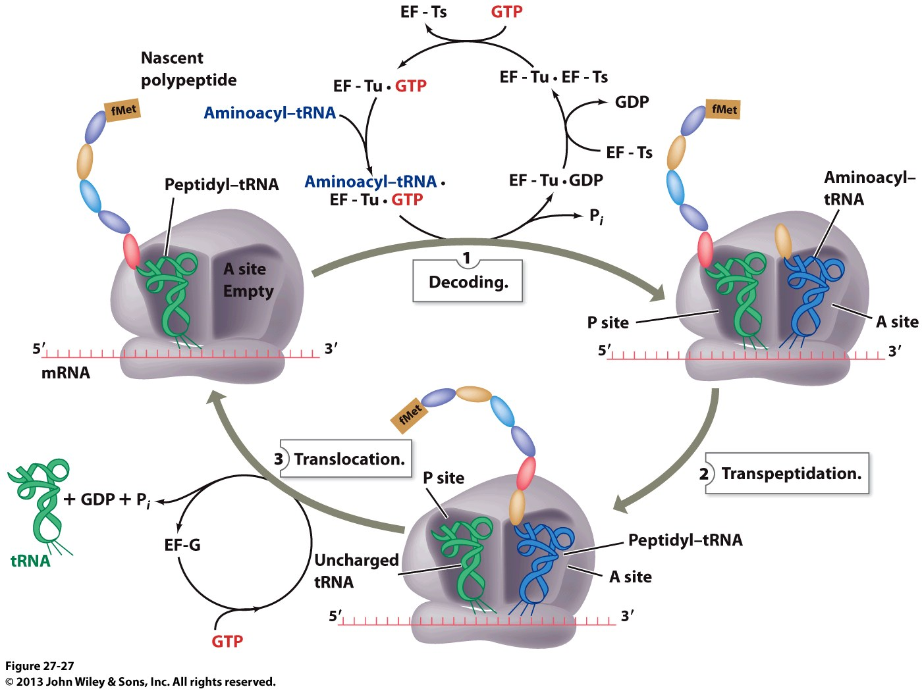
Translation Elongation: Overview
eEF1B
GTP
eEF1A.GTP
eEF1A-eEF1B
Met
aa-tRNA
GDP
Met
eEF1B
Peptidyl-tRNA (metRNA_{i}^{Met})
aa-tRNA.eEF1A.GTP
eEF1A.GDP
aa-tRNA
(1) Decoding
(3) Translocation
Met
(2) Transpeptidation
eEF2
eEF2.GTP
GTP

Slide 34
Translation Elongation: (1) Decoding
eEF1B
GTP
eEF1A.GTP
eEF1A-eEF1B
Met
aa-tRNA
GDP
Met
eEF1B
Peptidyl-tRNA
aa-tRNA.eEF1A.GTP
eEF1A.GDP
aa-tRNA
(1) Decoding
Coupled with GTP hydrolysis, the incoming aminoacyl-tRNA (aa-tRNA) is escorted/delivered by eEF1A and eEF1B to the A-site within the ribosome
In this manner, the ribosome selects and recruits an aa-tRNA whose anticodon is complementary to the mRNA codon @ the A-site in a phenomenon referred to as “decoding”
eEF1A and eEF1B specifically bind to tRNAs only after they become aminoacylated—ie aa-tRNAs

Slide 35
Translation Elongation: (2) Transpeptidation
Peptidyl transferase—an RNA component of ribosome (ribozyme)—catalyzes the formation of a peptide bond through the nucleophilic displacement of the peptidyl-tRNA @ the P-site by the aminoacyl group of aa-tRNA @ the A-site in a reaction referred to as “transpeptidation”
This reaction thus not only increases the peptide length of the peptidyl-tRNA from n to n+1 but also moves it to the A-site
The release of free energy upon the cleavage of “high-energy” ester linkage in peptidyl-tRNA drives the reaction to completion
Met
eEF1B
Peptidyl-tRNA
aa-tRNA
Met
(2) Transpeptidation

Slide 36
Translation Elongation: (3) Translocation
In order to prepare the ribosome for the next elongation cycle—ie to add the next aminoacyl group of aa-tRNA to the nascent (growing) polypeptide chain as dictated by the codon-anticodon complementarity—the following events that together constitute the “translocation” phase have to be accomplished:
The newly synthesized peptidyl-tRNA @ the A-site must be translocated to the P-site
The uncharged or deacylated tRNA already occupying the P-site must be transferred to E-site—so as to not only effect its release from the ribosome but also to make way for the incoming peptidyl-tRNA, thereby vacating the A-site
In sync with the above two events, the ribosome must also advance exactly three nucleotides forward along the mRNA track in order to accommodate the next aa-tRNA
Such translocation of various components is facilitated by the binding of eEF2 to the ribosome in a GTP-dependent manner—and the subsequent hydrolysis of GTP returns the ribosome to “ground zero” of its elongation cycle
Met
Nascent polypeptide
(3) Translocation
Met
eEF2
eEF2.GTP
GTP

Slide 37
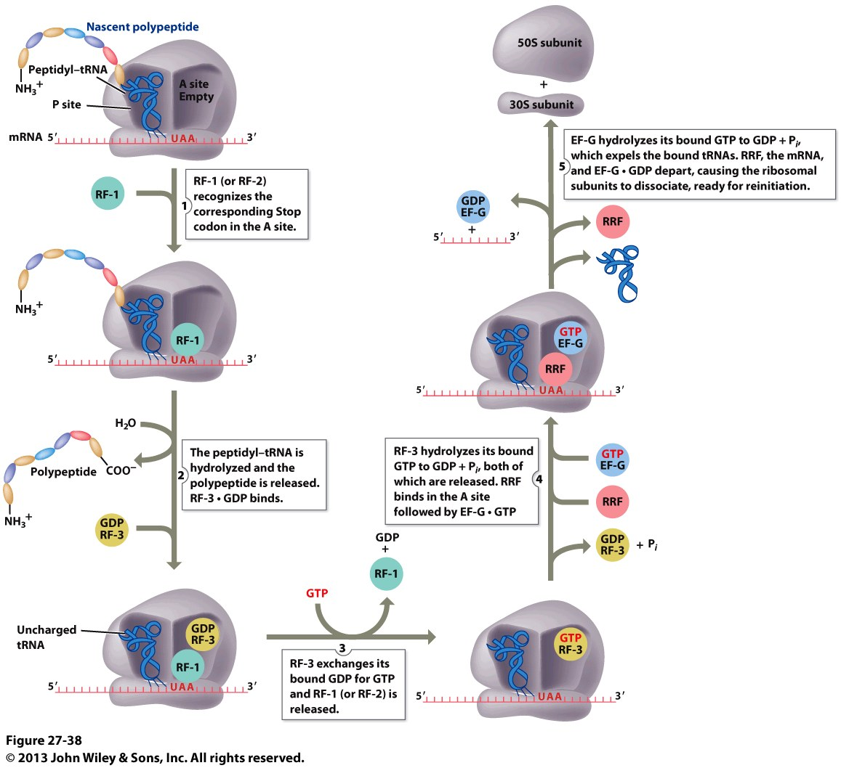
Translation Termination: Overview
60S
30S
(2) Ribosomal Recycling
eRF1
(1) Polypeptide Release
Rli1
eRF1
Rli1
Rli1
eRF3.GDP
eRF3.GTP
GTP
eRF1
+
GDP
eRF3.GDP
eRF3.GTP
eRF1

Slide 38
Translation Termination: (1) Polypeptide Release
When the ribosome encounters one of the three stop codons—UAA, UGA or UAG—at the A-site, it comes to a grinding halt due to the fact there is no aa-tRNA counterpart that can base pair with one of these stop codons in mRNA
Such halting signals the loading of eukaryotic release factors (eRFs) such as eRF1, eRF3 and Rli1—also called ABCE1
Upon recognition and confirmation of one of the stop codons at the A-site within the ribosome, eRF1 triggers the hydrolysis of the ester bond in peptidyl-tRNA @ the P-site—thereby releasing the newly synthesized polypeptide
Upon the cleavage of the ester bond, GDP-bound eRF3 loads onto the ribosome to accelerate the release of the cleaved polypeptide
eRF1
(1) Polypeptide Release
eRF1
eRF3.GDP
GTP
eRF3.GDP
eRF1

Slide 39
Translation Termination: (2) Ribosomal Recycling
60S
40S
(2) Ribosomal Recycling
eRF3 undergoes GDP-GTP exchange in order to induce a conformational change within the ribosome so as to facilitate the release of eRF1
Upon the release of eRF1, Rli loads on to the ribosome and, in so doing, displaces GTP-bound eRF3
Next, Rli facilitates the release of bound mRNA and deacylated tRNA from the ribosome
The release of mRNA and tRNA finally triggers the dissociation of ribosome into constituent 40s and 60s subunits so that they can be recycled for another round of translation
This marks the end of termination and the beginning of the first step of initiation—voila!
Rli1
Rli1
Rli1
eRF3.GTP
eRF1
+
GDP
eRF3.GTP

Slide 40
Exercise 4.5c
Describe the positions and functions of the three tRNA-binding sites in the ribosome
Which base pairings account for wobble at the third codon–anticodon position?
Summarize the roles of initiation, elongation, and release factors in translation
How does the ribosome catalyze peptide bond formation?
How does the ribosome verify correct tRNA–mRNA pairing?

