Slide 1
IV. NUCLEAR BIOCHEMISTRY
§4.1 Nucleotides
§4.1a Nomenclature
§4.1b Functions
§4.1c Biosynthesis

Slide 2
The Molecular Dogma of Life
DNA carries genetic information in the form of its sequence of nucleotides that is ultimately expressed in the form of proteins—it accomplishes such a remarkable feat via three major mechanisms:
DNA Replication—a process by which DNA copies or “replicas” itself, or simply produces two identical strand replicas from a parent DNA double helix
RNA Transcription—a process of converting or “transcribing” the deoxyribonucleotide sequence within one strand of DNA into single-stranded RNAs such as the messenger RNA (or mRNA)
RNA Translation—a process whereby the genetic information carried by mRNA is “translated” into the synthesis of a polypeptide chain in conjunction with the ribosomal machinery
But, before we can shed light on these remarkable phenomena, we need to understand the structure and thermodynamics of DNA and its RNA counterpart @ the very minimum:
- Structure (or shape)—what do they look like? It is all in the looks!
- Thermodynamics (or stability)—why do they look the way they do?! What are the “invisible” forces responsible for the stability of their shapes?

Slide 3
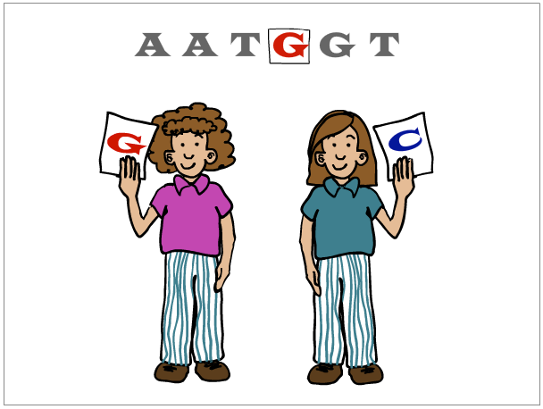
§4.1a Nomenclature

Slide 4
Synopsis 4.1a
Nucleotides are the building blocks of nucleic acids such as DNA (deoxyribonucleic acid) and RNA (ribonucleic acid)
A nucleotide consists of:
- a nitrogenous base (an heterocyclic ring)
- a ribose (RNA) or deoxyribose (DNA) sugar
- one or more phosphate groups
The nitrogenous bases of nucleotides can be classified into two heterocyclic ring systems:
(1) Purines—adenine (A), guanine (G), and hypoxanthine (I)
(2) Pyrimidines—cytosine (C), thymine (T), and uracil (U)
While DNA is exclusively comprised of AGCT, T is replaced with U in RNA—tRNA also contains I

Slide 5
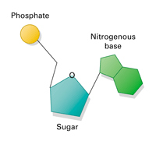
Nucleoside versus Nucleotide
Nucleoside
Nucleotide
Nucleoside:
Nitrogenous base (an heterocyclic aromatic ring)
(Deoxy)ribose sugar—a pentose with a furanose ring
Nucleotide:
Nitrogenous base (an heterocyclic aromatic ring)
(Deoxy)ribose sugar—a pentose with a furanose ring
One or more phosphate groups (attached to the sugar)

Slide 6
Nucleotide Bases: Heterocyclic Rings
+
Imidazole
Nucleotide bases are derivatives of either purine or pyrimidine—the two most-widely occurring heterocyclic aromatic ring compounds in nature
Purine is essentially a pyrimidine ring fused to imidazole—the sidechain functional group of histidine (recall §2.1)
In the context of nucleic acids:
- Purines include adenine (A), guanine (G), and hypoxanthine (I)
- Pyrimidines include cytosine (C), thymine (T) and uracil (U)
One-letter codes are also used to generalize bases/nucleotides:
N → Nucleotide (any base or nucleotide)
R → Purine (any one of the three purines)
Y → Pyrimidine (any one of the three pyrimidines)

Slide 7
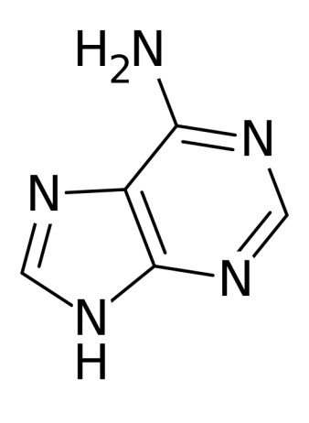
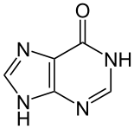
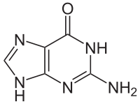
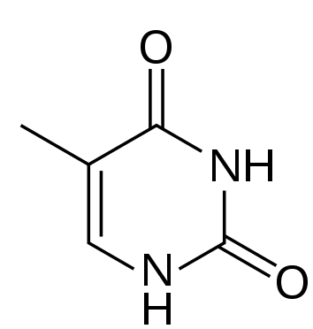
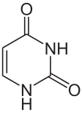
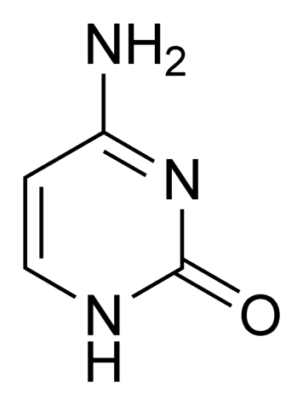
Nucleotide Bases: Purines and Pyrimidines
6
6
6
Deamination
Transamination
2
Transamination
Adenine (A)
Hypoxanthine (I)
Guanine (G)
2-amino-hypoxanthine
H₃C
6
6
6
5
Methylation
Deamination
2
2
2
Transamination
Thymine (T)
5-methyl-uracil
Uracil (U)
Cytosine (C)
While DNA is solely comprised of AGCT, RNA generally harbors AGCU—uracil (U) replaces thymine (T)
Hypoxanthine (I) is commonly found in transfer RNA (tRNA) as an essential modification but in DNA as a mismatch due to its preferential base-pairing with cytosine (C)
In both DNA and tRNA, hypoxanthine (I) results from the deamination of adenine (A)

Slide 8
Nucleotide Sugars: Ribose and Deoxyribose
In the context of nucleic acids, ribose and deoxyribose constitute the sole sugar components of nucleotides
The atoms in sugar components of nucleic acids are suffixed (or appended) with a prime (’) so as to distinguish them from the atoms of bases!
Ribose is a 5-C sugar (pentose) exclusively found in ribonucleotides (the building blocks of RNA)
Reduction of 2’-OH group in ribose generates deoxyribose—the sole sugar component of deoxyribonucleotides (the building blocks of DNA)

Slide 9
Ribonucleotides and Deoxy(ribo)nucleotides
OH
OH
Ribose 5’-phosphate
Deoxyribose 3’-phosphate
N-glycosidic
bond
Nitrogenous bases are covalently linked to the 1’-C atom of ribose (or deoxyribose) via the so-called “N-glycosidic bond” (recall §1.1)
One or more phosphate groups are covalently linked to 5’-C or 3’-C atoms of ribose (or deoxyribose) via the so-called “phosphoester bonds”

Slide 10
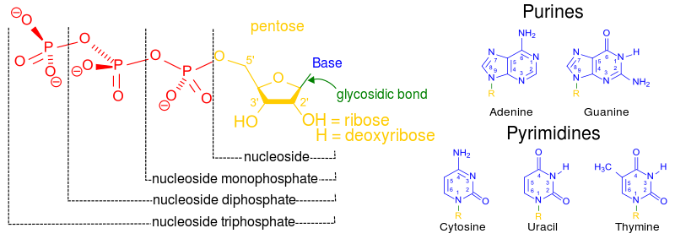
Relationship Between Nucleosides and Nucleotides
Nucleosides are solely comprised of a sugar (ribose or deoxyribose) bonded to a nitrogenous base
In nucleotides, one or more phosphate group is attached to either the 5’-O atom or the 3’-O atom of ribose or deoxyribose

Slide 11
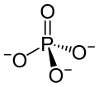
Phosphorus Compounds
Inorganic
phosphate
(PO₄³⁻)
Hydrogen
phosphate
(HPO₄²⁻)
pK = 12
H
HPO₄²⁻
PO₄³⁻ + H⁺
Phosphoryl
group
R
Under physiological conditions (pH ~ 7), inorganic phosphate (PO₄³⁻), often denoted as P_{i} in textbooks, only exists in the protonated form called hydrogen phosphate (HPO₄²⁻)—ie if a textbook calls for P_{i} as one of the reactants, it has to be in its protonated form!
Phosphate
group
R

Slide 12
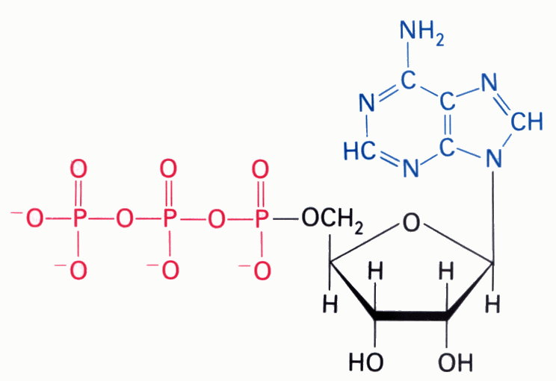
Comparison of Complex Bonds
O O
|| ||
R1—C—O—C—R2
O
||
R2—C—O—R1
Anhydride
[without hydride(H⁻)—two acyl groups bonded together via an O atom]
Ester
[acyl group bonded to an R moiety via an O atom]
O O
|| ||
—O—P—O—P—O—
| |
O⁻ O⁻
Phosphoanhydride
[two phosphoryl groups bonded together via an O atom]
O
||
⁻O—C—S—R1
Thioester
[acyl group bonded to an R via an S atom]
ATP
O
||
⁻O—P—O—R1
|
O⁻
(3)
Phosphoester
[phosphoryl group bonded to an R moiety via an O atom]
(1)
(2)
(4)
O
||
R2—O—P—O—R1
|
O⁻
Phosphoanhydride
Phosphoanhydride
Phosphoester
N-glycosidic
Phosphodiester
[phosphoryl group bonded to two R moieties via O atoms]

Slide 13
Bases—Ribonucleosides—Ribonucleotides
if X = H
if X = ribose
if X = ribose phosphate
Adenine (A)
Adenosine (A)
Adenosine monophosphate (AMP)
Guanine (G)
Guanosine (G)
Guanosine monophosphate (GMP)
Hypoxanthine (I)
Inosine (I)
Inosine monophosphate (IMP)
Cytosine (C)
Cytidine (C)
Cytidine monophosphate (CMP)
Uracil (U)
Uridine (U)
Uridine monophosphate (UMP)
Thymine (T)
Thymidine (T)
Thymidine monophosphate (TMP)

Slide 14
Bases—Deoxyribonucleosides—Deoxyribonucleotides
if X = H
if X = deoxyribose
if X = deoxyribose phosphate
Adenine (A)
Deoxyadenosine (dA)
Deoxyadenosine monophosphate (dAMP)
Guanine (G)
Deoxyguanosine (dG)
Deoxyguanosine monophosphate (dGMP)
Hypoxanthine (I)
Deoxyinosine (dI)
Deoxyinosine monophosphate (dIMP)
Cytosine (C)
Deoxycytidine (dC)
Deoxycytidine monophosphate (dCMP)
Uracil (U)
Deoxyuridine (dU)
Deoxyuridine monophosphate (dUMP)
Thymine (T)
Deoxythymidine (dT)
Deoxythymidine monophosphate (dTMP)

Slide 15
Exercise 4.1a
Identify the purines and pyrimidines commonly found in nucleic acids
Draw the structures of adenine, adenosine, and adenosine monophosphate (AMP)
Describe the chemical differences between a ribonucleoside triphosphate and a deoxyribonucleoside monophosphate

Slide 16
§4.1b Functions

Slide 17
Synopsis 4.1b
While nucleotides are the building blocks of nucleic acids (RNA and DNA), they also mediate numerous metabolic functions in the form of:
- Adenosine triphosphate (ATP)
- Guanosine triphosphate (GTP)
- Cytidine triphosphate (CTP)
- Uridine triphosphate (UTP)
- Uridine diphosphate glucose (UDP-glucose)
- Nicotinamide adenine dinucleotide (NAD⁺)
- Flavin adenine dinucleotide (FAD)
- Coenzyme A (CoA)

Slide 18
ATP
Adenine
Phosphoester
Bond
Phosphoanhydride
Bonds
N-glycosidic
Bond
Ribose
Adenosine triphosphate (ATP)
An high-energy compound that serves as the cell’s primary energy currency (recall §3.6)—involved in driving or mediating virtually all cellular processes!

Slide 19
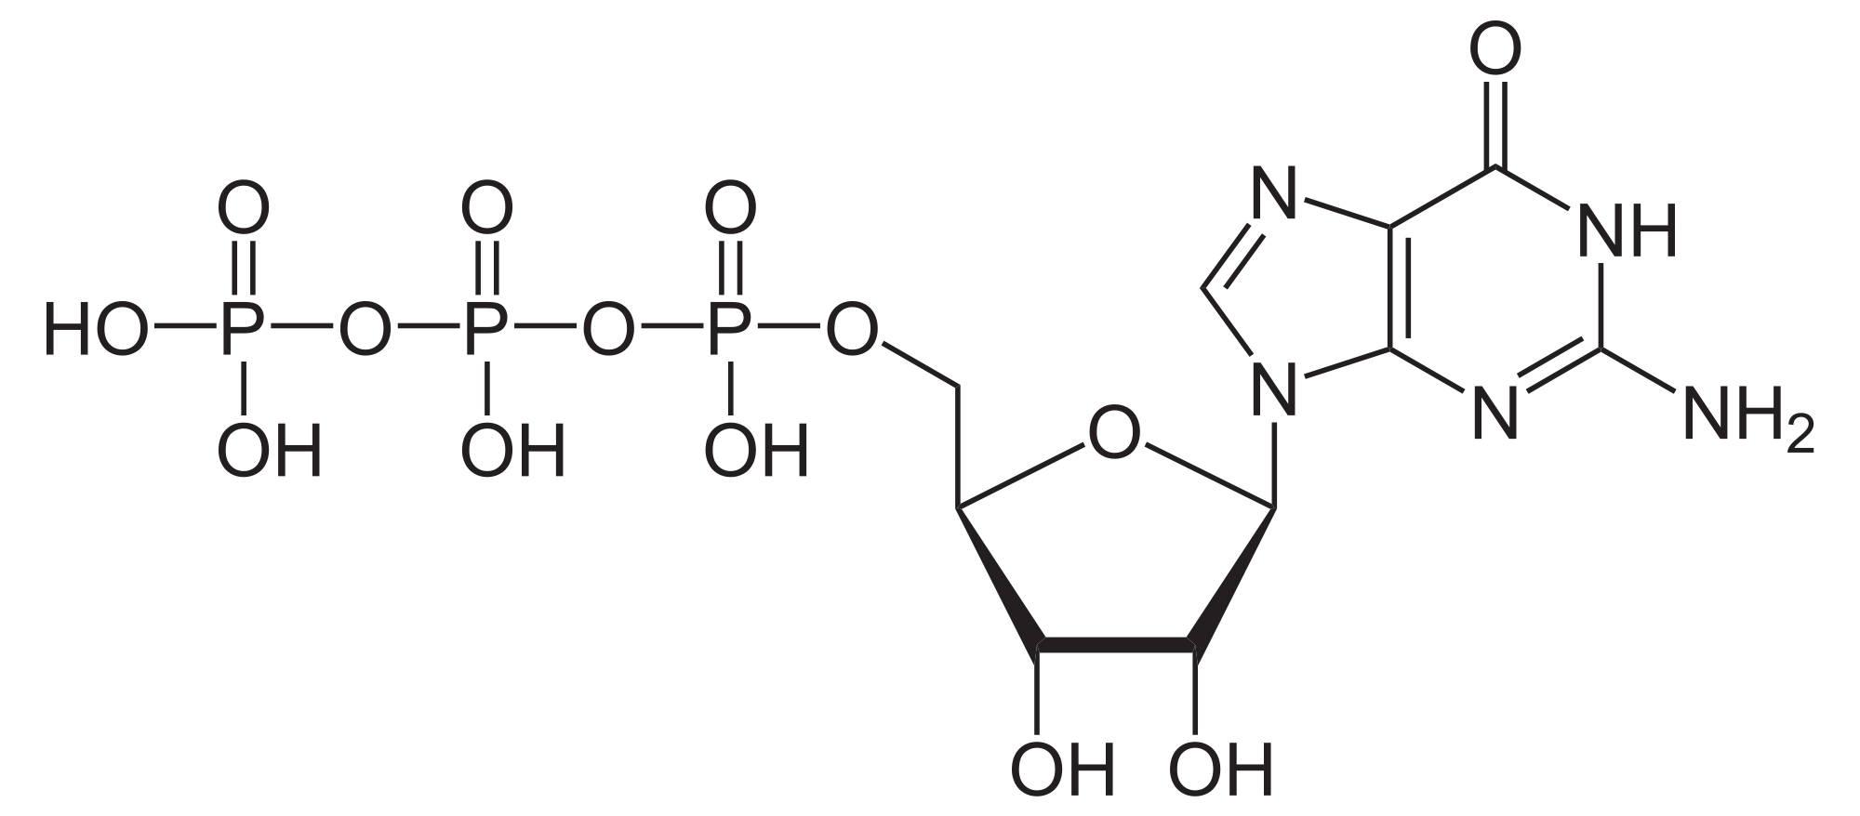
GTP
Phosphoester
Bond
Phosphoanhydride
Bonds
Guanine
N-glycosidic
Bond
Ribose
Guanosine triphosphate (GTP)
An high-energy compound that serves as the source of energy for driving nucleotide synthesis (next section) and protein synthesis (see §4.5)

Slide 20
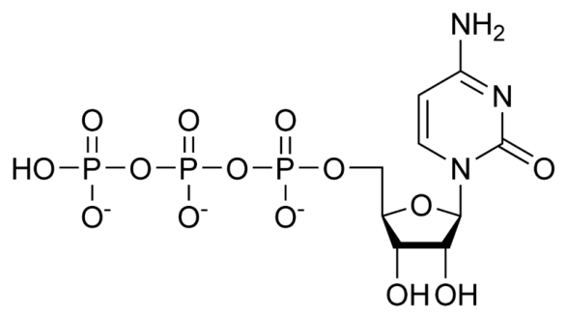
CTP
Phosphoester
Bond
Cytosine
Phosphoanhydride
Bonds
N-glycosidic
Bond
Ribose
Cytidine triphosphate (CTP)
An high-energy compound that serves as the source of energy for driving lipid biosynthesis

Slide 21
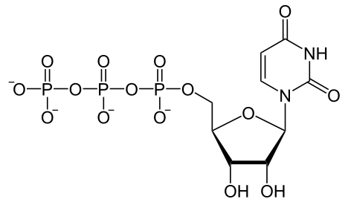
UTP
Phosphoester
Bond
Phosphoanhydride
Bonds
Uracil
N-glycosidic
Bond
Ribose
Uridine triphosphate (UTP)
An high-energy compound that serves as the source of energy for driving carbohydrate metabolism—usually aiding the formation of an activated sugar (eg UDP-glucose)

Slide 22
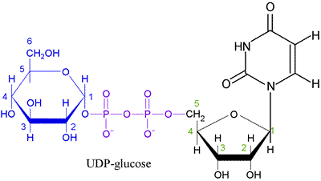
UDP-Glucose
Phosphoanhydride
Bond
Uracil
Phosphoester
Bond
N-glycosidic
Bond
Glucose
Ribose
Uridine diphosphate glucose (UDP-glucose)
An activated molecule that spontaneously donates a glucosyl unit to the growing chain of glycogen (recall §3.2)

Slide 23
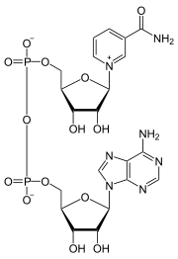
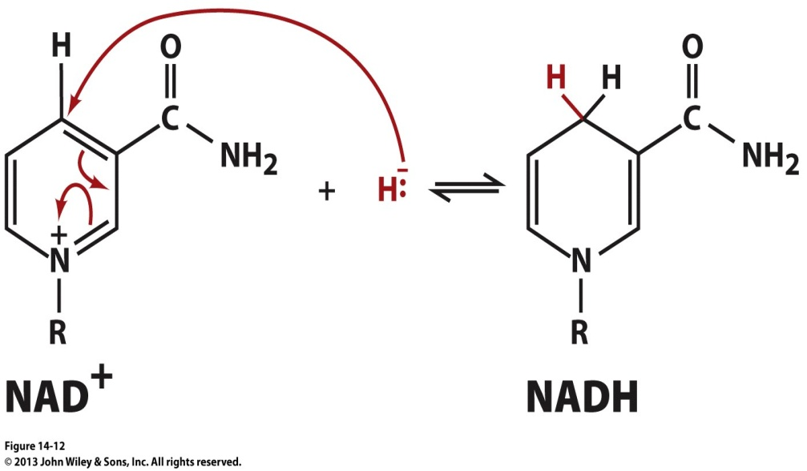
NAD⁺
Nicotinamide
Ribose
Phospho-
anhydride
bond
Ribose
Adenine
phosphorylated
in NADP
Nicotinamide adenine dinucleotide (NAD)
A cofactor (usually acting as a cosubstrate) involved in redox reactions as an electron carrier (recall §3.1, §3.3 and §3.5)

Slide 24
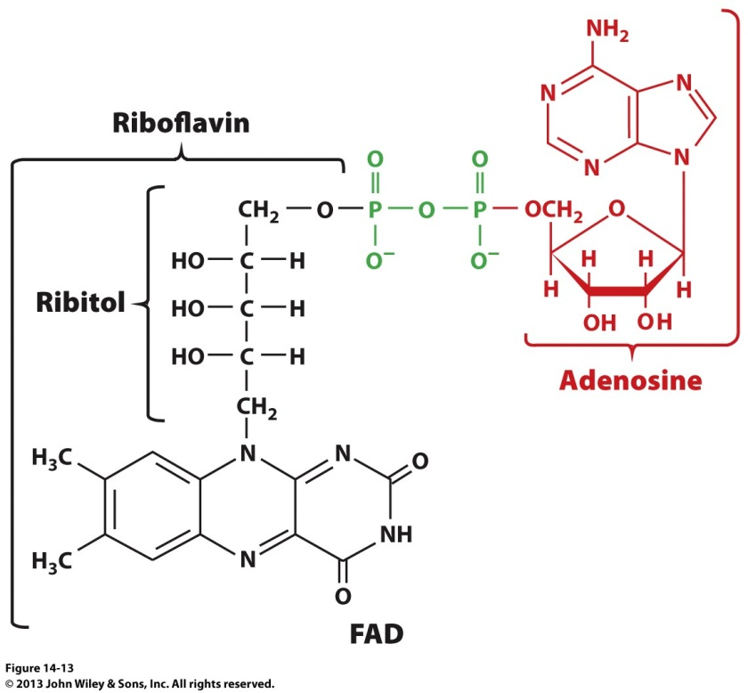
FAD
Phosphoanhydride bond
AMP
Ribose
Ribitol is the reduced form of ribose—cf aldose vs alditol (§1.1)
Flavin
Flavin adenine dinucleotide (FAD)
A cofactor (usually acting as a prosthetic group) involved in redox reactions as an electron carrier (recall §3.1, §3.3 and §3.5)

Slide 25
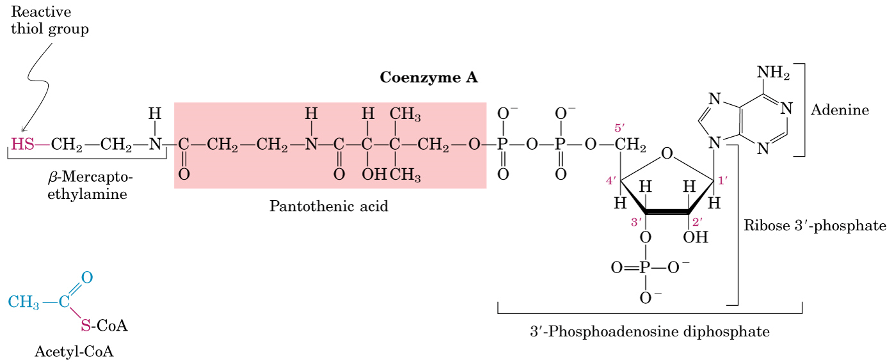
CoA
Phosphoanhydride
Bond
Phosphoester
Bond
Coenzyme A (CoA)
A cofactor (usually acting as a cosubstrate) involved in the synthesis and oxidation of fatty acids as well as oxidation of glycolytic end product pyruvate (recall §3.1, §3.3 and §3.5)

Slide 26
Exercise 4.1b
Identify individual chemical moieties found in nucleotides
Identify bonds that link together various chemical moieties in nucleotides
Describe the roles of nucleotides in mediating metabolic reactions

Slide 27
§4.1c Biosynthesis

Slide 28
Synopsis 4.1c
Given their numerous structural (eg as building blocks in the assembly of DNA and RNA) and functional (eg in mediating metabolic pathways) roles, basic understanding of how nucleotides are synthesized within the cell is warranted
Nucleotides are biosynthesized from simple metabolites such as amino acids, bicarbonate (HCO₃⁻), and ribose-5-phosphate (R5P) with ATP hydrolysis providing the free energy needed to drive anabolic reactions
Prior to nucleotide biosynthesis, ribose-5-phosphate (R5P)—or 5-phosphoribose—is activated with ATP to generate 5-phosphoribosyl-α-pyrophosphate (PRPP)
R5P results from the oxidation of glucose via a metabolic cascade called the “Pentose Phosphate Pathway”

Slide 29
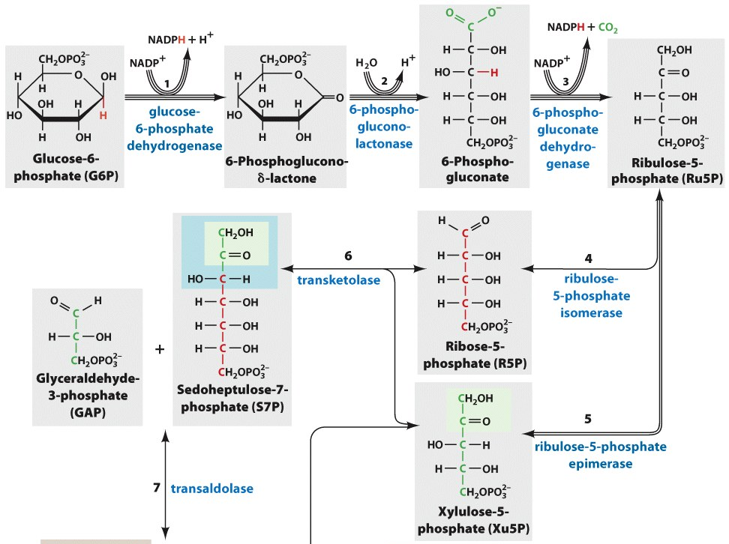
Pentose Phosphate Pathway (Partial)
ADP
Hexokinase
(Glycolysis)
ATP
Oxidation of glucose via the pentose phosphate pathway results in the production of ribose-5-phosphate (R5P)—the precursor for the synthesis of nucleotides

Slide 30
Purine Biosynthesis
Purine nucleotide biosynthesis largely occurs in the cytosol
Upon synthesis in the cytosol, purine nucleotides freely diffuse through the nuclear pores into the nucleus—the site of nucleic acid biosynthesis
In purine ribonucleotides, the purine base hypoxanthine is constructed in situ (“on site”) on ribose-5-phosphate (R5P) backbone to generate inosine monophosphate (IMP)—which is then converted to adenosine monophosphate (AMP) and guanosine monophosphate (GMP)
Purine deoxynucleotides—dATP and dGTP—are generated from their corresponding ribonucleoside diphosphates by the reduction of the 2’-OH group of ribose by ribonucleotide reductase

Slide 31
IMP Synthesis: R5P→IMP
Ribose-5-phosphate (R5P)—or 5-phosphoribose—is initially activated with ATP to generate 5-phosphoribosyl-α-pyrophosphate (PRPP)
PRPP then releases its pyrophosphate moiety to provide an R5P backbone for the construction in situ of the purine base hypoxanthine to generate inosine monophosphate (IMP)
Generation of IMP from PRPP requires a total of 10 reactions employing additional metabolites such as glutamine (cyan), glycine (red), and aspartate (green)—as well as HCO₃⁻ and ATP
IMP can then be converted to other purine nucleotides such as adenosine monophosphate (AMP) and guanosine monophosphate (GMP)
glutamine
glycine
aspartate
10 reactions
glutamate
fumarate

Slide 32
(d)ATP Synthesis: [1/2] IMP → AMP
6
Hypoxanthine (the base of IMP) only differs from adenine (the base of AMP) in having a 6-keto group in lieu of 6-amino group
Thus, the conversion of IMP to AMP
merely involves transamination of 6-keto group in IMP to 6-amino group in AMP
via a two-step reaction
In the first step, aspartate donates an amino group to hypoxanthine of IMP in a reaction powered by GTP hydrolysis
In the subsequent step, the adenylosuccinate intermediate splits up into AMP, releasing fumarate as a by-product
How is AMP converted to corresponding (d)ATP for subsequent incorporation into nucleic acids?!
6

Slide 33
(d)ATP Synthesis: [2/2] AMP → (d)ATP
AMP can be phosphorylated to ADP by adenylate kinase:
ADP can then be reduced to its deoxy-counterpart by ribonucleotide reductase—a reductase that does not discriminate between bases of ribonucleoside diphosphates (eg ADP, GDP, CDP and UDP):
(d)ADP is finally converted to (d)ATP by a nucleoside diphosphate kinase (NDK)—a kinase that does not discriminate between bases and/or sugars of ribonucleotides and deoxyribonucleotides:
Adenine
ATP
ADP
_
_
Adenine
AMP
OH
ADP
OH
_
Adenine
_
Adenine
Reduction
ADP
OH
dADP
H
NTP
NDP
_
Adenine
Adenine
(d)ADP
(O)H
(d)ATP
(O)H

Slide 34
(d)GTP Synthesis: [1/2] IMP → GMP
6
2
H
Guanine (the base of GMP) only differs
from hypoxanthine (the base of IMP) in having a 2-amino group in place of an 2-H
Thus, the conversion of IMP to GMP merely involves transamination of hypoxanthine @ C2—a two-step process
In the first step, IMP is oxidized to xanthosine monophosphate (XMP) harboring a keto group @ C2
In the subsequent step, XMP is transaminated @ C2 via the transfer of the δ-amino group of glutamine—in a reaction powered by ATP hydrolysis—to generate GMP
How is GMP converted to corresponding (d)GTP for subsequent incorporation into nucleic acids?!
6
2

Slide 35
(d)GTP Synthesis: [2/2] GMP → (d)GTP
GMP can be phosphorylated to GDP by guanylate kinase:
GDP can then be reduced to its deoxy-counterpart by ribonucleotide reductase—a reductase that does not discriminate between bases of ribonucleoside diphosphates (eg ADP, GDP, CDP and UDP):
(d)GDP is finally converted to (d)GTP by a nucleoside diphosphate kinase (NDK)—a kinase that does not discriminate between bases and/or sugars of ribonucleotides and deoxyribonucleotides:
Guanine
ATP
ADP
_
_
Guanine
GMP
OH
GDP
OH
_
Guanine
_
Guanine
Reduction
GDP
OH
dGDP
H
NTP
NDP
_
Guanine
Guanine
(d)GDP
(O)H
(d)GTP
(O)H

Slide 36
Pyrimidine Biosynthesis
Pyrimidine nucleotide biosynthesis also occurs in the cytosol except for dihydroorotate dehydrogenase being tethered on the outer face of inner mitochondrial membrane (IMM)
Upon synthesis in the cytosol, pyrimidine nucleotides freely diffuse through the nuclear pores into the nucleus—the site of nucleic acid biosynthesis
In pyrimidine ribonucleotides, the pyrimidine base orotate (4-carboxyuracil) is first assembled alone and then coupled to ribose-5-phosphate (R5P) moiety to generate uridine monophosphate (UMP)—which is then transaminated to cytidine triphosphate (CTP)
Pyrimidine deoxynucleotides—dUTP and dCTP—are generated from their corresponding ribonucleoside diphosphates by the reduction of the 2’-OH group of ribose by ribonucleotide reductase
Deoxythymidine triphosphate (dTTP) is generated via methylation of dUMP @ C5—thymine can be thought of as “5-methyluracil”!

Slide 37
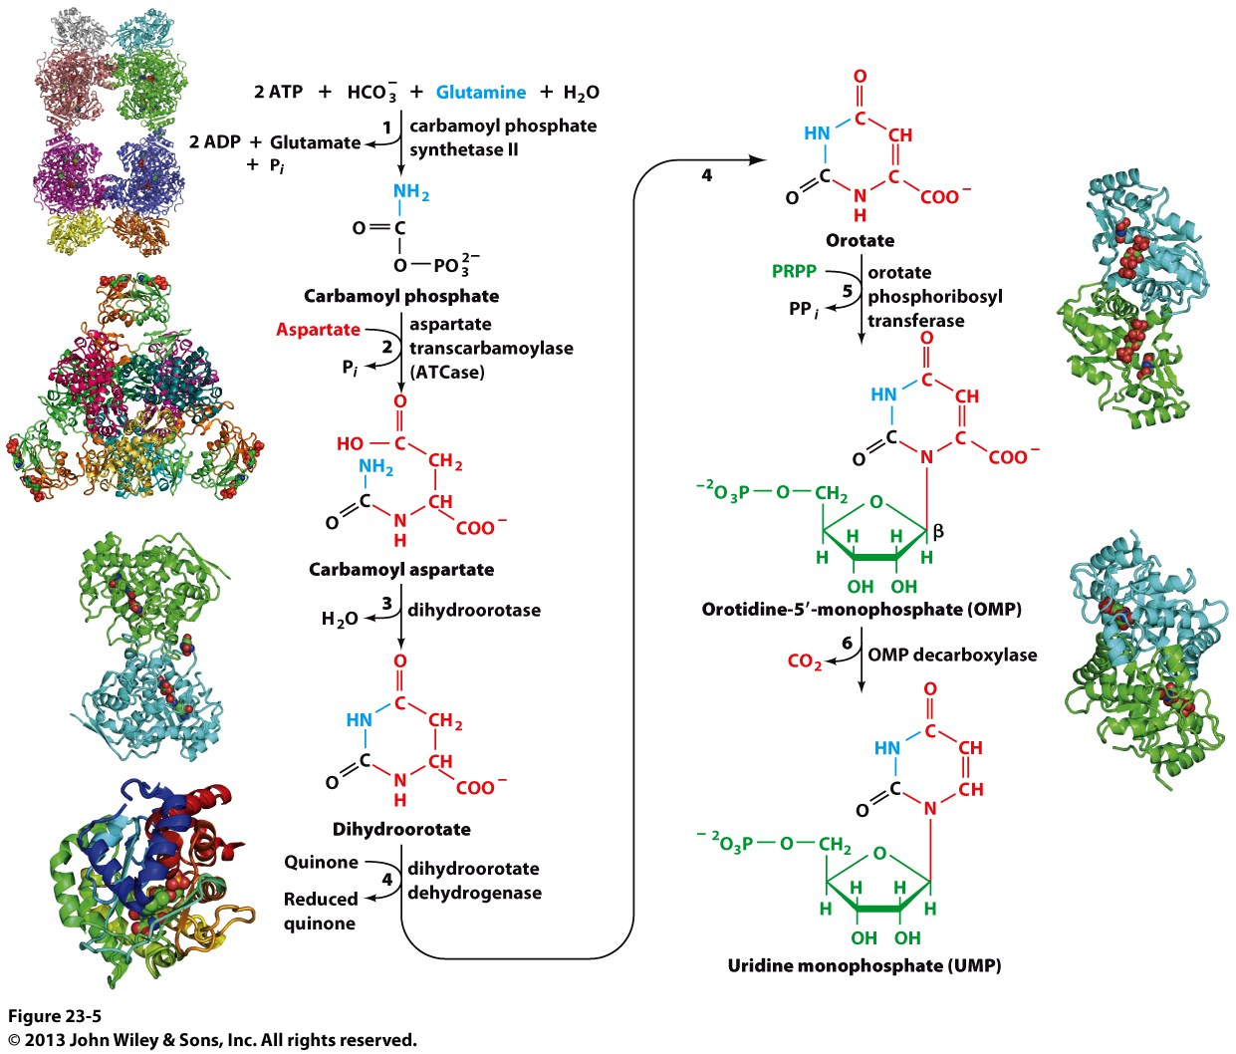
(d)UTP Synthesis: [1/2] R5P→UMP
Unlike purine nucleotides, the pyrimidine ring orotate is first constructed alone from metabolites such as bicarbonate (black), glutamine (cyan) , and aspartate (red)
Assembly of orotate involves a total of four reactions with ATP hydrolysis serving as a source of energy
Once assembled, the orotate ring is coupled to 5-phosphoribosyl-α-pyrophosphate (PRPP) to generate orotidine monophosphate (OMP)
Finally, the orotate base of OMP is decarboxylated to generate uridine monophosphate (UMP)
How is UMP converted to corresponding (d)UTP for subsequent incorporation into nucleic acids?!

Slide 38
(d)UTP Synthesis: [2/2] UMP → (d)UTP
UMP can be phosphorylated to UDP by uridylate kinase:
UDP can then be reduced to its deoxy-counterpart by ribonucleotide reductase—a reductase that does not discriminate between bases of ribonucleoside diphosphates (eg ADP, GDP, CDP and UDP):
(d)UDP is finally converted to (d)UTP by a nucleoside diphosphate kinase (NDK)—a kinase that does not discriminate between bases and/or sugars of ribonucleotides and deoxyribonucleotides:
Uracil
ATP
ADP
_
_
Uracil
UMP
OH
UDP
OH
_
Uracil
_
Uracil
Reduction
UDP
OH
dUDP
H
NTP
NDP
_
Uracil
Uracil
(d)UDP
(O)H
(d)UTP
(O)H

Slide 39
(d)CTP Synthesis: [1/2] UTP → CTP
Unlike ATP/GTP/UTP—which are generated via phosphorylation of their corresponding nucleoside monophosphates—CTP is formed by direct transamination of UTP @ C6 by CTP synthetase:
In the above reaction, glutamine serves as the amino donor
How then is CTP converted to its deoxy-counterpart dCTP?
6
6

Slide 40
(d)CTP Synthesis: [2/2] CTP → dCTP
CTP can now be converted to CDP by a nucleoside diphosphate kinase (acting in reverse)—a kinase that does not discriminate between bases and/or sugars of ribonucleotides and deoxyribonucleotides:
CDP can then be reduced to its deoxy-counterpart by ribonucleotide reductase:
dCDP is finally converted to dCTP by a nucleoside diphosphate kinase (NDK):
Cytosine
NDP
NTP
Cytosine
_
CTP
OH
CDP
OH
_
Cytosine
_
Cytosine
Reduction
CDP
OH
dCDP
H
NTP
NDP
_
Cytosine
Cytosine
dCDP
H
dCTP
H

Slide 41
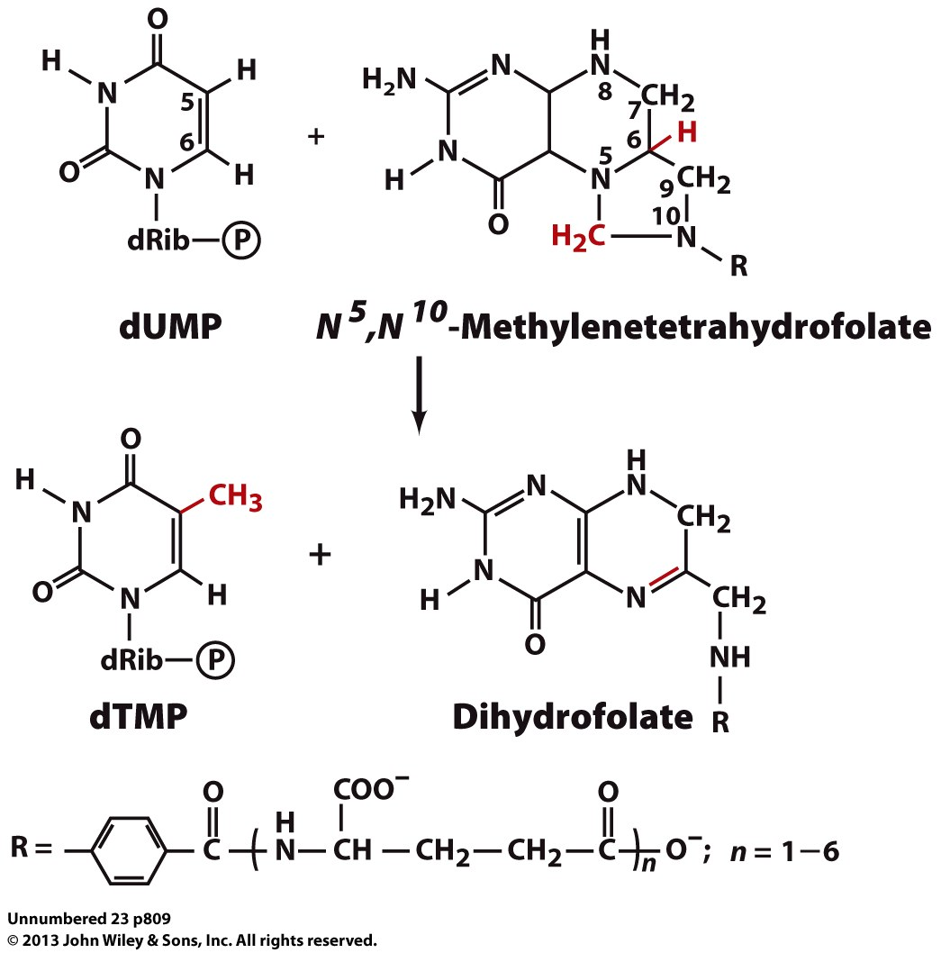
dTTP Synthesis: [1/2] dUTP → dTMP
In order to generate dTMP, dUTP (formed from UMP) is first hydrolyzed to dUMP by dUTP diphosphorylase:
dUMP then undergoes methylation @ C5 to
generate dTMP by thymidylate synthetase
Methylenetetrahydrofolate serves as
the methyl donor
H₂O
PPi
Uracil
Uracil
_
dUTP
H
dUMP
H

Slide 42
dTTP Synthesis: [2/2] dTMP → dTTP
dTMP can be phosphorylated to dTDP by thymidylate kinase:
dTDP is finally converted to dTTP by a nucleoside diphosphate kinase (NDK):
Thymine
ATP
ADP
_
_
Thymine
dTMP
H
dTDP
H
NTP
NDP
_
Thymine
Thymine
dTDP
H
dTTP
H

Slide 43
Exercise 4.1c
List simple metabolites required for IMP and UMP biosynthesis
Describe the reactions that convert IMP to (d)ATP and (d)GTP
Describe the reactions that convert UMP to (d)UTP
Describe the reactions that convert UTP to dCTP
Describe the reactions that convert dUTP to dTTP

