Slide 1
II. PROTEIN BIOCHEMISTRY
§2.6 Enzyme Kinetics
§2.6a Chemical Kinetics
§2.6b Michaelis-Menten Kinetics
§2.6c Enzyme-Inhibition Kinetics

Slide 2
§2.6a Chemical Kinetics

Slide 3
Synopsis 2.6a
Chemical kinetics (or reaction kinetics) is the study of rates of chemical reactions—enzyme kinetics is concerned with reactions catalyzed by enzymes!
Getting a good grasp of chemical kinetics is all about befriending algebra and calculus coupled with mastering the units of various parameters—to treat each parameter in terms of its SI units is the real trick here!
The square brackets [ ] enclosing a parameter are used to indicate either its concentration or units—the context provides the distinction!
The >> or << sign usually implies greater than or less than at least an order of magnitude!
Y is n orders of magnitude greater than X—what does this mean?:
if n=1 => Y = 10¹.X => One order of magnitude
if n=2 => Y = 10².X => Two orders of magnitude
if n=3 => Y = 10³.X => Three orders of magnitude
The “order of magnitude” is expressed in terms of the logarithmic scale!

Slide 4
First-Order Reaction: The Rate Equation
k
A P
Consider the above reaction involving the decay of species A into P
Assuming that A decays into P with first-order kinetics, the reaction rates in terms of [A] or [P] at time t can be expressed as follows:
d[A]/dt = -k[A] [1.1]
but: [A] = [A]₀ - [P] [1.2]
thus: d[A]/dt = -k([A]₀-[P]) [1.3]
also: d[P]/dt = - d[A]/dt = k[A] = k([A]₀-[P]) [1.4]
where: [A]₀ = Concentration @ time t=0 of reactant A [M]
[A] = Concentration @ time t of reactant A [M]
[P] = Concentration @ time t of reactant P [M]
k = First-order rate constant (s⁻¹)
In a first-order reaction, the reaction rate is simply proportional to the concentration of species A remaining or species P already formed at time t

Slide 5
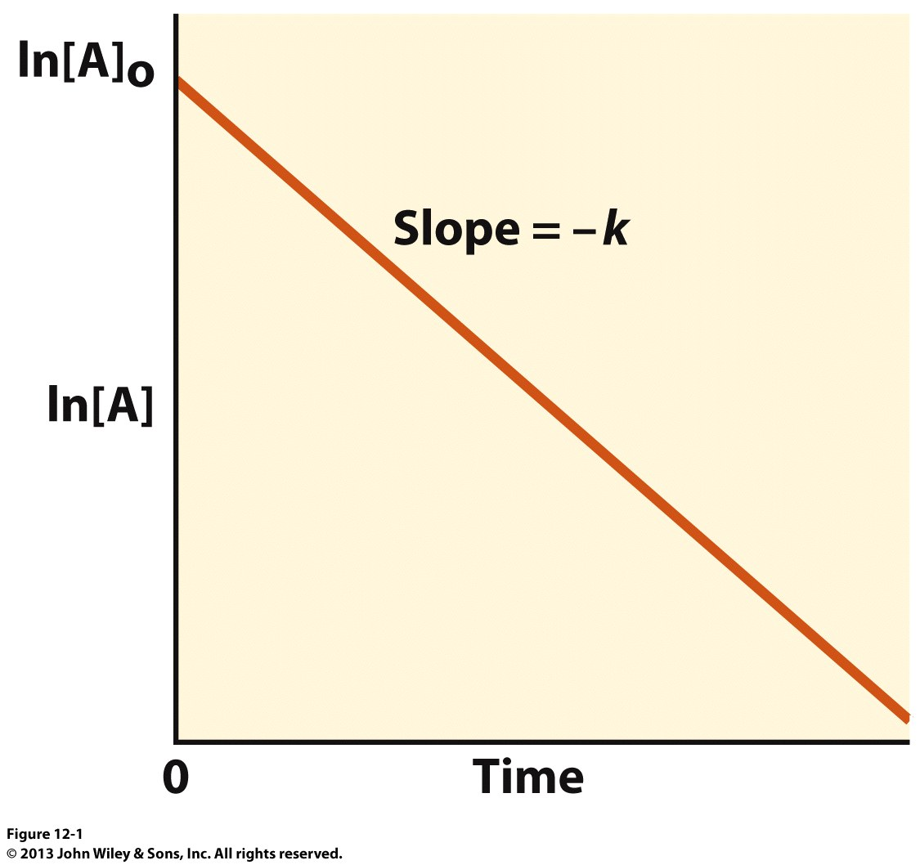
First-Order Reaction: The Linear Plot
Integrating Eq[1.1] with respect to t yields:
d[A]/dt = -k[A] [1.1]
=> ʃ d[A]/[A] = -k ʃdt
=> ln[A]-ln[A]₀ = -kt
=> ln[A] = -kt + ln[A]₀ [1.5]
where [A]₀ is the initial concentration of reactant A @ time zero (t₀)
Recall from calculus that:
ʃ(1/x)dx = lnx
According to Eq[1.5], a plot of ln[A] versus t will generate a straight line with:
slope = -k
y-intercept = ln[A]₀
Why the units of k are s⁻¹?—from Eq[1.1], we have:
[k] = {[d[A]]/[dt]}.{1/[[A]]}
[k] = {M/s}.{1/M}
[k] = s⁻¹
ln[A] = -kt + ln[A]₀
t

Slide 6
Second-Order Reaction: The Rate Equation
k
A + L P
Consider the above reaction involving the decay of species A and L into P
Assuming that the formation of P proceeds with second-order kinetics, the reaction rates in terms of [A] or [P] at time t can be expressed as follows:
d[A]/dt = -k[A][L] [2.1]
assuming [A]=[L]: d[A]/dt = -k[A]² [2.2]
but: [A] = [A]₀ - [P] [2.3]
thus: d[A]/dt = -k([A]₀-[P])² [2.4]
also: d[P]/dt = - d[A]/dt = k[A]² = k([A]₀-[P])² [2.5]
where: A]₀ = Concentration @ time t=0 of reactant A [M]
[A] = Concentration @ time t of reactant A [M]
[L] = Concentration @ time t of reactant L (M)
[P] = Concentration @ time t of reactant P [M]
k = First-order rate constant (s⁻¹)
In a second-order reaction, the reaction rate is simply proportional to the square of the concentration of species A remaining or species P already formed at time t

Slide 7
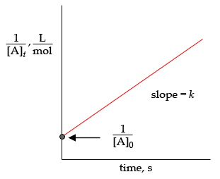
Second-Order Reaction: The Linear Plot
Integrating Eq[2.2] with respect to t yields:
d[A]/dt = -k[A][L] [2.1]
=> ʃ d[A]/[A]² = -k ʃdt
=> -1/[A] + 1/[A]₀ = -kt
=> 1/[A] = kt + 1/[A]₀ [2.6]
where [A]₀ is the (initial) concentration of reactant A @ time zero (t₀)
Recall from calculus that:
ʃ(1/x²)dx = -(1/x)
According to Eq[2.6], a plot of 1/[A] versus t will generate a straight line with:
slope = k
y-intercept = 1/[A]₀
Why the units of k are M⁻¹s⁻¹?—from Eq[2.2], we have:
[k] = {[d[A]]/[dt]}.{1/[[A]²]}
[k] = {M/s}.{1/M²}
[k] = M⁻¹s⁻¹
1/[A] = kt + 1/[A]₀
1/[A]
t

Slide 8
Pseudo-First-Order Reaction: The Rate Equation
k
k[L]
A + L P
if: [L] >> [A]
A P
Second-order
Pseudo-first-order
In the context of a second-order reaction scheme, let us assume that:
[L] >> [A]
Under these conditions, the change in [L] is negligible over the course of reaction relative to change in [A]—in other words, the rate of the above reaction is primarily determined by [A]
Simply put, the second-order reaction (top left) will essentially behave like a first-order reaction (top right)
Kineticists refer to the above scenario as a “pseudo-first-order reaction” with a pseudo-first-order rate constant (k’) given by the following relationship:
k’ = k[L] [3.1]
with the units of k’ being s⁻¹! Why?!
The rate equation in terms of [A] at time t for the pseudo-first order reaction is analogous to the bona fide first-order reaction:
d[A]/dt = -k’[A] [3.2]

Slide 9
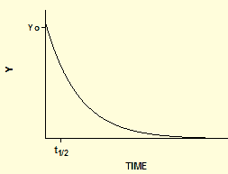
Pseudo-First-Order Reaction: The Exponential Plot
Integrating Eq[3.2] with respect to t yields:
d[A]/dt = -k[A][L] [3.2]
=> ʃ d[A]/[A] = -k’ ʃdt
=> ln[A]-ln[A]₀ = -k’t
=> ln[A] = -k’t + ln[A]₀ [3.3]
Taking anti-ln of both sides of Eq[3.3] generates the corresponding exponential equation:
ln[A] - ln[A]₀ = -k’t
=> ln([A]/[A]₀) = -k’t
=> [A]/[A]₀ = exp(-k’t)
=> [A] = [A]₀ exp(-k’t) [3.4]
According to Eq[3.4], a plot of [A] vs t will generate an exponential decay curve—such plots are referred to as “exponential kinetics”
Exponential kinetics form the basis of enzyme kinetics and protein-ligand kinetics—the decay of a reactant into a product usually occurs in an exponential manner (doubling the time doubles the amount of product formed under non-limiting concentrations of reactant )!
[A] = [A]₀ exp(-k’t)
[A] = [A]₀ e^{(-k’t)}
where: e = 2.7182
[A]₀
[A]
t

Slide 10
Exercise 2.6a
Write the rate equation for a first-order and a second-order reaction
Express the first-order and the second-order rate constants in terms of SI units
What is a pseudo-first-order reaction?
What are exponential kinetics?
In terms of kinetics, who wins the race? Tortoise or hare?

Slide 11
§2.6b Michaelis-Menten Kinetics

Slide 12
Synopsis 2.6b
Michaelis-Menten kinetics describes a reaction scheme that best models the
action of simple enzymes—eg that convert a single substrate into a product
In Michaelis-Menten model of enzyme kinetics, it is assumed that the enzymatically-catalyzed reaction proceeds through two distinct steps:
An enzyme E binds a substrate (S) to form a transient (or intermediate) enzyme-substrate (ES) complex
(2) The enzyme-substrate (ES) complex subsequently decays (or turns over) into the free enzyme (E) and a product (P)
The Michaelis-Menten rate equation is based on the so-called “steady-state assumption”—ie enzyme-catalyzed reactions operate under steady-state conditions wherein the rate of formation of ES complex (from E and S) equals its decay (into E and P)
How good is an enzyme at catalyzing a reaction is called the “catalytic efficiency”—this is expressed in terms of the k_{cat}/K_{M} quotient, where:
k_{cat} = the turnover number (or the catalytic constant) that is equal to the number of catalytic cycles per unit time—a measure of how good an enzyme is at turning a substrate over into a product!
K_{M} = the Michaelis constant (K_{M}) that is equal to substrate concentration at which the enzyme attains its half-maximal velocity—a measure of how good an enzyme is at binding to its substrate (lower the KM, stronger the binding!)

Slide 13
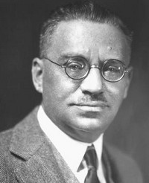
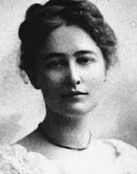
Michaelis-Menten Kinetics: Reaction Scheme
In Michaelis-Menten kinetics, the conversion of a substrate (S) into product (P) by an enzyme (E) is proposed to proceed via an enzyme-substrate (ES) complex intermediate as embodied in the above reaction scheme
Let us define the concentrations—all expressed in the units of M (mol/L)—for the various reactants, intermediates and products as follows:
[E]₀ = Free (total) enzyme concentration @ time t₀
[E] = Free (available) enzyme concentration @ time t
[S] = Substrate concentration @ time t₀
[ES] = Enzyme-substrate complex concentration @ time t
[P] = Product concentration @ time t
[P]₀ = Product concentration @ time t (during the initial burst phase)
With elementary kinetics under our belt, we can easily infer what the various rate constants are:
k₊₁ = Second-order rate constant (M⁻¹s⁻¹)
k₋₁ = First-order rate constant (s⁻¹)
k₊₂ = First-order rate constant (s⁻¹)
k₋₂ = Second-order rate constant (M⁻¹s⁻¹)
Since the reversible conversion of P to ES is negligible for the forward reaction, it is assumed that k₊₂ >> k₋₂ (contribution of k₋₂ is ignored!)
Leonor Michaelis
(1875-1949)
Maud Menten
(1879-1960)

Slide 14
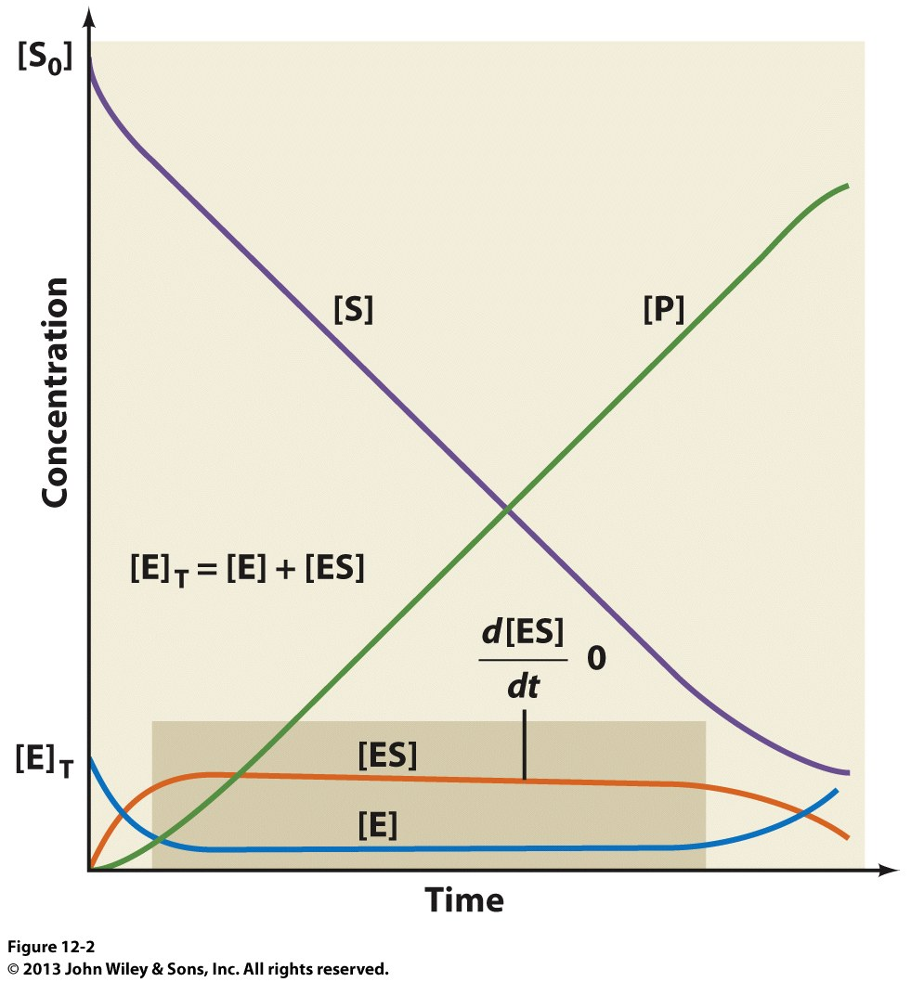
Michaelis-Menten Kinetics: Steady-State Assumption
Progress Curves
[S]₀
Given that the total enzyme (E₀) only exists in two states—either as free enzyme (E) or that bound to the substrate (ES)—we have the following relationship at time t in the reaction:
[E]₀ = [E] + [ES] [4.1]
Next, assuming that k₊₂ >> k₋₂ (k₋₂ is negligible!), the rate of formation of ES at time t is given by:
d[ES]/dt = k₊₁[E][S] – k₋₁[ES] – k₊₂[ES] [4.2]
Given that [S] is not limiting or simply put [S] >> [E], [ES] remains more or less constant over the steady-state phase of the reaction (excluding the initial and final stages)—this is called the “steady-state assumption”— ie the rate of formation of [ES] equals its decay!
In calculus terms, we can express the steady-state assumption as:
d[ES]/dt = 0 [4.3]
Such steady-state assumption is a hallmark of Michaelis-Menten kinetics!
[E]₀ = [E] + [ES]
=
=
[E]₀
Steady-State Phase
t

Slide 15
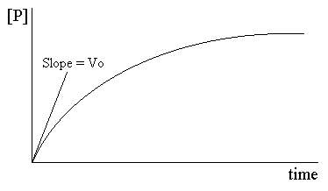
Michaelis-Menten Kinetics: Initial Velocity
Now, combining Eq[4.2] and Eq[4.3], we have:
k₊₁[E][S] – k₋₁[ES] – k₊₂[ES] = 0
=> k₊₁[E][S] = k₋₁[ES] + k₊₂[ES] [4.4]
Next, we combine Eq[4.1] with Eq[4.4] so as to eliminate the variable [E]:
k₊₁[S].{[E]₀ – [ES]} = k₋₁[ES] + k₊₂[ES]
=> {[S]/[ES]}.{[E]₀ – [ES]} = (k₋₁ + k₊₂)/k₊₁ [4.5]
For simplicity, the various rate constants on the right side of Eq[4.5] can be treated as a single composite steady-state constant—designated K_{M}—this is the Michaelis constant defined as:
K_{M} = (k₋₁ + k₊₂)/k₊₁ [4.6]
Now, let us combine Eq[4.5] and Eq[4.6]:
K_{M} = {[S]/[ES]}.{[E]₀ – [ES]}
=> K_{M}[ES] = [S].{[E]₀ – [ES]} [4.7]
Solving Eq[4.7] for [ES] and multiplying both sides with k₊₂ yields:
K_{M}[ES] = [S][E]₀ – [S][ES]
=> K_{M} = {[S][E]₀}/[ES] – [S]
=> K_{M} + [S] = {[S][E]₀}/[ES]
=> [ES] = {[S][E]₀}/{K_{M} + [S]}
=> k₊₂[ES] = k₊₂{[S][E]₀}/{K_{M} + [S]} [4.8]
Now, the initial reaction rate or velocity (v) of the formation of product P can be expressed as (with [P]₀ being the product concentration during the initial burst phase and the units of v being Ms⁻¹):
v = d[P]₀/dt = k₊₂[ES] [4.9]
Determining v @ [S]=x1
Slope = v
[P]
Initial burst phase
t

Slide 16
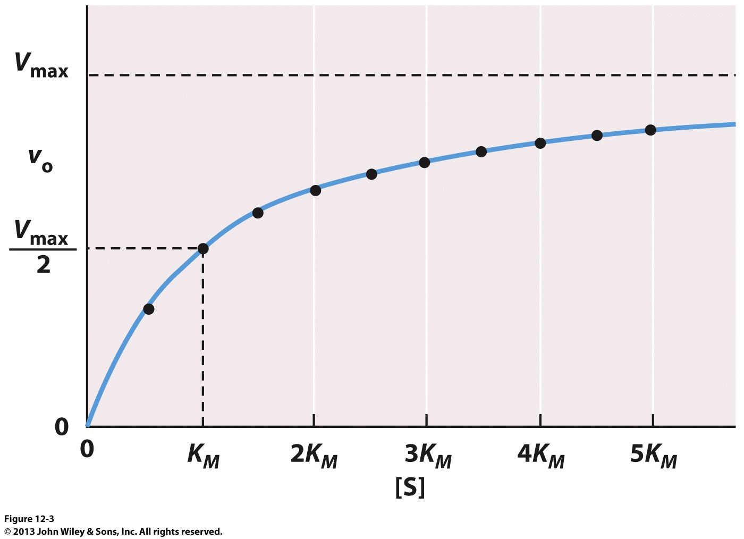
Michaelis-Menten Kinetics: Michaelis-Menten Equation
Combining Eq[4.8] and Eq[4.9], we have:
v = k₊₂{[S][E]₀}/{K_{M} + [S]} [4.10]
The maximum reaction velocity (V_{max}) occurs when the enzyme is fully saturated with substrate—ie when [ES] is no longer-rate-limiting and approaches [E]₀:
[ES] → [E]₀
Thus, under such steady-state conditions, the reaction reaches V_{max} solely determined by the product of k₊₂ and [E]₀:
V_{max} = d[P]/dt = k₊₂[E]₀ [4.11]
Now, combining Eq[4.10] and Eq[4.11], we obtain:
v = {V_{max}[S]}/{K_{M} + [S]} [4.12]
Eq[4.12] is the Michaelis-Menten equation that describes a hyperbola characteristic of substrates catalyzed by simple enzymes—ie a plot of v versus [S]—or the Michaelis-Menten Plot!
Can we determine the values of K_{M} and V_{max} from the Michaelis-Menten plot? If so, should we adapt this approach?
Michaelis-Menten Plot

Slide 17
Michaelis-Menten Kinetics: Michaelis-Menten Plot
Assuming that v=V_{max}/2, Eq[4.12] reduces to:
V_{max}/2 = {V_{max}[S]}/{K_{M} + [S]}
=> K_{M} + [S] = 2[S]
=> K_{M} = [S] [4.13]
Simply put, K_{M} is the value of [S] @ v=V_{max}/2—ie K_{M} is indicative of the affinity of an enzyme for a substrate—the lower the K_{M}, the greater the affinity!
Accordingly, from a Michaelis-Menten plot, one COULD directly determine the values of K_{M} and V_{max} using a least-squares fit of the experimental data points to Eq[4.12]
Thus, K_{M} (M) would be the value of [S] @ V_{max}/2, and V_{max} (Ms⁻¹) the value of v when the curve plateaus out—but, where exactly does the curve plateau out?!!!
Although the curve asymptotically approaches V_{max} @ very high values of [S], accurate determination of V_{max} is still far from certain
Because of such uncertainty, we LINEARIZE Eq[4.12] to determine the values of K_{M} and V_{max}—enter the Lineweaver-Burk plot!
Michaelis-Menten Plot

Slide 18
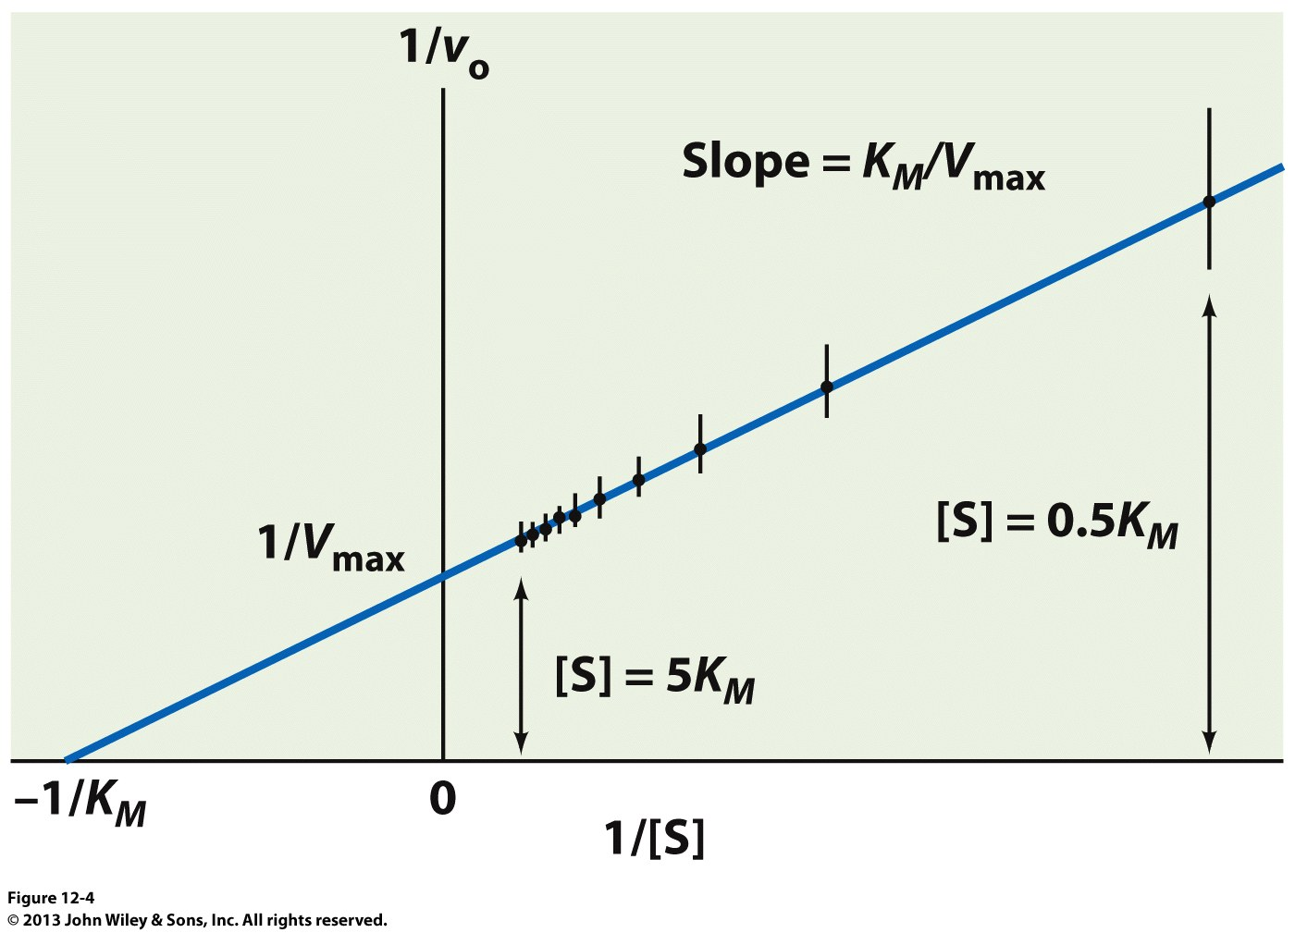
Michaelis-Menten Kinetics: Lineweaver-Burk Plot
Reciprocating both sides of Eq[4.12], we obtain:
1/v = {K_{M} + [S]}/{V_{max}[S]}
=> 1/v = {K_{M}/(V_{max}[S])} + {[S]/(V_{max}[S])}
=> 1/v = (K_{M}/V_{max}).(1/[S]) + (1/V_{max}) [4.14]
=> y = (m).(x) + (b)
Eq[4.14] is the equation of a straight line—it is called the Lineweaver-Burk equation
Thus, a plot of 1/v versus 1/[S] generates a straight line from which the various kinetic parameters can be accurately determined using a linear fit with:
slope = K_{M}/V_{max}
y-intercept = 1/V_{max}
x-intercept = -1/K_{M}
When 1/v=0 (in order to determine the x-intercept), Eq[4.14] reduces to:
0 = (K_{M}/V_{max}).(1/[S]) + (1/V_{max})
=> (K_{M}/V_{max}).(1/[S]) = -(1/V_{max})
=> K_{M}.(1/[S]) = -1
=> 1/[S] = -1/K_{M} [4.15]
The double-reciprocal plot of 1/v versus 1/[S] is called the Lineweaver-Burk plot
Lineweaver-Burk Plot
1/v

Slide 19
Michaelis-Menten Kinetics: Catalytic Constant
In order to assess the catalytic efficiency of an enzyme, a parameter called the catalytic constant (k_{cat}) is defined as follows (with the units of k_{cat} being s⁻¹):
k_{cat} = V_{max}/[E]₀ [4.16]
Now, combining Eq[4.11] and Eq[4.16], tells us that k_{cat} is the first-order rate constant (k₊₂) associated with the decay of ES into P and E—an inherent consequence of steady-state assumption:
k_{cat}[E]₀ = k₊₂[E]₀
=> k_{cat} = k₊₂ [4.17]
Thus, k_{cat} is essentially the number of reaction turnovers or catalytic cycles per unit time accomplished by a particular enzyme—hence, k_{cat} is also referred to as the “turnover number”
But, k_{cat} only tells us how good an enzyme is @ turning over the substrate after it is already bound to the active site—it tells us nothing about how good an enzyme is @ binding the substrate for if this cannot occur efficiently, substrate binding would become the rate-limiting step and diminish the overall performance of the enzyme even if k_{cat} is working @ supersonic speed!
So what else do we need beside k_{cat} to accurately determine the catalytic efficiency of an enzyme? What kinetic parameter determines how good an enzyme is @ binding the substrate? Would K_{M} suffice? If so, what do we do with it?

Slide 20
Michaelis-Menten Kinetics: Catalytic Efficiency
During the initial “burst” phase of the reaction when [S] << K_{M}, we can say that:
K_{M} + [S] ≈ K_{M} [4.18]
Additionally, during the initial “burst” phase of the reaction,
the amount of free enzyme available is virtually the same
as the amount of enzyme initially added, or simply put:
[E] ≈ [E]₀ [4.19]
Thus, combining Eq[4.18] and Eq[4.19] with Eq[4.10], we have:
v = k₊₂{[S][E]}/K_{M}
v = (k_{cat}/K_{M}).[S][E] [4.20]
Eq[4.20] is a second-order reaction with k_{cat}/K_{M} quotient being the second-order rate constant with units of M⁻¹s⁻¹
The k_{cat}/K_{M} parameter is an indicator of the overall catalytic efficiency—ie how efficiently an enzyme converts a substrate into product
Given that the catalytic efficiency will eventually reach an upper limit due to the limitation of substrate and product molecules to diffuse in and out of the enzyme active site (particularly within the highly viscous milieu of the living cell), the k_{cat}/K_{M} parameter unsurprisingly displays the diffusion-controlled limit of about 10⁹ M⁻¹s⁻¹—some enzymes can however operate in excess of this limit via the so-called quantum tunneling!
Slope = v
[P]
Initial burst phase
t

Slide 21
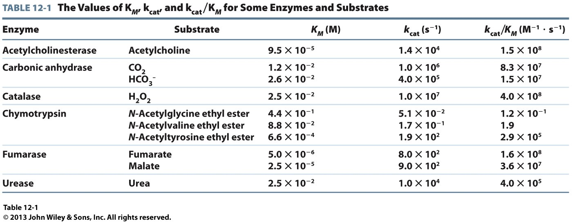
Michaelis-Menten Kinetics: Comparison of k_{cat}/K^{M}

Slide 22
Exercise 2.6b
What are the differences between initial velocity, and maximum velocity for an enzymatic reaction?
Derive the Michaelis–Menten equation. Show the workout and reasoning behind each assumption.
What do the values of K_{M} and k_{cat}/K_{M} reveal about an enzyme?
Why an enzyme cannot have a k_{cat}/K_{M} value greater than 10⁹ M^{–1}s^{–1}?
Write the Lineweaver–Burk equation and describe the features of a Lineweaver–Burk plot

Slide 23
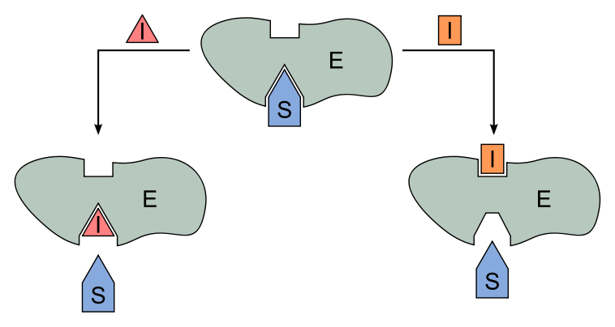
§2.6c Enzyme-Inhibition Kinetics

Slide 24
Synopsis 2.6c
Enzyme inhibition is central to understanding the action of drugs on enzymes
Enzyme inhibitors (eg drugs) interact reversibly or irreversibly with an enzyme to alter its K_{M} and/or V_{max} values—such inhibitors can be classified into three types: competitive, uncompetitive and mixed (or noncompetitive)
A competitive inhibitor competes with the substrate (S) for binding to the free enzyme (E)—it increases the K_{M} but has no effect on the V_{max}
An uncompetitive inhibitor binds only to enzyme-substrate (ES) complex and does NOT compete with the substrate (S) for binding to the free enzyme (E)—it decreases both the K_{M} and V_{max}
A mixed inhibitor competes with the substrate (S) for binding to the free enzyme (E) but uncompetitively binds to the enzyme-substrate (ES) complex—it decreases the V_{max} but K_{M} may increase or decrease
A noncompetitive inhibitor is a mixed inhibitor that indiscriminately or noncompetitively binds to both the free enzyme (E) and the enzyme-substrate (ES) complex with an equal affinity—it decreases the V_{max} but has no effect on K_{M}
In short, enzyme inhibition can be divided into THREE categories:
(1) Competitive Inhibition
(2) Uncompetitive Inhibition
(3) Mixed Inhibition

Slide 25
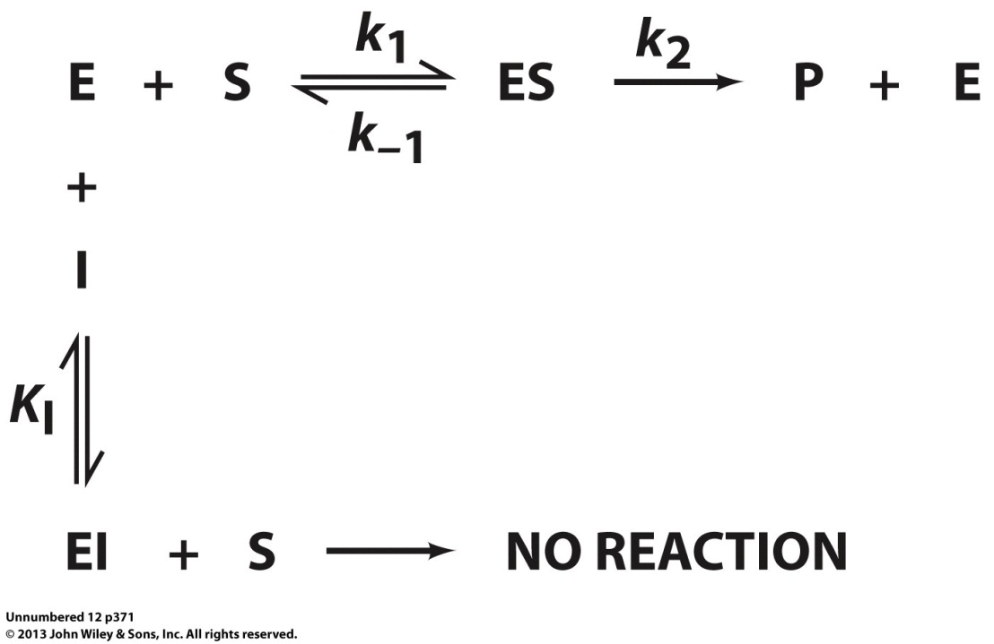
(1) Competitive Inhibition: General Model
In competitive inhibition, an inhibitor usually resembles the substrate—it is a chemical analogue of the substrate and exerts its action by binding to the active site!
Thus, a competitive inhibitor (I) directly competes with the substrate (S) for the active site of the free enzyme (E)—but cannot be converted to a product (P)—thereby essentially acting as a ligand to sterically block substrate binding
In the generalized model shown, EI is the catalytically-inactive enzyme-inhibitor complex—the equilibrium dissociation constant (K_{I}) associated with the formation of EI is given by:
K_{I} = [E][I]/[EI] [1.1]
where [E] = Concentration (M) of freely available enzyme @ equilibrium
[I] = Concentration (M) of freely available inhibitor @ equilibrium
[EI] = Concentration (M) of enzyme-inhibitor complex @ equilibrium

Slide 26
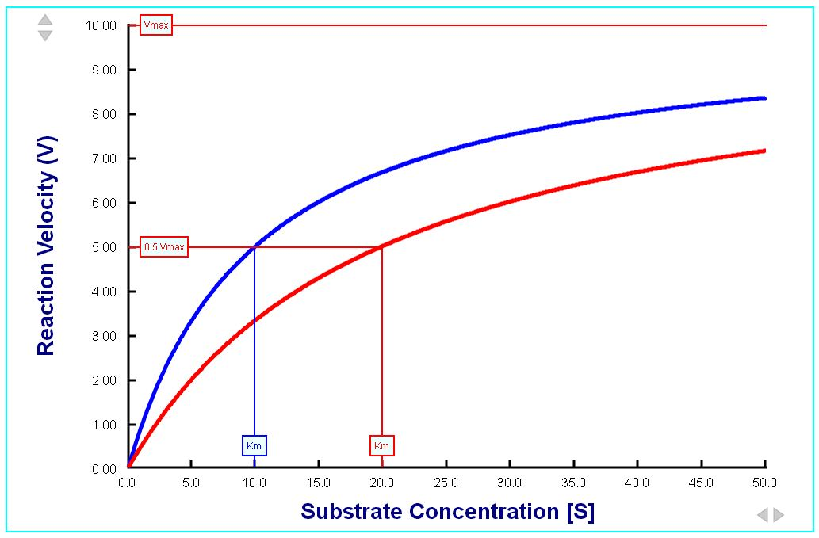
(1) Competitive Inhibition: Michaelis-Menten Plot
v
V_{max} unaffected!
No Inhibition
Competitive
Inhibition
[S]
K_{M} increased!
Since a competitive inhibitor reduces the concentration of available enzyme for substrate binding, K_{M} is INCREASED by a factor α (>= 1) but V_{max} is unaffected in the Michaelis-Menten equation:
v = {V_{max}[S]}/{αK_{M} + [S]} [1.2]
where α = 1 + {[EI]/[E]} = 1 + {[I]/K_{I}}
[I] = Total concentration of inhibitor added
Simply put, Eq[1.2] tells us that the presence of I makes [S] appear to be less than it really is—accordingly, increasing [S] by a factor of α or more will override the effect of competitive inhibitor:
when [S] → ∞, v → V_{max}

Slide 27
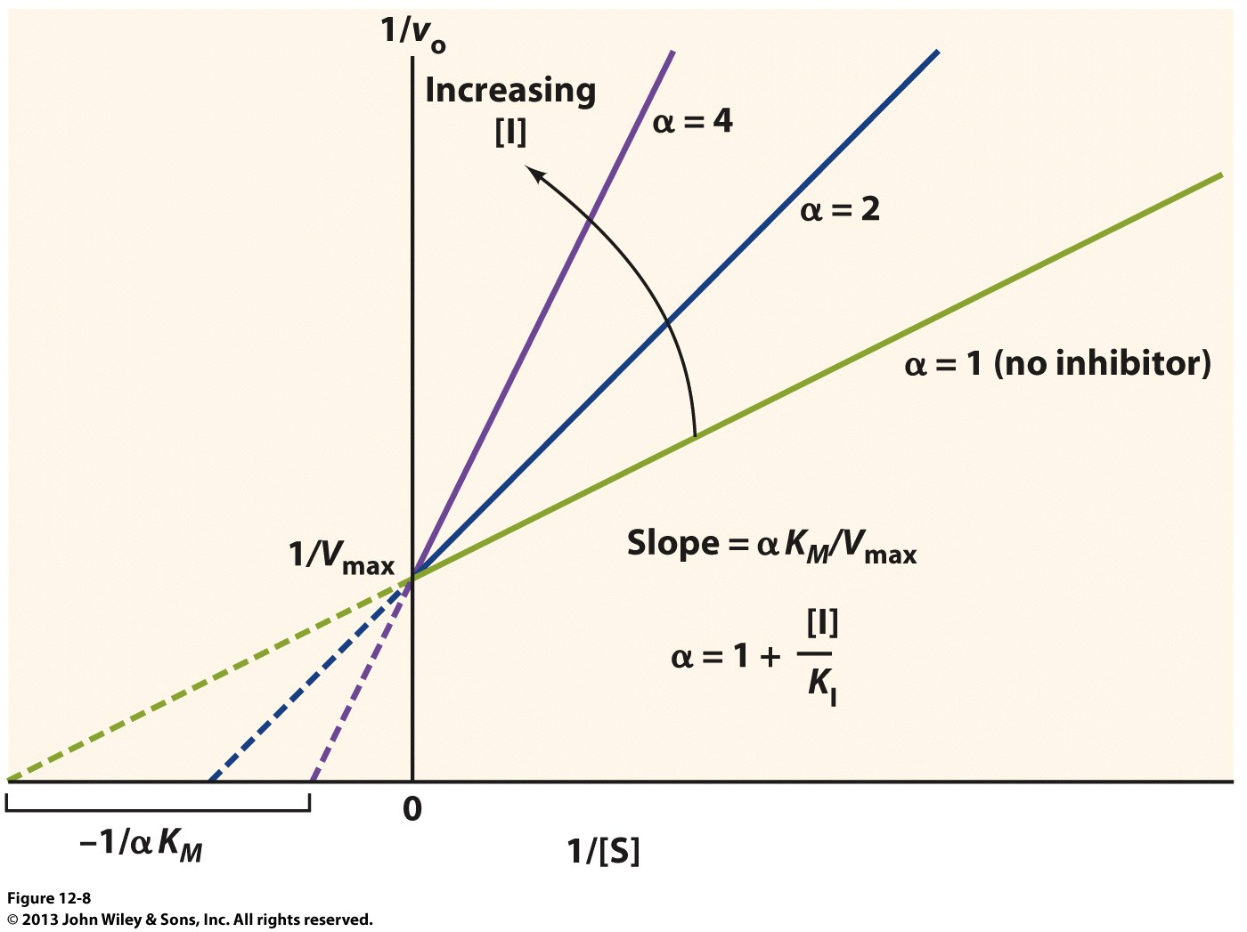
(1) Competitive Inhibition: Lineweaver-Burk Plot
For competitive inhibition, the Lineweaver-Burk equation adopts the form:
1/v = (αK_{M}/V_{max}).(1/[S]) + (1/V_{max}) [1.3]
Thus, a plot of 1/v versus 1/[S] generates a straight line from which the various kinetic parameters can be accurately determined using a linear fit with:
slope = αK_{M}/V_{max}
y-intercept = 1/V_{max}
x-intercept = -1/αK_{M}
Because a competitive inhibitor only affects K_{M} but not V_{max}, multiple Lineweaver-Burk plots generated as a function of [I] intersect on the ordinate (y-axis) @ 1/ V_{max}
For a given set of [I] and α, the extent of competitive inhibition in terms of K_{I} can be directly computed from the relationship:
α = 1 + {[I]/K_{I}} [1.4]
Since Eq[1.4] is an equation of a straight line with respect to α and [I], one can also calculate K_{I} from the slope of a linear plot of α versus [I]—a more accurate procedure
1/v

Slide 28
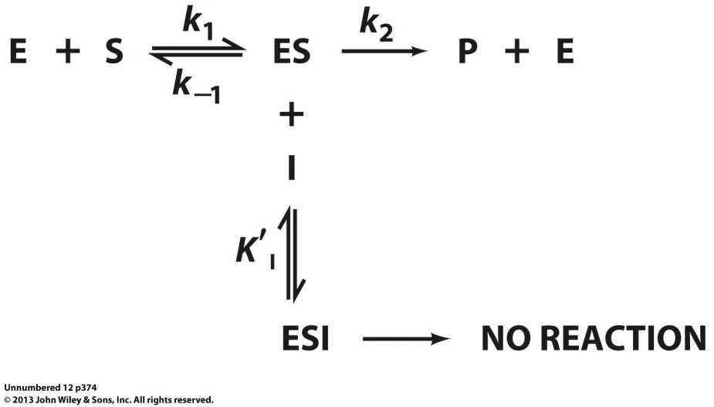
(2) Uncompetitive Inhibition: General Model
In uncompetitive (NOT noncompetitive!) inhibition, an uncompetitive inhibitor (I) directly binds to the enzyme-substrate (ES) complex but NOT to the free enzyme (E)
While it may or may not resemble the substrate, an uncompetitive inhibitor exerts its effect by virtue of its ability to distort the enzyme active site so as to render it catalytically-inactive—the inhibitor must bind at an allosteric site located away from the active site!
In the generalized model shown, ESI is the catalytically-inactive enzyme-substrate-inhibitor complex—the equilibrium dissociation constant (K’_{I}) associated with the formation of ESI is given by:
K’_{I} = [ES][I]/[ESI] [2.1]
where [ES] = Concentration (M) of freely available ES complex @ equilibrium
[I] = Concentration (M) of freely available inhibitor @ equilibrium
[ESI] = Concentration (M) of ESI complex @ equilibrium

Slide 29
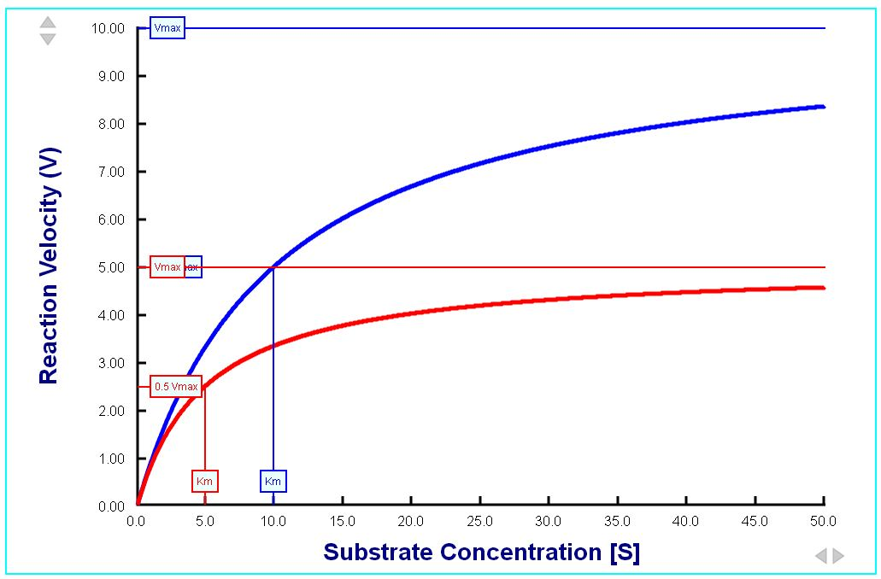
(2) Uncompetitive Inhibition: Michaelis-Menten Plot
v
No Inhibition
V_{max} reduced!
Uncompetitive
Inhibition
[S]
K_{M} reduced!
Since an uncompetitive inhibitor reduces the concentration of ES complex available for product generation, both K_{M} and V_{max} are DECREASED by a factor α’ (>= 1) in the Michaelis-Menten equation:
v = {(V_{max}/α’)[S]}/{(K_{M}/α’)+ [S]} [2.2]
where α’ = 1 + {[ESI]/[ES]} = 1 + {[I]/K’_{I}}
[I] = Total concentration of inhibitor added!
Eq[2.2] tells us that while uncompetitive inhibition reduces both K_{M} and V_{max} by a factor α’, it does not affect the overall K_{M}/V_{max} quotient!
Unlike competitive inhibition, increasing [S] does NOT reverse the effect of an uncompetitive inhibitor!

Slide 30
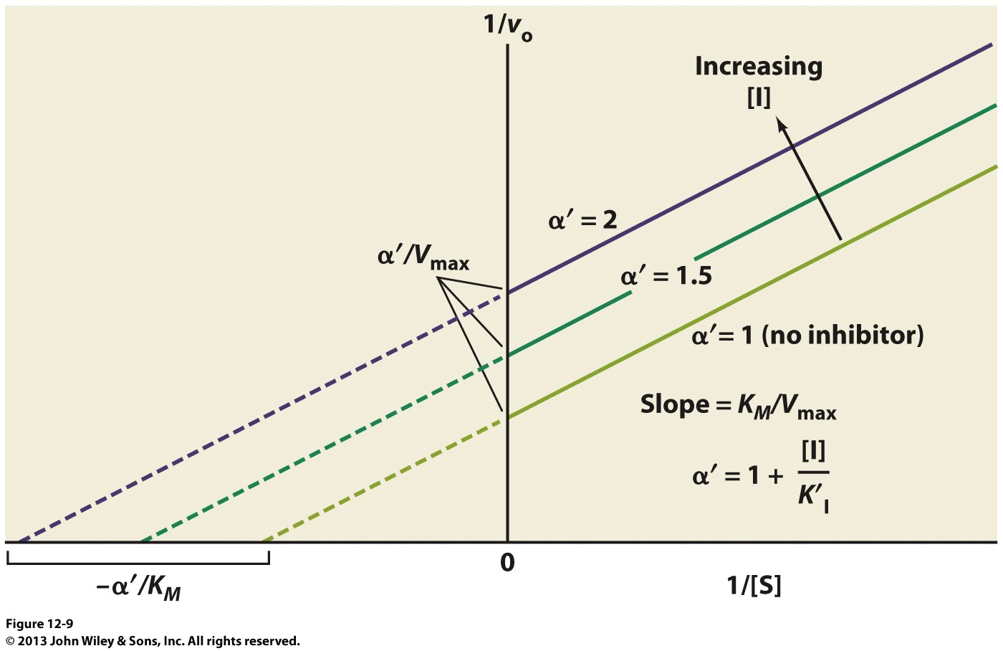
(2) Uncompetitive Inhibition: Lineweaver-Burk Plot
For uncompetitive inhibition, the Lineweaver-Burk equation adopts the form:
1/v = (K_{M}/V_{max}).(1/[S]) + (α’/V_{max}) [2.3]
Thus, a plot of 1/v versus 1/[S] generates a straight line from which the various kinetic parameters can be accurately determined using a linear fit with:
slope = K_{M}/V_{max}
y-intercept = α’/V_{max}
x-intercept = - α’/K_{M}
Because an uncompetitive inhibitor does NOT affect the K_{M}/V_{max} quotient, multiple Lineweaver-Burk plots generated as a function of [I] harbor the same slope—they never intersect either @ abscissa (x-axis) or ordinate (y-axis)
For a given set of [I] and α’, the extent of uncompetitive inhibition in terms of K’_{I} can be directly computed from the relationship:
α’ = 1 + {[I]/K’_{I}} [2.4]
Since Eq[2.4] is an equation of a straight line with respect to α’ and [I], one can also calculate K’_{I} from the slope of a linear plot of α’ versus [I]—a more accurate procedure
1/v

Slide 31
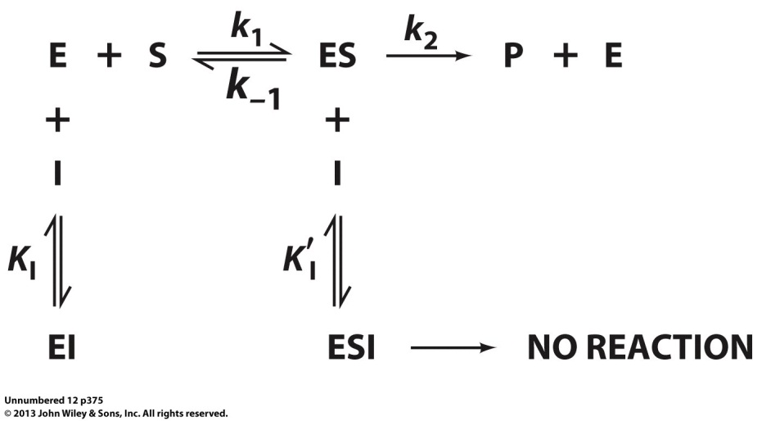
(3) Mixed Inhibition: General Model
In mixed (or noncompetitive) inhibition, a mixed inhibitor (I) binds to both free enzyme (E) and enzyme-substrate (ES) complex—it has characteristics of both the competitive and uncompetitive inhibition!
While it may or may not resemble the substrate, a mixed inhibitor exerts its effect by virtue of its ability to not only block substrate binding but also distorting the enzyme active site so as to render it catalytically-inactive—the inhibitor must bind at an allosteric site located away from the active site!
In the generalized model shown, EI is the catalytically-inactive EI complex, and ESI is the catalytically-inactive enzyme-substrate-inhibitor complex—the equilibrium dissociation constants (K_{I} and K’_{I}) respectively associated with the formation of EI and ESI are given by:
K_{I} = [E][I]/[EI] [3.1]
K’_{I} = [ES][I]/[ESI] [3.2]
where [E] = Concentration (M) of freely available enzyme @ equilibrium
[ES] = Concentration (M) of freely available ES complex @ equilibrium
[I] = Concentration (M) of freely available inhibitor @ equilibrium
[EI] = Concentration (M) of EI complex @ equilibrium
[ESI] = Concentration (M) of ESI complex @ equilibrium

Slide 32
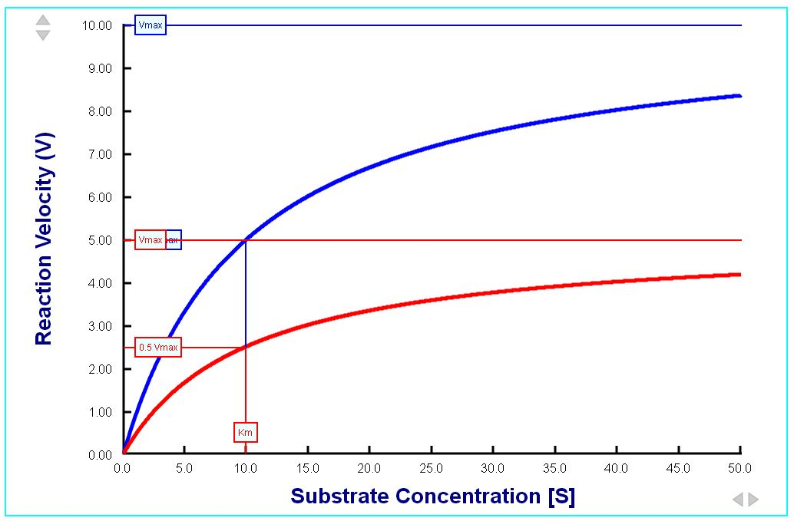
(3) Mixed Inhibition: Michaelis-Menten Plot
v
No Inhibition
V_{max} reduced!
Mixed
Inhibition
K_{M} unaffected (but could also increase or decrease)!
[S]
Since a mixed inhibitor harbors the characteristics of both the competitive and uncompetitive inhibition, both K_{M} and V_{max} are MODULATED—K_{M} increases by a factor α (>= 1) due to competitive inhibition, and both K_{M} & V_{max} decrease by a factor α’ (>= 1) due to uncompetitive inhibition—in the Michaelis-Menten equation:
v = {(V_{max}/α’)[S]}/{((α/α’)K_{M})+ [S]} [3.3]
where α = 1 + {[EI]/[E]} = 1 + {[I]/K_{I}}
α’ = 1 + {[ESI]/[ES]} = 1 + {[I]/K’_{I}}
[I] = Total concentration of inhibitor added
Eq[3.3] tells us that while mixed inhibition must always reduce V_{max} by a factor α’, it has a subtle effect on K_{M}—simply put, K_{M} may increase (α > α’) or decrease (α < α’) depending on the values of factors α and α’, or it may even remain unaffected (α=α’)—inhibitor binds to both E and ES with an equal affinity (a special case of mixed inhibition referred to as noncompetitive inhibition)

Slide 33
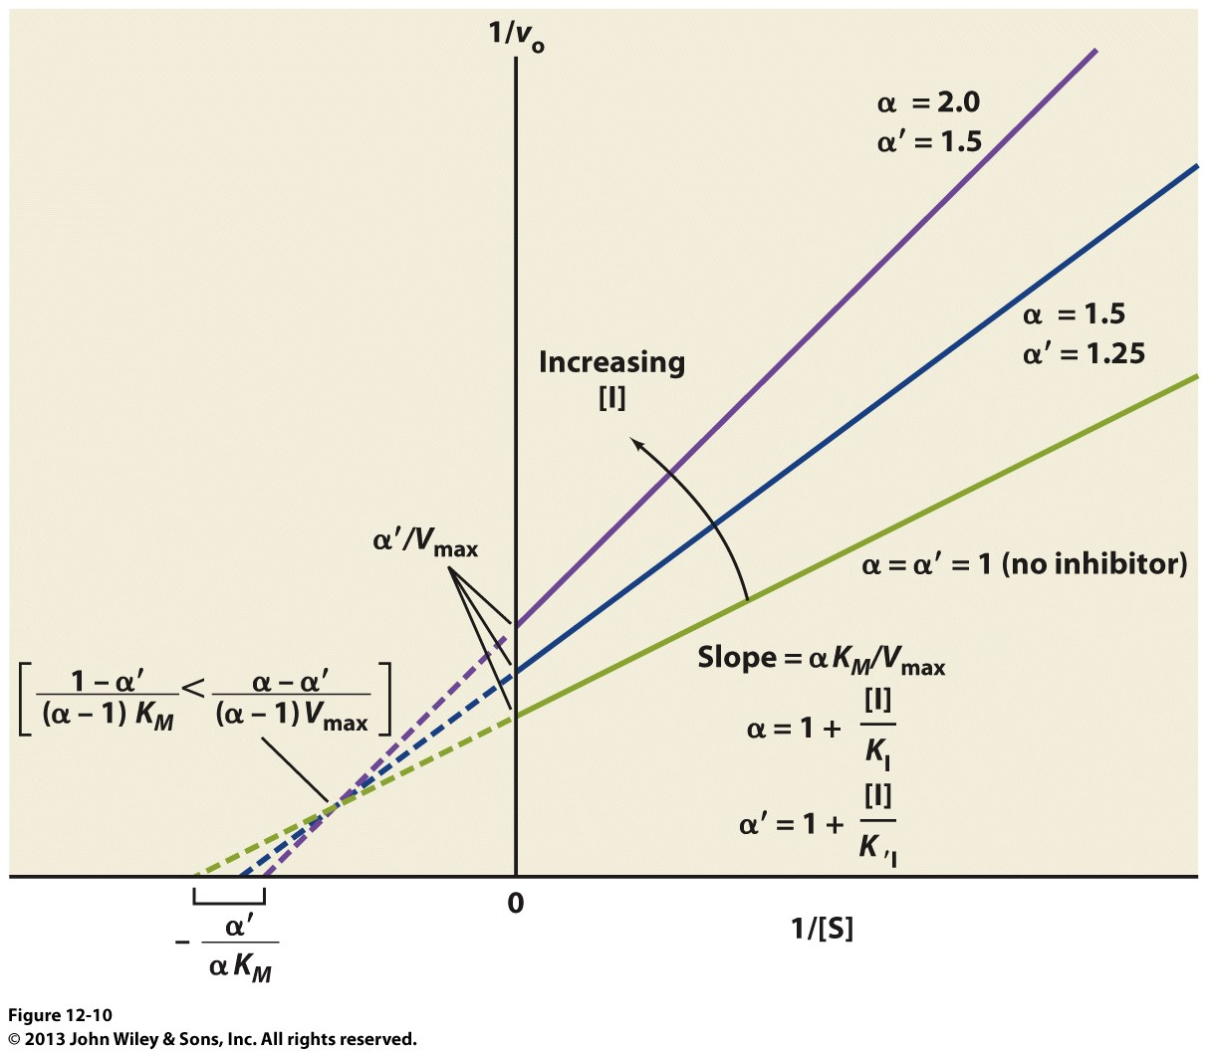
(3) Mixed Inhibition: Lineweaver-Burk Plot
For mixed inhibition, the Lineweaver-Burk equation adopts the form:
1/v = (αK_{M}/V_{max}).(1/[S]) + (α’/V_{max}) [3.4]
Thus, a plot of 1/v versus 1/[S] generates a straight line from which the various kinetic parameters can be accurately determined using a linear fit with:
slope = αK_{M}/V_{max}
y-intercept = α’/V_{max}
x-intercept = - α’/αK_{M}
For mixed inhibition, multiple Lineweaver-Burk plots generated as a function of [I] can never intersect @ the ordinate but they intersect on its left provided that α≠α’, or intersect @ the abscissa when α=α’
For a given set of [I] and α’, the extent of uncompetitive inhibition in terms of K’_{I} can be directly computed from the relationship:
α = 1 + {[I]/K_{I}} [3.5]
α’ = 1 + {[I]/K’_{I}} [3.6]
Since Eq[3.5] is an equation of a straight line with respect to α and [I], one can also calculate K_{I} from the slope of a linear plot of α versus [I]—ditto for K’_{I}
1/v

Slide 34
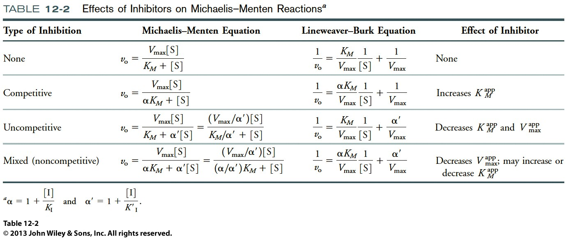
Enzyme Inhibition: Comparison of Mechanisms

Slide 35
Exercise 2.6c
Why might an enzyme’s substrate, transition state, and product all serve as starting points for the design of a competitive inhibitor?
Describe the effects of competitive, uncompetitive, and mixed inhibitors on K_{M} and V_{max}
How can inhibitor binding to an enzyme be quantified?

