Slide 1
II. PROTEIN BIOCHEMISTRY
§2.1 Amino Acids
§2.1a Nomenclature
§2.1b Ionization
§2.1c Chirality
§2.1d Modification

Slide 2
§2.1a Nomenclature

Slide 3
Synopsis 2.1a
Proteins (or polypeptides) are polymers made up of building blocks, or monomeric units, called “amino acids”
There are 20 naturally-occurring amino acids referred to as “standard amino acids” or “α-amino acids”
Standard amino acids share a common structure but differ in their side chains—the so-called R group
Amino acids are linked together to generate a polypeptide chain via so-called “peptide” or “amide” bonds
Amino acids are often abbreviated to “AA” or “aa”—eg the polypeptide chain is 20-aa long

Slide 4
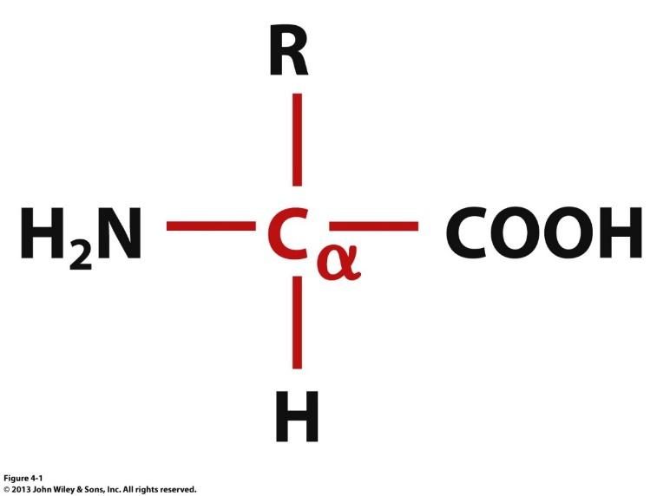
Chemical Structure
Sidechain group/atoms
H
Amino
group
Carboxylic
group
O
Amino Acid
(alone)
Amino Acid
(proteinized)
Except for proline, all amino acids are constructed from a primary amino (-NH₂) group and a carboxylic acid (-COOH) group linked together via a carbon atom called “Cα”
For its part, proline harbors a secondary amino (-RNH) group and a carboxylic acid (-COOH)
Amino acid nomenclature is based on a three-letter code and a one-letter code—eg glycine (the simplest amino acid with R=H) can be denoted as “Gly” or “G”

Slide 5
Atom Nomenclature
Backbone Atoms
α-amino
α-carboxyl
Sidechain
Atoms
γ-carboxyl
ε-amino
The central carbon atom (-Cα-) along with its attached H atom and those making up the flanking amino group (H₂N-) and carboxyl group (-COOH) are referred to as “backbone atoms”—and the groups as“α-amino” and “α-carboxyl”
The various atoms running along the R group are called “sidechain atoms”—these are also denoted by Greek alphabets starting with Cβ, Cγ, and so forth
Accordingly, the sidechain –NH₂ and –COOH groups can be referred to as “ε-amino” and “γ-carboxyl” so as to distinguish them from their backbone counterparts

Slide 6
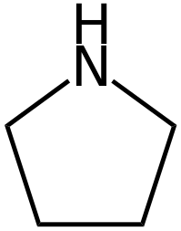
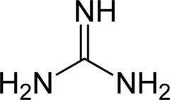
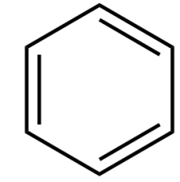
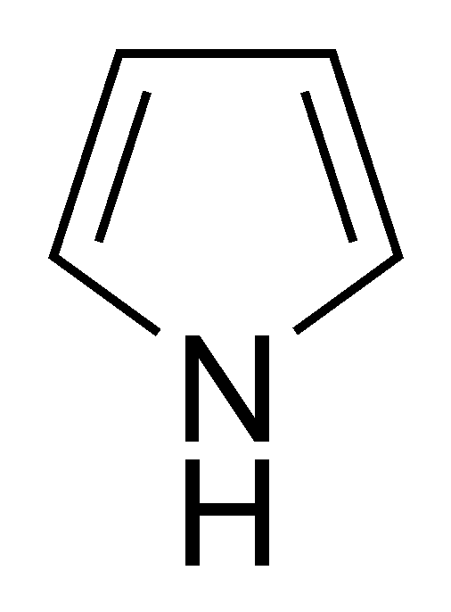
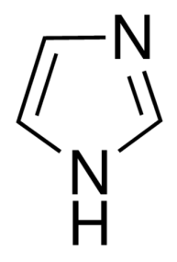
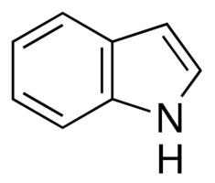
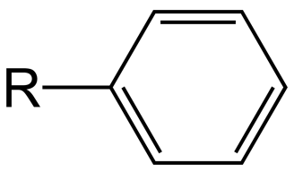
Diversity of Sidechain ᴙ Groups
—OH
—SH
—NH₂
—COOH
—C(O)NH₂
Simple
Hydroxyl
(STY)
Sulfhydryl
(C)
Amino
(K)
Carboxyl
(DE)
Carbamoyl
(NQ)
Complex
Benzene
Pyrrole
Guanidine
(R)
Pyrrolidine
(P)
Aromatic
R
Imidazole
(H)
Phenyl
(FY)
Benzyl
(FY)
Indole
(W)

Slide 7
Alkyl Sidechain ᴙ Groups
R
R
n-propyl
Isopropyl
(V)
R
R
n-butyl
sec-butyl
(I)
R
R
tert-butyl
Isobutyl
(L)

Slide 8
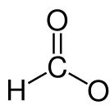
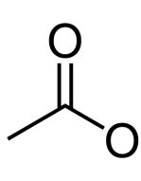
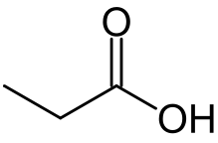
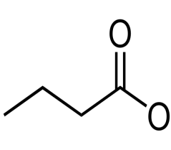
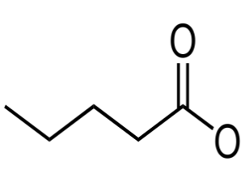
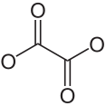
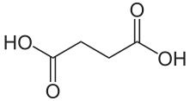
Carboxylic Derivatives ᴙ Us!
Monocarboxylate Anions
-
-
-
-
-
-
1:1
Formate
(Methanoate)
2:1
Acetate
(Ethanoate)
3:1
Propionate
(Propanoate)
4:1
Butyrate
(Butanoate)
5:1
Valerate
(Pentanoate)
6:1
Caproate
(Hexanoate)
Dicarboxylate Dianions
-
-
-
-
-
-
-
-
2:2
Oxalate
(Ethanedioate)
3:2
Malonate
(Propanedioate)
4:2
Succinate
(Butanedioate)
5:2
Glutarate
(Pentanedioate)

Slide 9
Systematic Naming
H
HO
-
-
-
H₃N
COO
H₃N
COO
H₃N
COO
+
+
+
Glycine
α-Amino-acetate
α-Methyl-glycine
α-Amino-propionate
α-Ethylhydroxy-glycine
α-Amino-β-hydroxy-butyrate
Amino acid residues can be systematically named using either a glycine skeleton, or a carboxylate backbone
On the basis of the chemical properties of their sidechain atoms/groups, amino acids can be divided into the following overlapping (!) classes (with histidine and tyrosine belonging to more than one class):
Aromatic Residues (WHYF)
Aliphatic Residues (VILA)
Hydroxyl Residues (TYS)
Basic Residues (KRH)
Acidic Residues (DE)
Carbamoyl Residues (NQ)
Unique Residues (CGMP)

Slide 10
Aromatic Residues: WHYF
-
-
H₃N
COO
H₃N
COO
+
+
Tryptophan | Trp | W
α-Indolylmethyl-glycine
α-Amino-β-indolyl-propionate
Histidine | His | H
α-Imidazolylmethyl-glycine
α-Amino-β-imidazolyl-propionate
HO
-
-
H₃N
COO
H₃N
COO
+
+
Phenylalanine | Phe | F
α-Benzyl-glycine
α-Amino-β-phenyl-propionate
Tyrosine | Tyr | Y
α-Hydroxybenzyl-glycine
α-Amino-β-hydroxyphenyl-propionate
In aromatic residues, the sidechain moiety is a (hetero)cyclic ring with a conjugated delocalized π bond system—ie alternating single C-C and double C=C bonds

Slide 11
Aliphatic Residues: VILA
-
-
H₃N
COO
H₃N
COO
+
+
Alanine | Ala | A
α-Methyl-glycine
α-Amino-propionate
Valine | Val | V
α-Isopropyl-glycine
α-Amino-β-methyl-butyrate
-
-
H₃N
COO
H₃N
COO
+
+
Leucine | Leu | L
α-Isobutyl-glycine
α-Amino-γ-methyl-valerate
Isoleucine | ILE | I
α-Sec-butyl-glycine
α-Amino-β-methyl-valerate
Exclusively harbor alkyl or aliphatic sidechains with strictly nonpolar properties
Leu and Ile are structural isomers

Slide 12
Hydroxyl Residues: TYS
HO
HO
-
-
H₃N
COO
H₃N
COO
+
+
Threonine | Thr | T
α-Ethylhydroxy-glycine
α-Amino-β-hydroxy-butyrate
Tyrosine | Tyr | Y
α-Hydroxybenzyl-glycine
α-Amino-β-hydroxyphenyl-propionate
HO
-
H₃N
COO
+
Serine | Ser | S
α-Hydroxymethyl-glycine
α-Amino-β-hydroxy-propionate
The hydroxyl (–OH) group of all three residues harbors polar and nucleophilic properties—it is also subject to post-translational phosphorylation in proteins

Slide 13
Basic Residues: KRH
H
NH₂
+
N
NH₃
NH₂
+
-
-
H₃N
COO
H₃N
COO
+
+
Lysine | Lys | K
α-Aminobutyl-glycine
α,ε-Diamino-caproate
Arginine | Arg | R
α-Guanidinopropyl-glycine
α-Amino-δ-guanidino-valerate
+
While the sidechain groups of Lys (pK_{R}∼10) and Arg (pK_{R}∼12) are almost always protonated under physiological settings (pH∼7), the imidazole group of His (pK_{R}∼6) becomes protonated only under certain conditions (eg when a neighboring residue can stabilize its proton usually via hydrogen bonding so as to augment its pK_{R} to > 7)
H
-
H₃N
COO
+
Histidine | His | H
α-Imidazolylmethyl-glycine
α-Amino-β-imidazolyl-propionate

Slide 14
Acidic Residues: DE
-
O
O
O
-
O
-
-
H₃N
COO
H₃N
COO
+
+
Aspartate | Asp | D
α-Carboxymethyl-glycine
α-Amino-succinate
Glutamate | Glu | E
α-Carboxyethyl-glycine
α-Amino-glutarate
Under physiological settings (pH∼7), the sidechain groups of Asp (pK_{R}∼4) and Glu (pK_{R}∼4) are almost always deprotonated (or ionized)
The sidechain amide-equivalents of Asp and Glu are respectively referred to as asparagine (Asn) and glutamine (Gln)

Slide 15
Carbamoyl Residues: NQ
H₂N
O
O
H₂N
-
-
H₃N
COO
H₃N
COO
+
+
Asparagine | Asn | N
α-Carbamoylmethyl-glycine
α-Amino-β-carbamoyl-propionate
Glutamine | Gln | Q
α-Carbamoylethyl-glycine
α-Amino-γ-carbamoyl-butyrate
The —C(O)NH₂ functional group is called CARBAMOYL (if used as a prefix) or AMIDE (if used as a suffix)
Although electrostatically neutral, the sidechain carbamoyl group of both Asn and Gln is polarized

Slide 16
Unique Residues: CGMP
S
HS
-
-
H₃N
COO
H₃N
COO
+
+
Cysteine | Cys | C
α-Thiomethyl-glycine
α-Amino-β-sulfhydryl-propionate
Methionine | Met | M
α-Methylthioethyl-glycine
α-Amino-γ-methylthio-butyrate
H
+
-
N
COO
-
H₂
H₃N
COO
+
Proline | Pro | P
α-N-Propyl-glycine
α,δ-Amino-valerate
α-Carboxy-pyrrolidine
Glycine | Gly | G
Glycine
α-Amino-acetate
So-named “unique” by Professor Farooq, because none of these residues share structural analogy among themselves or with any other amino acids—though the sidechain sulfhydryl/thio (-SH) group of Cys also harbors polar and nucleophilic properties reminiscent of the –OH sidechain group of Ser

Slide 17
Sidechain Polarity
δ⁺
δ⁻
X
Y
Polarity is the extent of polarization (or separation) of electric charge between two atoms X and Y—the greater the difference in electronegativity of X and Y, the greater the dipole moment, and the greater the polarity
According to conventional school of thought (eg textbooks), amino acids are usually classified into one of the following categories on the basis of their polarity (or the chemical nature of their sidechain groups):
Apolar (or nonpolar) Residues
Polar Residues
Charged Residues
However, polarity is not a discrete quantity but rather a continuum that varies in a highly subtle manner from one chemical group to another (eg O-H, N-H)—with the two extremes of polarity defined as “polar” and “nonpolar”
Accordingly, many amino acids experience polar-nonpolar duality in that their sidechains may harbor both polar and nonpolar characteristics

Slide 18
Polarity-Based Classification
Nonpolar Residues
hydrophobic
buried
Polar Residues
hydrophilic
solvent-exposed
T S
V I L A
Y C
G P
F W
N Q
M
H
D E
K R
Charged Residues
hydrophilic
solvent-exposed

Slide 19
Exercise 2.1a
Draw a generic amino acid and identify the Cα atom and its substituents
Draw the structures of the 20 standard amino acids and provide their one- and three-letter abbreviations
Classify the 20 standard amino acids by polarity, structure, type of functional group, and acid–base properties

Slide 20
§2.1b Ionization

Slide 21
Synopsis 2.1b
pK is a measure of the propensity of an acid (or base) to lose a proton—the lower the pK, the higher the propensity of the proton to dissociate!
Backbone groups of free amino acids can adopt multiple ionization states depending on their pK values and solution pH—in the context of a protein, such groups are not ionizable
Side chain groups of many amino acids harbor ionizable groups with distinct pK_{R} values—pK_{R} specifically refers to the pK values of sidechain groups
Such pK_{R} values of sidechain groups can be modulated by as much as several units by neighboring residues in the context of a protein
This discrepancy/anomaly arises due to electrostatic interactions of ionizable sidechain groups with other neighboring residues within close vicinity
The extent of ionization of amino acid groups can be rationalized in terms of Henderson-Hasselbalch equation

Slide 22
pK Is a Measure of the Strength of an Acid
Consider the dissociation/ionization of an acid HA into its constituent components in hydrogen ion (H⁺) and the conjugate base (A⁻):
HA <=> H⁺ + A⁻
The equilibrium dissociation constant of the acid (K) is defined as:
K = [H⁺][A⁻]/[HA] [1]
The extent to which an acid is ionized is expressed in terms of pK (the lower the pK, the higher the propensity of the proton of an acid to dissociate):
pK = -logK [2]
where K must be in the units of molar (M)
The relationship between the pH of a solution and pK of an acid can be derived as follows:
(i) Rearrange Eq [1] for [H+]: [H⁺] = K[HA]/[A⁻]
(ii) Take negative logarithm of each term: -log[H⁺] = -logK - log{[HA]/[A⁻]}
(iii) Substitute the quantities and rearrange: pH = pK + log{[A⁻]/[HA]} [3]
Eq[3] has come to be known as the “Henderson-Hasselbalch equation”
When pH=pK => [A⁻]=[HA] => ie an acid is half-dissociated when solution pH equals its pK!

Slide 23
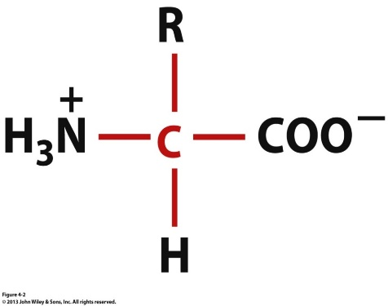
Backbone Ionization: Free Amino Acids
H⁺
H⁺
H
H₂
H⁺
H⁺
pH < 2
pH = 7
pH > 9
pK values of backbone –NH₂ and –COOH groups are respectively around 9 and 2
Under physiological settings (pH 6-8), the –NH₂ group will be protonated and the –COOH group will be deprotonated, thereby rendering the amino acid to exist as a charged dipolar ion—such oppositely charged dipolar ions are referred to as “zwitterions”
When pH < 2, the backbone –COOH group will be fully protonated, and the amino acid will bear a net positive charge—it will exist as a cation
When pH > 9, the backbone –NH₂ group will be fully deprotonated, and the amino acid will harbor a net negative charge—it will exist as an anion
In the context of a protein, ionization of amino acids is restricted to sidechain groups—why?!

Slide 24
Sidechain Ionization: Aspartate
O
O
H⁺
HO
-
↑ pK_{R}
O
pK_{R} ↓
N
C
H⁺
N
C
H
O
H
O
pH < 4
pK_{R} = 4
pH > 4
When pH = pK_{R}, both the neutral and anionic forms will be equally populated
When pH > pK_{R}, the anionic (deprotontaed) form of aspartate will dominate
When pH < pK_{R}, the neutral (protontaed) form of aspartate will dominate
Neighboring basic residues (eg arginine) that can ion pair with the carboxylate anion will stabilize the deprotonated form, thereby lowering the pK_{R}
Neighboring polar residues (eg glutamine) that can hydrogen bond with the carboxylic acid will stabilize the protonated form, thereby increasing the pK_{R}

Slide 25
Sidechain Ionization: Glutamate
O
-
O
HO
O
H⁺
↑ pK_{R}
pK_{R} ↓
N
C
H⁺
N
C
H
O
H
O
pH < 4
pK_{R} = 4
pH > 4
When pH = pK_{R}, both the neutral and anionic forms will be equally populated
When pH > pK_{R}, the anionic (deprotontaed) form of aspartate will dominate
When pH < pK_{R}, the neutral (protontaed) form of aspartate will dominate
Neighboring basic residues (eg lysine) that can ion pair with the carboxylate anion will stabilize the deprotonated form, thereby lowering the pK_{R}
Neighboring polar residues (eg asparagine) that can hydrogen bond with the carboxylic acid will stabilize the protonated form, thereby increasing the pK_{R}

Slide 26
Sidechain Ionization: Cysteine
H⁺
-
HS
S
↑ pK_{R}
pK_{R} ↓
N
C
H⁺
N
C
H
O
H
O
pH < 8
pK_{R} = 8
pH > 8
When pH = pK_{R}, both the neutral and anionic forms will be equally populated
When pH > pK_{R}, the anionic (deprotontaed) form of cysteine will dominate
When pH < pK_{R}, the neutral (protontaed) form of cysteine will dominate
Neighboring basic residues (eg histidine) that can abstract the thiol proton will destabilize the protonated form, thereby lowering the pK_{R}
Neighboring polar residues (eg asparagine) that can hydrogen bond with the thiol group will stabilize the protonated form, thereby increasing the pK_{R}

Slide 27
Sidechain Ionization: Lysine
+
NH₃
NH₂
H⁺
↑ pK_{R}
pK_{R} ↓
N
C
H⁺
N
C
H
O
H
O
pH < 11
pK_{R} = 11
pH > 11
When pH = pK_{R}, both the neutral and cationic forms will be equally populated
When pH > pK_{R}, the neutral (deprotontaed) form of lysine will dominate
When pH < pK_{R}, the cationic (protontaed) form of lysine will dominate
Neighboring polar residues (eg glutamine) that can hydrogen bond with the neutral amino group will stabilize the deprotonated form, thereby lowering the pK_{R}
Neighboring acidic residues (eg glutamate) that can ion pair with the cationic amino group will stabilize the protonated form, thereby increasing the pK_{R}

Slide 28
Sidechain Ionization: Arginine
H
NH₂
H
NH₂
N
N
NH₂
H⁺
NH
↑ pK_{R}
+
pK_{R} ↓
N
C
H⁺
N
C
H
O
H
O
pH < 12
pK_{R} = 12
pH > 12
When pH = pK_{R}, both the neutral and cationic forms will be equally populated
When pH > pK_{R}, the neutral (deprotontaed) form of arginine will dominate
When pH < pK_{R}, the cationic (protontaed) form of arginine will dominate
Neighboring polar residues (eg asparagine) that can hydrogen bond with the neutral guanidino group will stabilize the deprotonated form, thereby lowering the pK_{R}
Neighboring acidic residues (eg aspartate) that can ion pair with the cationic guanidino group will stabilize the protonated form, thereby increasing the pK_{R}

Slide 29
Sidechain Ionization: Histidine
+
H⁺
H
↑ pK_{R}
pK_{R} ↓
N
C
H⁺
N
C
H
O
H
O
pH < 6
pK_{R} = 6
pH > 6
When pH = pK_{R}, both the neutral and cationic forms will be equally populated
When pH > pK_{R}, the neutral (deprotontaed) form of histidine will dominate
When pH < pK_{R}, the cationic (protontaed) form of histidine will dominate
Neighboring polar residues (eg asparagine) that can hydrogen bond with the neutral imidazole group will stabilize the deprotonated form, thereby lowering the pK_{R}
Neighboring acidic residues (eg aspartate) that can ion pair with the cationic imidazole group will stabilize the protonated form, thereby increasing the pK_{R}

Slide 30
Exercise 2.1b
Why do pK_{R} values of ionizable groups differ between free amino acids and amino acid residues in polypeptides?
With respect to their sidechain ionizable groups, which amino acid residues exist between neutral and cationic forms?
With respect to their sidechain ionizable groups, which amino acid residues exist between neutral and anionic forms?
Describe mechanisms by which the pK_{R} of histidine and cysteine may be modulated in the context of a globular protein?

Slide 31
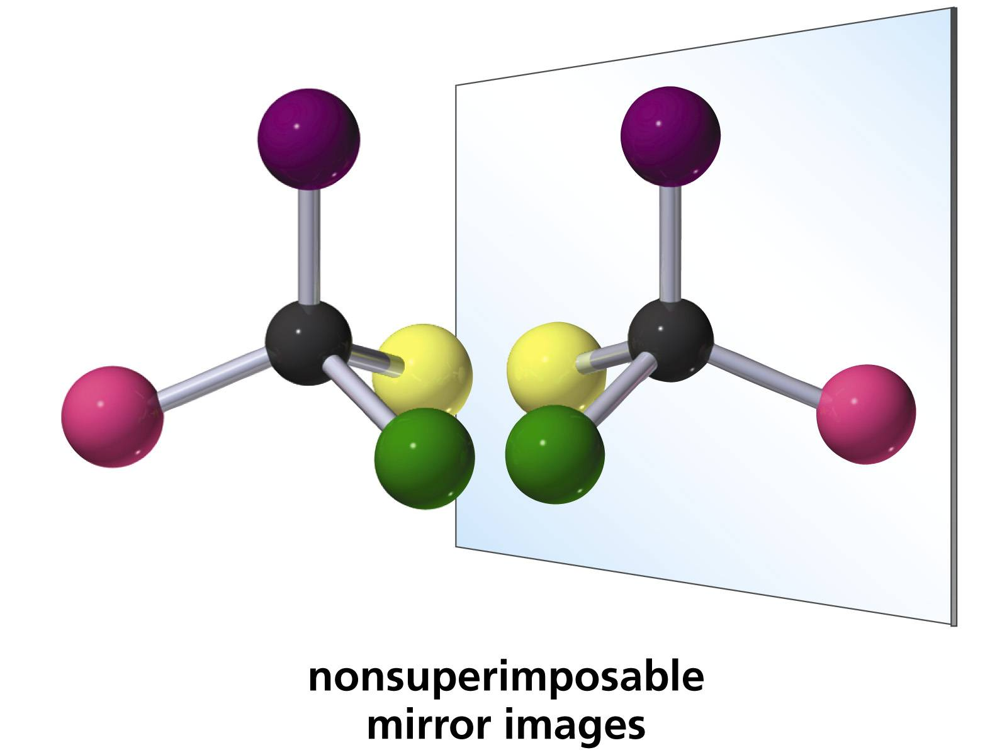
§2.1c Chirality

Slide 32
Synopsis 2.1c
Amino acids and many other biological compounds are chiral
molecules—recall §1.1
All chiral molecules have an asymmetric C atom—attached to
four different substituent groups
All amino acids but glycine are chiral!
Each chiral molecule has a non-superimposable mirror image—the pair of such mirror images are termed “enantiomers”
Enantiomers are often designated D and L depending on whether they rotate the plane of polarized light right/dextrorotatory (D) or left/levorotatory (L)
Proteins are exclusively comprised of L-amino acids—even though many L-amino acids are dextrorotatory!
Biochemists employ Fischer projections to depict the D/L configuration of chiral molecules in lieu of the actual rotation of the plane of polarized light

Slide 33
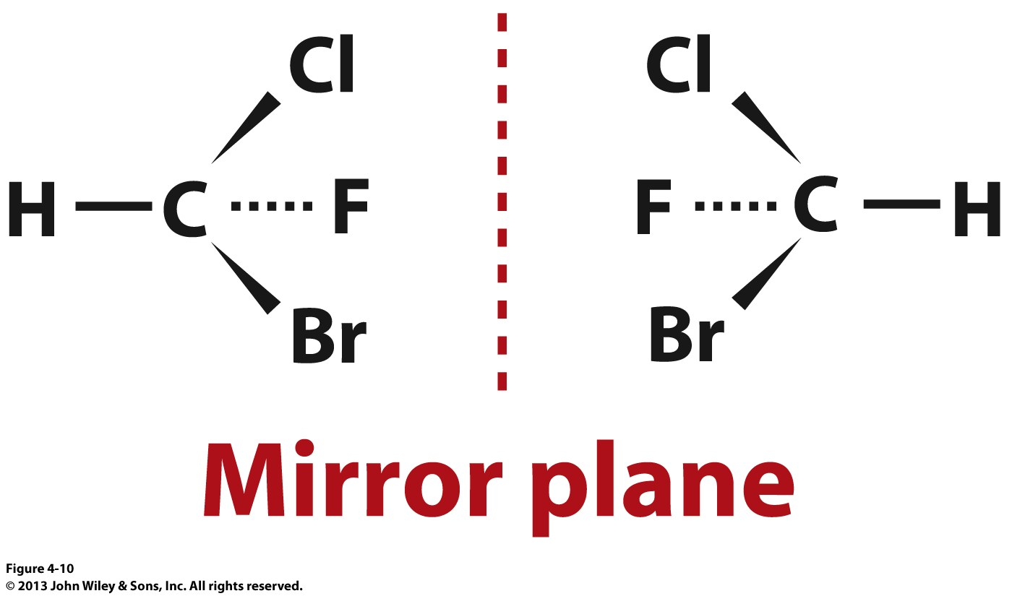
Enantiomers
Molecules such as tetrahedral C atom attached to four different substituents are chiral—ie their mirror images are non-superimposable in a manner akin to left and right hands
Such non-superimposable mirror images are called “enantiomers”
Enantiomers harbor distinct physicochemical properties—ie they rotate the plane of polarized light in opposite directions by equal amounts (D/L-isomers)

Slide 34
Polarized Light: Properties
End-on View of Light Polarization
Non-Polarized
Light (a cluster of photons) is a form of electromagnetic radiation
Each photon of light is comprised of two electromagntic wave components that are always in-phase and oscillating perpendicular to each other and to the direction of travel: electric field (E) and magnetic field (B)
Within a cluster of light photons, E may oscillate in all directions (non-polarized light)—this includes most sources such as a light bulb or sunlight
Alternatively, E can be made to oscillate vertically (vertical polarization), horizontally (horizontal polarization), or elliptically (circular polarization)
It is noteworthy that the polarization of light refers to the direction of oscillation of E (B is always perpendicular to E!)
Vertically-Polarized
Horizontally-Polarized

Slide 35
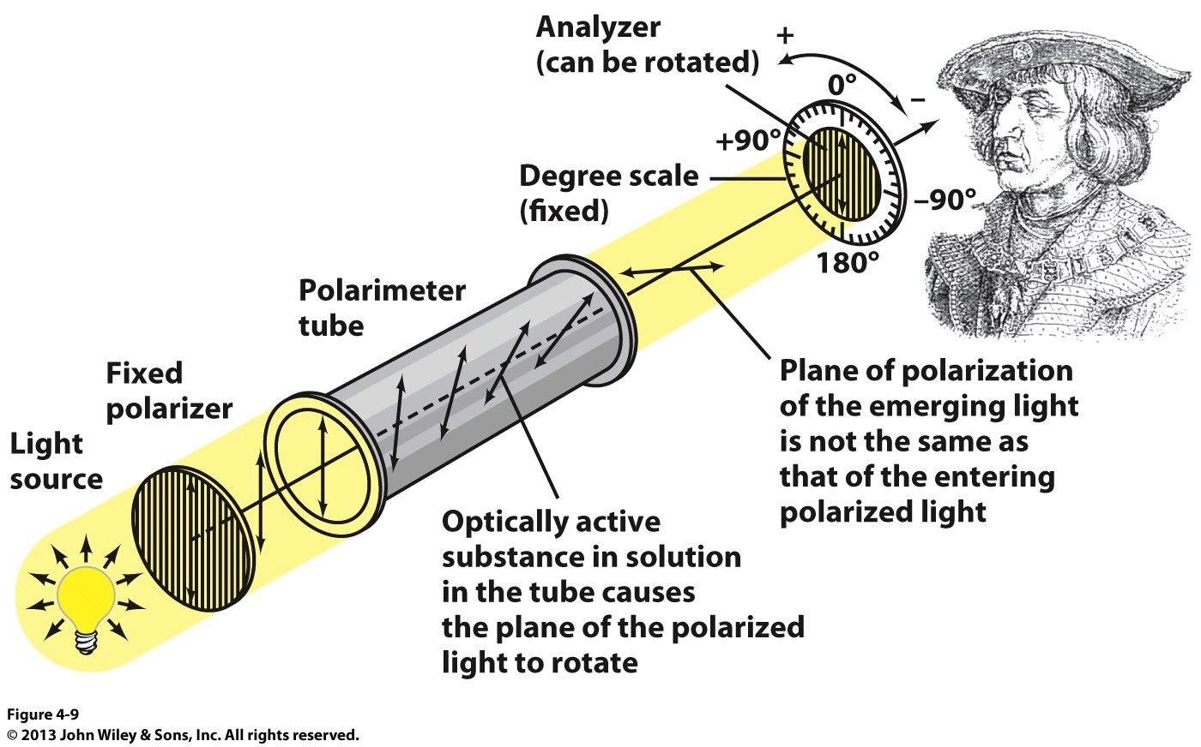
Polarized Light: Polarimeter
The direction and angle of rotation of the plane of polarized light can be determined using an instrument called the “polarimeter”

Slide 36
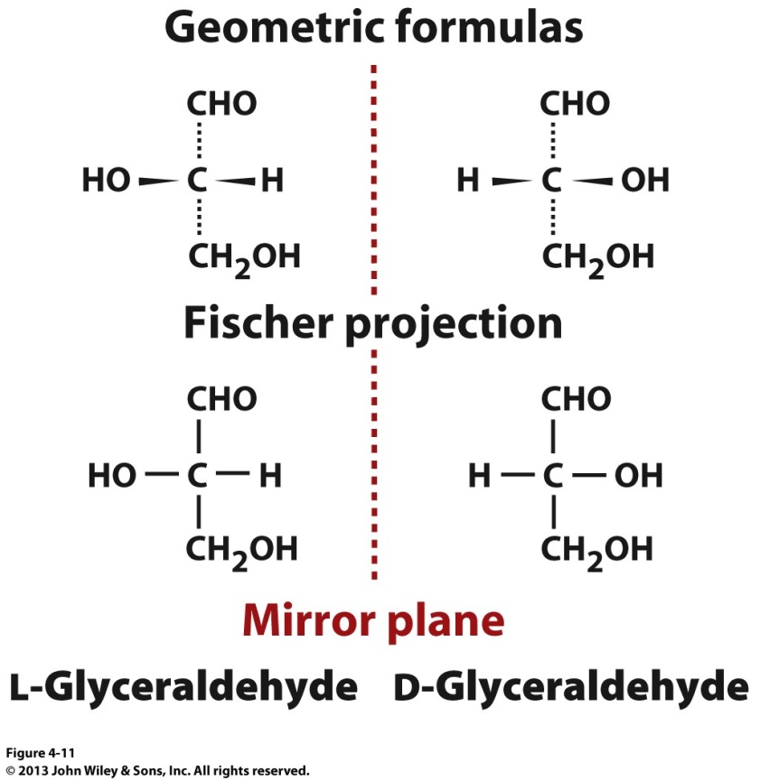
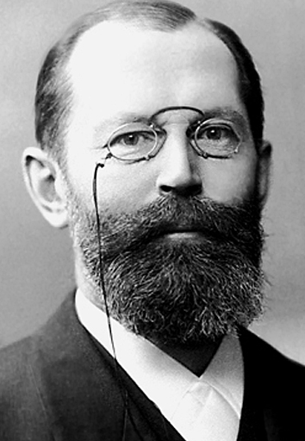
Fischer Projection
Emil Fischer
(1852-1919)
Fischer projection is a 2D representation of a 3D molecule
In Fischer projection:
- horizontal lines represent bonds coming out of the page
- vertical lines represent bonds extending into the page
Amino acids are assigned D/L configurations on the basis of the spatial position of the four substituents attached to the asymmetric C atom (harboring four distinct substituents) relative to those of glyceraldehyde:
- if OH group is to the left → L-isomer
- if OH group is to the right → D-isomer

Slide 37
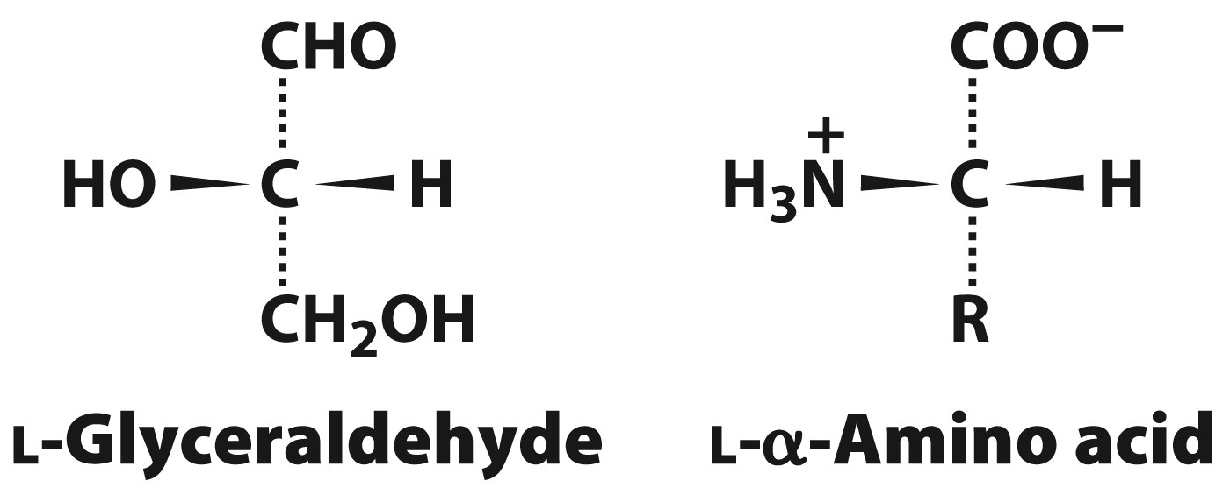
D/L Configuration
Biochemists employ Fischer projections to depict the D/L configuration of amino acids in lieu of the actual rotation of the plane of polarized light
Thus, amino acids are assigned D/L configurations on the basis of the spatial position of the four substituents attached to the asymmetric C atom relative to those of glyceraldehyde:
-H = -H
-NH₂ = -OH
-COOH = -CHO
-R = -CH₂OH
Proteins are exclusively comprised of L-amino acids—even though many L-amino acids are dextrorotatory!

Slide 38
Chirality is a Hallmark of Life
Thalidomide
(sedative/anticancer)
Thalidomide
(teratogenic)
Most drugs are chiral molecules and only exert their action in the form of one of the two enantiomers
Only the correct enantiomer is active, while the inactive enantiomer may be inert or toxic—eg while one enantiomer of thalidomide is widely used as a sedative (sleep-inducing) or anticancer drug, the other is teratogenic (causes severe birth defects)
Accordingly, the purity of drugs to a high chiral level is critical so as to ensure the administration of the correct enantiomer and avoid undesirable side effects

Slide 39
Exercise 2.1c
Explain why all amino acids but glycine are chiral
Explain how the Fischer convention describes the absolute configuration of a chiral molecule
Explain why an enzyme can catalyze a chemical reaction involving just one enantiomer of a compound

Slide 40
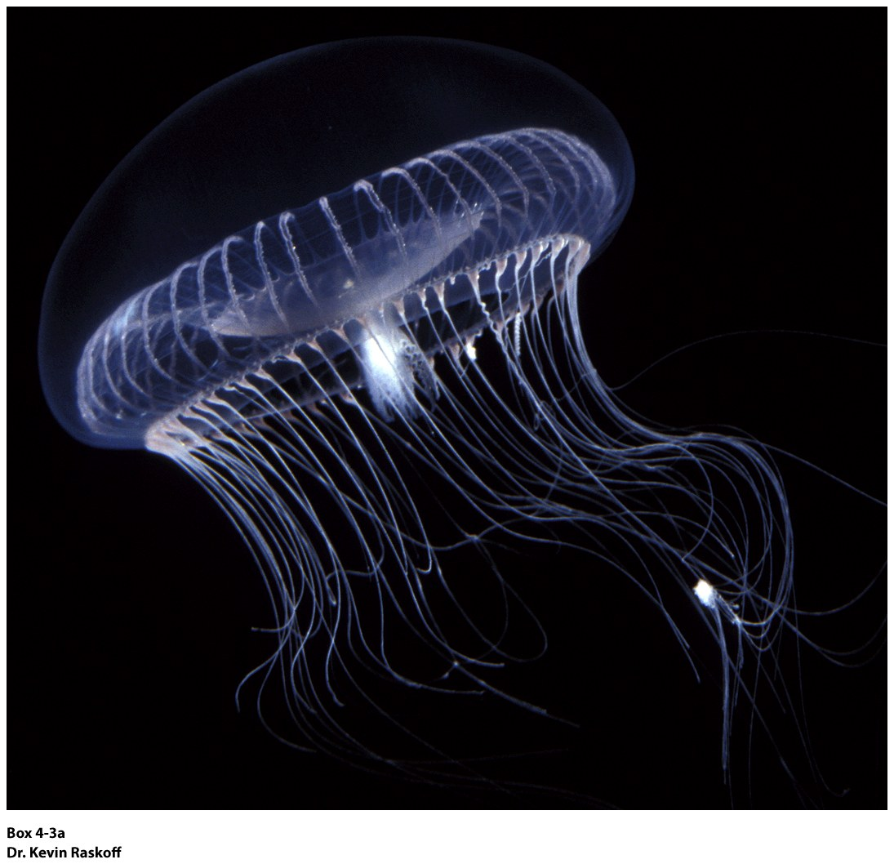
§2.1d Modification

Slide 41
Synopsis 2.1d
The side chains of amino acid residues in proteins may become covalently modified in a phenomenon that has come to be known as “post-translational modification (PTM)”
Three most common PTMs include phosphorylation, methylation and acetylation—less common are carboxylation, hydroxylation and nitration
Such PTMs serve as “molecular switches” in their ability to alter and modulate protein function
Like proteins, free amino acids can also be modified—such derivatives function as chemical messengers

Slide 42
Common PTMs in Proteins
Serine
Threonine
Tyrosine
(Histidine)
Glutamate
Proline
Phosphorylation
Carboxylation
Hydroxylation
Lysine
Arginine
(Histidine)
Lysine
(Parentheses indicate
a rare event)
Methylation
Acetylation

Slide 43
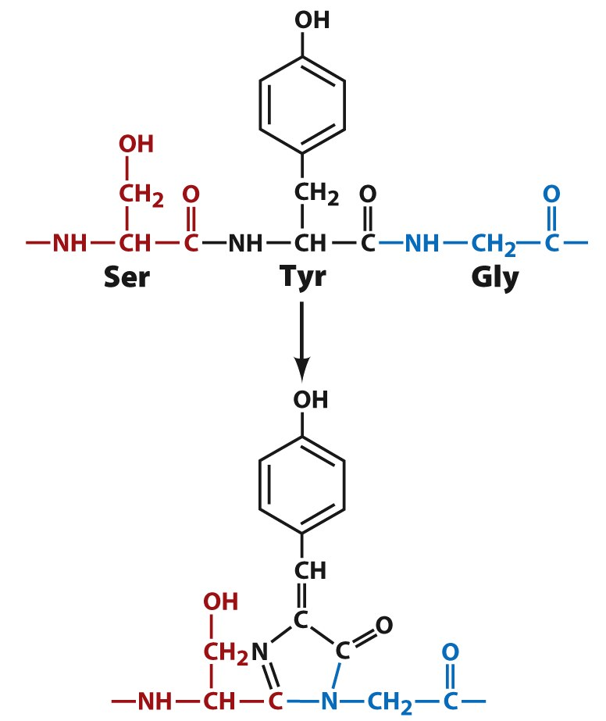
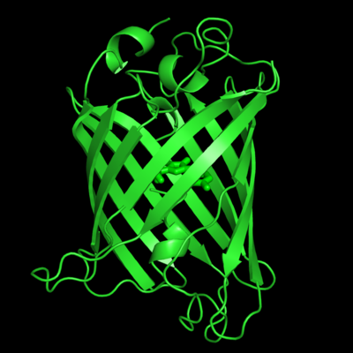
PTM—Biochemistry Goes Green!
Cyclization and oxidation of:
–Ser-Tyr-Gly-
Internal chromophore of GFP
Single Bond → One sigma (σ) bond
Double Bond → One sigma (σ) / One Pi (π)
Conjugated system → Alternating single/double bonds
The so-called green fluorescent protein (GFP) owes its colorful properties to cyclization and oxidation of –Ser-Tyr-Gly- (-SYG-) triad of residues located within the protein core
The resulting chromophore—harboring a conjugated pi-bond system—absorbs visible light of all wavelengths but green (λ_{max} = 510nm)

Slide 44
Amino Acid Derivatives As Chemical Messengers
Decarboxylated form of glutamate
Regulates functions such as behavior, cognition, stress, and anxiety
Decarboxylated form of histidine
Regulates inflammatory response
Hydroxylated/decarboxylated form of tyrosine
Regulates functions such as mood and happiness (a feeling of euphoria after exercise or accomplishing a goal is due to the release of dopamine—it is a reward hormone!)
A tyrosine derivative
Regulates cellular metabolism, development, and differentiation

Slide 45
Exercise 2.1d
List and describe major types of PTMs in proteins
List functions of amino acid derivatives

