Slide 1
I. MEMBRANE BIOCHEMISTRY
§1.1 Monosaccharides
§1.1a Sugar Chains
§1.1b Sugar Rings
§1.1c Sugar Derivatives

Slide 2
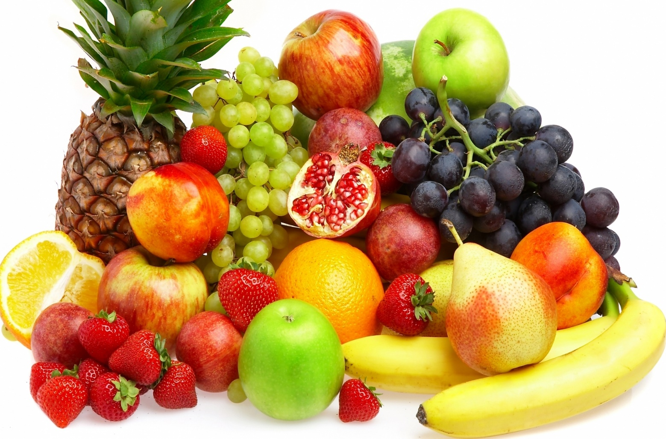
§1.1a Sugar Chains

Slide 3
Synopsis 1.1a
monosaccharide: zachari (Greek) → sugar
Monosaccharides are carbonyl polyols (or polyhydroxy carbonyls)—they contain a single carbonyl (C=O) group bundled with multiple hydroxyl (OH) moieties—with the general chemical formula (CH₂O)_{n}, where n ≥ 3
Monosaccharides are classified on the basis of whether the carbonyl group is an aldehyde (aldoses) or a ketone (ketoses)
Aldoses and ketoses are further sub-classified according to the number of C atoms they harbor—eg trioses, tetroses, pentoses, hexoses, and so forth
Monosaccharides, or simple sugars, are synthesized from smaller precursors that are ultimately derived from CO₂ and H₂O by photosynthesis
Monosaccharides display complex stereochemical properties

Slide 4
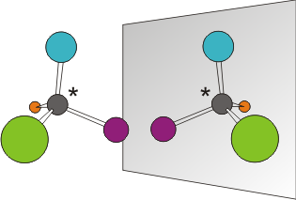
Stereochemistry Overview
Mirror
Monosaccharides are chiral
molecules in that they have
an asymmetric C atom—ie it
is attached to four different
substituent groups
Each chiral molecule has a non-superimposable
mirror image—the pair of such mirror images are termed “enantiomers”
Enantiomers are optical isomers—ie they rotate the plane of polarized light in opposite directions by equal amounts
Enantiomers are often designated D and L depending on whether they rotate the plane of polarized light right/dextrorotatory (D) or left/levorotatory (L)
In biochemistry, the so-called Fischer projections are employed to depict the D/L configuration of chiral molecules such as monosaccharides in lieu of the actual rotation of the plane of polarized light

Slide 5
Polarized Light: Properties
End-on View of Light Polarization
Non-Polarized
Light (a cluster of photons) is a form of electromagnetic radiation
Each photon of light is comprised of two electromagntic wave components that are always in-phase and oscillating perpendicular to each other and to the direction of travel: electric field (E) and magnetic field (B)
Within a cluster of light photons, E may oscillate in all directions (non-polarized light)—this includes most sources such as a light bulb or sunlight
Alternatively, E can be made to oscillate vertically (vertical polarization), horizontally (horizontal polarization), or elliptically (circular polarization)
It is noteworthy that the polarization of light refers to the direction of oscillation of E (B is always perpendicular to E!)
Vertically-Polarized
Horizontally-Polarized

Slide 6
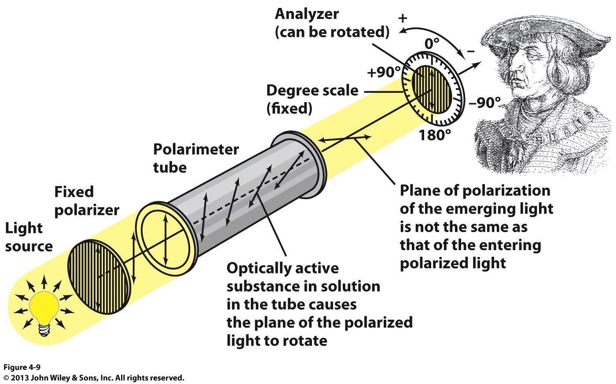
Polarized Light: Polarimeter
The direction and angle of rotation of the plane of polarized light can be determined using an instrument called the “polarimeter”

Slide 7
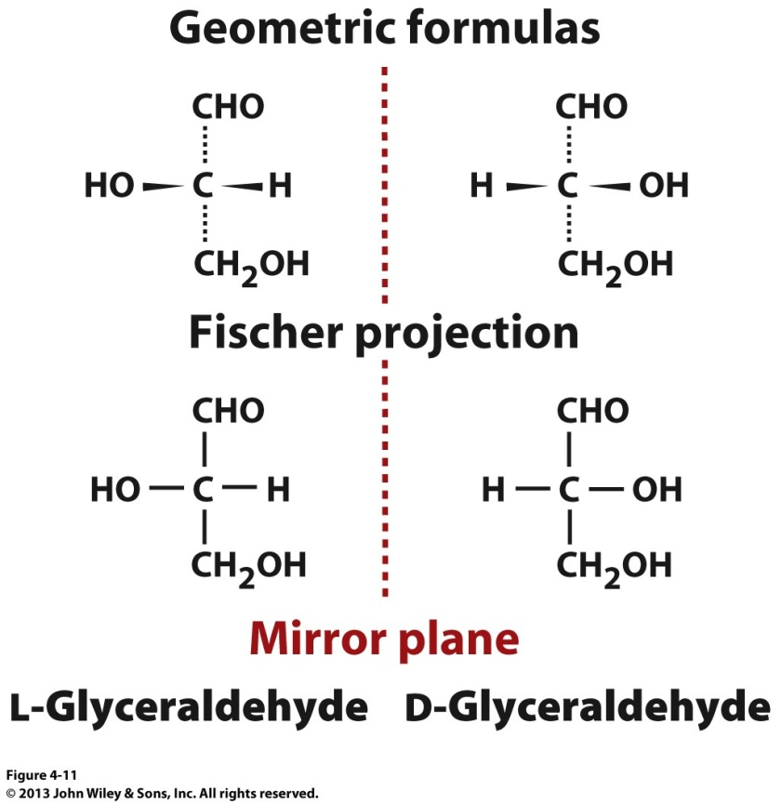
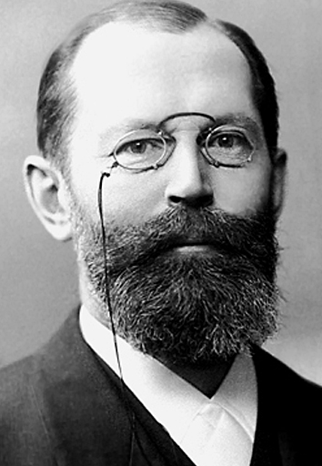
Stereochemistry: Fischer Projections
Emil Fischer
(1852-1919)
Fischer projection is a 2D representation of a 3D molecule
In Fischer projection:
- horizontal lines represent bonds coming out of the page
- vertical lines represent bonds extending into the page
Monosaccharides are assigned D/L configurations on the basis of the spatial position of the four substituents attached to the asymmetric C atom (harboring four distinct substituents) relative to those of glyceraldehyde:
- if OH group is to the left → L-isomer
- if OH group is to the right → D-isomer

Slide 8
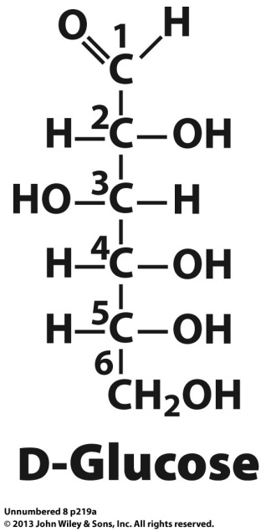
Stereochemistry: Enantiomers
Mirror
HO
H
H
HO
HO
H
HO
H
L
Fischer projections are used to depict the D/L configuration of monosaccharides in lieu of the actual rotation of the plane of polarized light
Monosaccharides are assigned D/L configurations on the basis of the spatial position of the four substituents attached to the asymmetric C atom (harboring four distinct groups) farthest away from the carbonyl group (eg C5 in D-Glucose) relative to those of glyceraldehyde
L-sugars are simply non-superimposable mirror images of their D counterparts (they are enantiomers)—ie they harbor different stereochemical configurations at all chiral centers!
Because L-sugars are rare in nature, the D- prefix is usually omitted—eg glucose implies that it is D-glucose
Monosaccharides have 2^{n} stereoisomers, where n is the number of asymmetric C atoms or chiral centers—eg D-glucose is one of 2⁴ (=16) stereoisomers

Slide 9
Stereochemistry: Enantiomers vs Epimers
HO
H
H
HO
HO
H
HO
H
HO
H
L
D-Galactose
ENANTIOMERS
EPIMERS
Optical isomers that differ in their configuration at all chiral centers are called enantiomers—hence they are non-superimposable images of each other—all D-sugars and their L-counterparts are enantiomers!
Optical isomers that differ in their configuration at one or more (but not all) chiral centers are called diastereomers (they are not mirror images)—epimers are a special class of diastereomers!
Epimers merely differ in the configuration at only one chiral center—eg glucose and galactose differ only in the configuration of OH group @ C4
Thus, glucose and galactose are epimers—or galactose is an epimer of glucose @ C4 and vice versa
Like enantiomers, diastereomers and epimers are also optical isomers—a class of stereoisomers that rotate the plane of polarized light due to at least one chiral center!

Slide 10
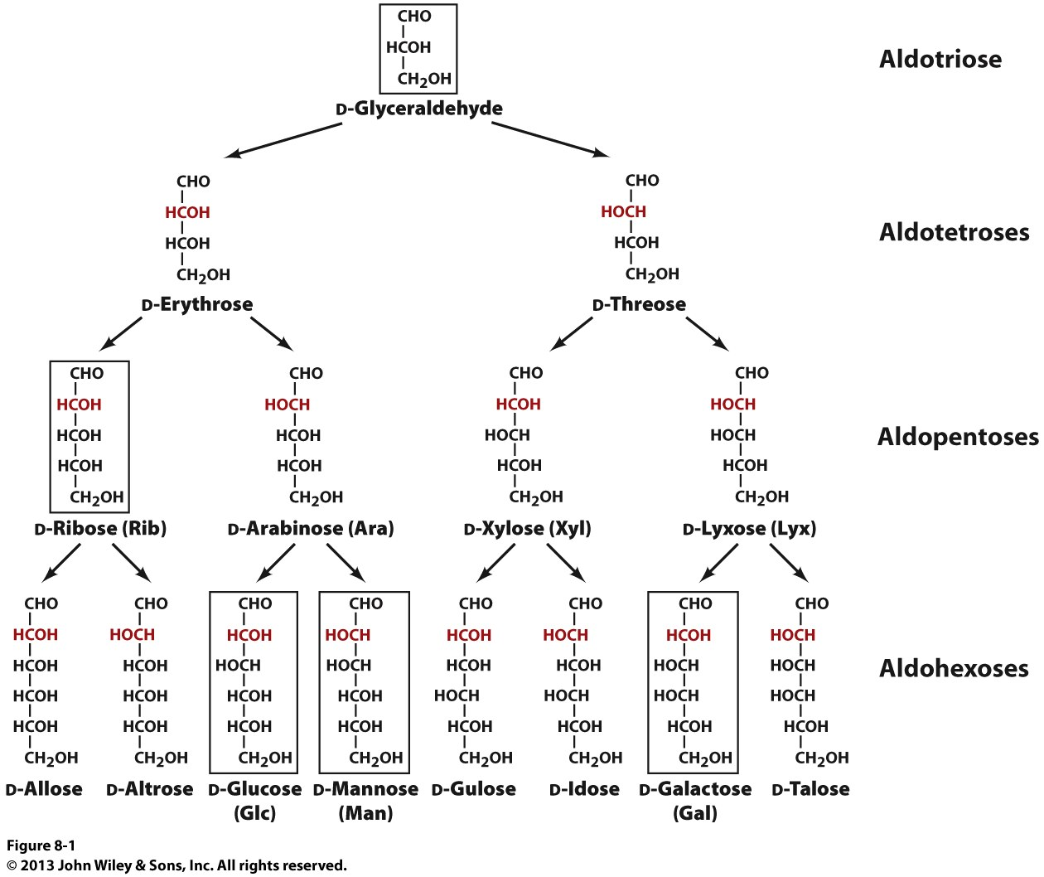
Aldoses Sugars
Biologically most common
aldoses are boxed!
glucose/mannose are epimers @ C2
glucose/galactose are epimers @ C4
Arrows indicate stereochemical (not biosynthetic) relationships
<----------- Epimers ------------>
Configuration around C2 (red)
atom distinguishes each pair of epimers
<-Epimers->
<--Epimers-->

Slide 11
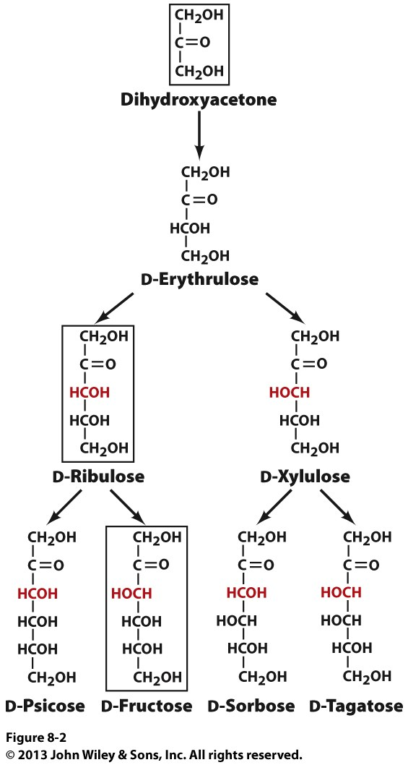
Ketoses Sugars
Biologically most common
ketoses are boxed!
Ketotriose
Arrows indicate stereochemical (not biosynthetic) relationships
Ketotetrose
Configuration around C3 (red)
atom distinguishes each pair
of epimers
<--Epimers-->
Ketopentoses
Ketohexoses
fructose/psicose
are epimers @ C3

Slide 12
Aldoses and Ketoses Are Structural Isomers
H
OH
C
O
C
H₂
H
OH
C
O
C
C
C
O
H₂
H
OH
C
C
O
C
H
OH
H
C
HO
HO
H
C
OH
H
H
H
H
C
OH
C
OH
C
OH
H
C
H
C
OH
C
OH
OH
C
OH
H
H
C
OH
C
OH
C
OH
C
OH
H₂
H₂
H₂
H₂
D-Glucose
D-Fructose
D-Ribose
D-Ribulose
Structural isomers
Structural isomers
While stereoisomers only differ from each other in terms of the spatial arrangement or configuration of various atoms, such atoms have different bonding organization in structural isomers—both stereoisomers and structural isomers harbor identical molecular formula for a given chemical entity
Aldoses and ketoses with isocarbon backbone are structural isomers of each other—examples include:
Glucose and fructose (hexoses)
Ribose and ribulose (pentoses)

Slide 13
Exercise 1.1a
How does an aldose differ from a ketose?
Draw a Fischer projection of D-glucose. Draw two stereoisomers of this molecule, including one that is an epimer
What is the stereochemical relationship between glucose, galactose, and mannose
How do epimers, diastereomers, and enantiomers of a sugar differ from each other?

Slide 14
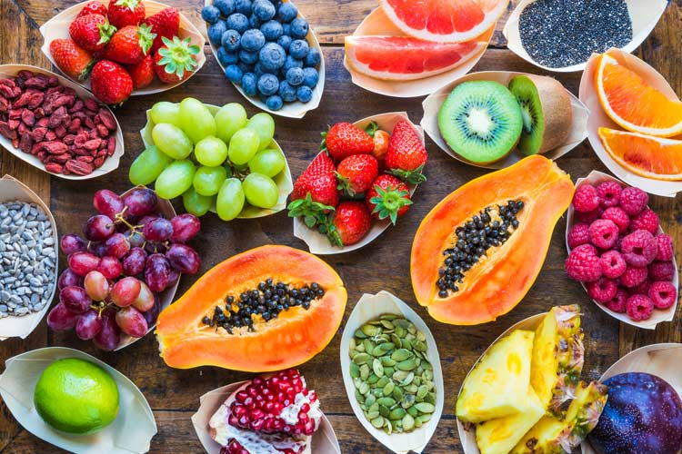
§1.1b Sugar Rings

Slide 15
Synopsis 1.1b
Owing to intramolecular nucleophilic reaction between the carbonyl group and one of the hydroxyl moieties, monosaccharides (comprised of 5 or more C atoms) predominantly exist in cyclic forms
Such cyclization in aldoses and ketoses creates either 5-membered or 6-membered rings
5-membered rings are called “furanoses”
6-membered rings are called “pyranoses”
In furanoses and pyranoses, the cyclic rings are “puckered” giving rise to the so-called “chair conformations”

Slide 16
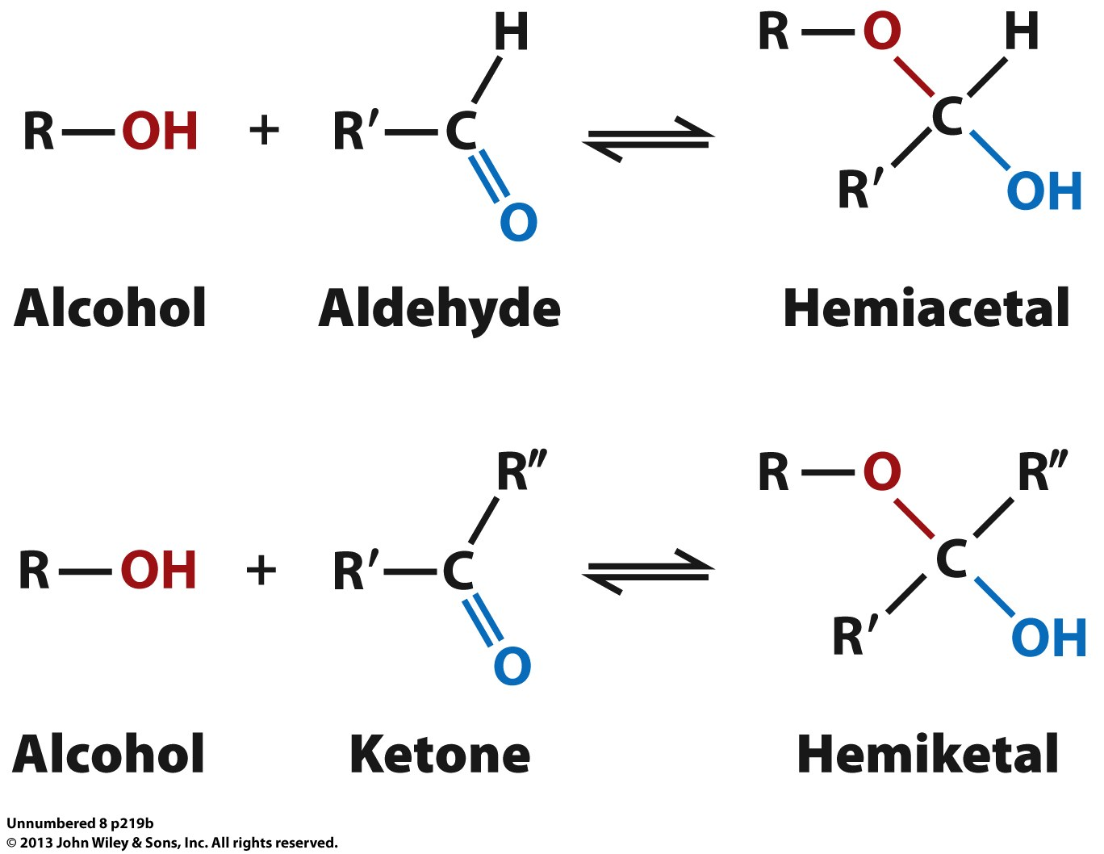
Cyclization: Hemiacetals and Hemiketals
Nucleophilic attack of hydroxyl O atom on carbonyl C atom leads to spontaneous production of hemiacetals and hemiketals
Owing to such nucleophilic reaction (but in an intramolecular manner) between the carbonyl group and one of the hydroxyl moieties, monosaccharides (comprised of 5 or more C atoms) predominantly exist in cyclic forms in both liquid and solid state @ thermodynamic equilibrium
In the cyclic form, the union between the carbonyl and hydroxyl groups creates either an hemiacetal (from aldoses) or hemiketal (from ketoses) group

Slide 17
Cyclization: D-Glucose
Owing to nucleophilic reaction between the terminal aldehyde group and the hydroxyl moiety attached to the asymmetric C5 atom farthest from it, the linear form of glucose spontaneously switches to the 6-membered cyclic form termed glucopyranose
Such 6-membered cyclic forms of monosaccharides are called pyranoses in analogy with the heterocyclic pyran ring

Slide 18
Cyclization: D-Fructose
Owing to nucleophilic reaction between the ketone group and the hydroxyl moiety attached to the asymmetric C5 atom farthest from it, the linear form of fructose spontaneously switches to the 5-membered cyclic form termed fructofuranose
Such 5-membered cyclic forms of monosaccharides are called furanoses in analogy with the heterocyclic furan ring

Slide 19
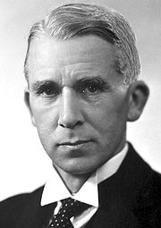
Cyclization: Fischer → Haworth Projection
Emil Fischer
(1852-1919)
Norman Haworth
(1883-1950)
D-Glucose
(Fischer projection)
β-D-Glucopyranose
(Haworth projection)
The 3D stereochemical configurations of cyclic forms of monosaccharides are usually represented via the so-called Haworth projection
In the Haworth projection, the heterocyclic ring lies perpendicular to the plane of the page (with the wedged line denoting atoms coming toward the observer) and the vertical lines indicate atoms above or below the plane of the ring
The substituents below the plane of the ring in the Haworth projection are equivalent to those on the right-hand side of Fischer projection—with the position of OH group involved in cyclization replaced with the left-hand side H atom

Slide 20
Cyclization: Chair conformations
Axial
Equatorial
≡
(dominant form)
D-Glucose
(Fischer projection)
β-D-Glucopyranose
(Haworth projection)
β-D-Glucopyranose
(Chair conformations)
In the Haworth projection, the heterocyclic ring is non-planar due to tetrahedral (sp³) hybridization of atomic orbitals
Since each C atom adopts tetrahedral geometry with respect to its four attached substituents, the heterocyclic ring becomes somewhat “puckered” so as to adopt a “chair conformation” in which steric clashes between attached substituents are minimized
In the chair conformation, the bulkiest substituents compete with smaller groups for the less crowded equatorial positions (rather than the more crowded axial positions) resulting in two interconvertible “chairs”
The chair conformation in which the bulkiest groups occupy the equatorial positions is thermodynamically the most favorable

Slide 21
Cyclization: α and β anomers
α-D-Glucopyranose
(Haworth projection)
D-Glucose
(Fischer projection)
β-D-Glucopyranose
(Haworth projection)
Upon cyclization, the carbonyl C atom (called the anomeric carbon) becomes chiral with two possible stereochemical configurations
Such pairs of stereoisomers at the anomeric C atom are referred to as α and β anomers
In the α anomer, the anomeric OH group orients below the plane of the ring on the side opposite to the CH₂OH substituent attached to the hydroxyl C atom involved in cyclization
In the β anomer, the anomeric OH group orients above the plane of the ring on the same side as the CH₂OH substituent attached to the hydroxyl C atom involved in cyclization
α (∼40%) and β (∼60%) anomers freely interconvert in solution with the equilibrium slightly in favor of the latter stereoisomer—eg glucose is predominantly a mixture of such anomers with negligible contributions from the linear form

Slide 22
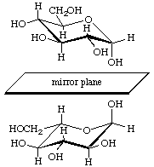
Stereochemistry: Epimers vs Anomers
HO
H
D-Galactose
α-D-Glucopyranose
β-D-Glucopyranose
EPIMERS
ANOMERS
Anomers are a special class of epimers in that they are concerned with the stereochemical configuration only at the anomeric C atom (hemiacetal or hemiketal group of cyclic monosaccharides)
Two anomers of the same linear monosaccharide have distinct physicochemical properties, including their ability to differentially rotate the plane of polarized light
Since anomers are not mirror images of each other, they are not enantiomers—they are diastereomers and so are epimers!
α-D-glucopyranose and α-L-glucopyranose would be enantiomers!
α-D-Glucopyranose
α-L-Glucopyranose

Slide 23
Stereochemistry: Outline
STEREOISOMERS
(spatial configuration of atoms)
OPTICAL ISOMERS
(one or more chiral centers and optical rotation)
CIS-TRANS ISOMERS
(configuration about the double-bond)
DIASTEREOMERS
(different configuration at one or more chiral centers but not all)
ENANTIOMERS
(different configuration at all chiral centers and non-superimposable mirror images)
EPIMERS
(different configuration at only one chiral center)
What is the difference between chemistry and biology?
The latter is all about stereochemistry!
ANOMERS
(different configuration at the anomeric C atom in cyclic monosaccharides)

Slide 24
Exercise 1.1b
Show how aldoses and ketoses can form five- and six-membered rings
Why does glucose adopt a pyranose ring, while fructose furanose?
Draw a Haworth projection of D-glucose and identify it as an α or β anomer
Explain why anomers of a monosaccharide can readily interconvert whereas epimers do not

Slide 25
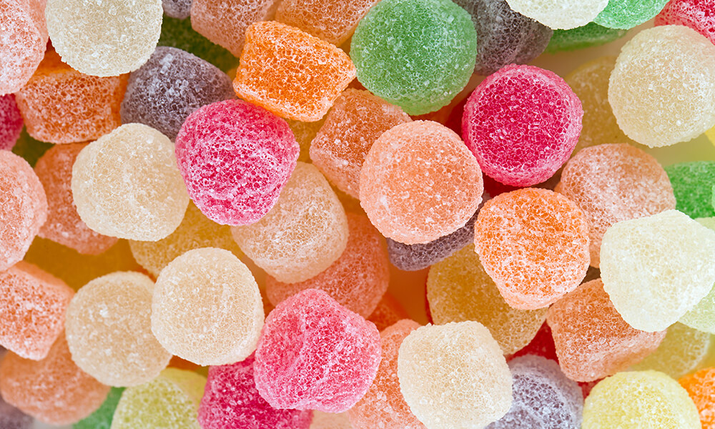
§1.1c Sugar Derivatives

Slide 26
Synopsis 1.1c
Monosaccharides are the building blocks from which more complex polysaccharides (carbohydrates)are synthesized—eg starch and glycogen—which serve as “fuels” or “energy reservoirs” in living cells
In addition to serving as fuels to provide living cells with energy, monosaccharides also play numerous regulatory roles central to cellular homeostasis
In particular, monosaccharides pull off such remarkable feats by virtue of their ability to exist in the form of numerous derivatives
Examples of such derivatives include:
- alditols
- aldonic acids
- alduronic acids
- deoxy sugars
- phospho sugars
- amino sugars

Slide 27
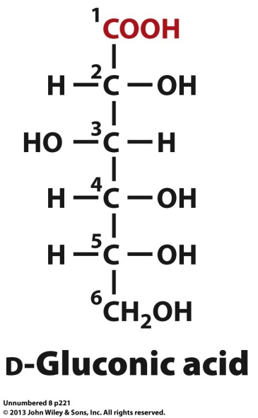
Aldonic Acids: CHO → COOH
HO
Oxidation
D-Glucose
Oxidation of the terminal CHO group of an aldose generates the corresponding polyhydroxy carboxylic acid derivative called “aldonic acid”
Nomenclature based on simply replacing the suffix –ose in the aldose to –onic in the aldonic acid
For example, oxidation of the terminal CHO group of glucose generates gluconic acid—wide occurrence in various fruits

Slide 28
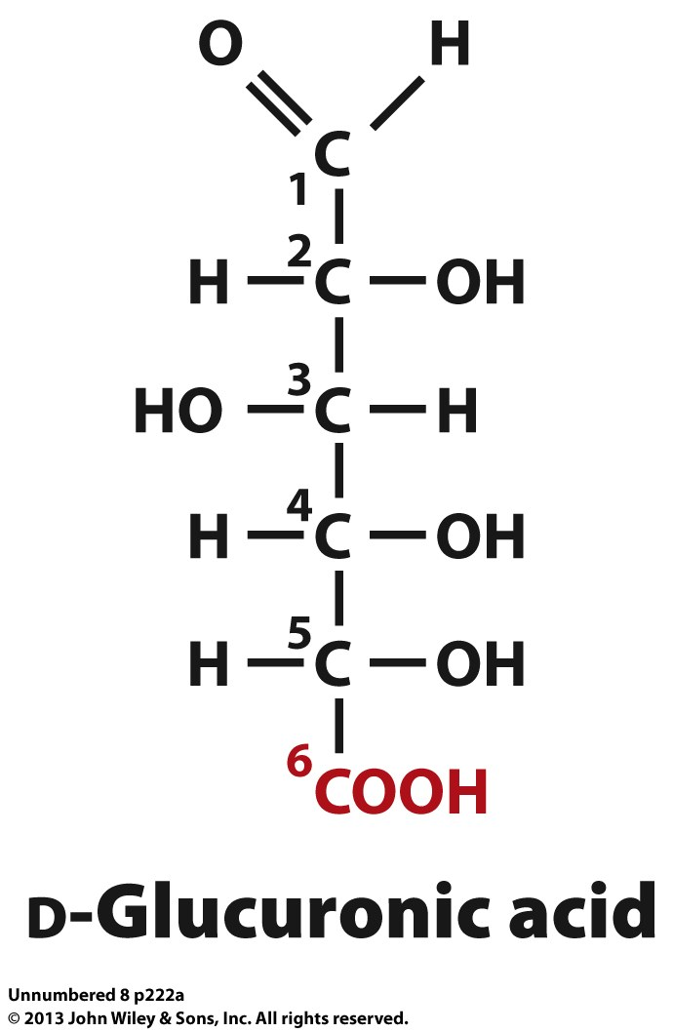
Alduronic Acids: CH₂OH → COOH
Oxidation
H₂OH
D-Glucose
Oxidation of the terminal CH₂OH group of an aldose generates the corresponding polyhydroxy-carbonyl carboxylic acid called alduronic acid (or simply uronic acid)
Nomenclature based on replacing the suffix –ose in the aldose to –uronic in the alduronic acid
For example, oxidation of the terminal CH₂OH group of glucose generates glucuronic acid—a component of glycosaminoglycans (see §1.2)

Slide 29
Alditols: CHO → CH₂OH
HO
H₂OH
Reduction
D-Glucose
D-Glucitol
Reduction of the terminal CHO group of an aldose generates the corresponding sugar alcohol (polyol) called alditol
Nomenclature based on simply replacing the suffix –ose in the aldose to –itol in the alditol
For example, reduction of the terminal CHO group of glucose generates glucitol (more commonly known as sorbitol)—used as a food sweetener as well as a laxative (draws water into the large intestine, thereby aiding bowel movement)

Slide 30
Deoxy Sugars: OH → H
Reduction
OH
β-D-Ribose
(RNA)
β-D-2-Deoxyribose
(DNA)
Reduction (via reductases) of an OH group to H generates the corresponding deoxy sugar
Nomenclature based on simply prefixing the sugar with n-deoxy-, where n is the position of OH reduced or replaced
For example, reduction of the OH group @ C2 of ribose generates 2-deoxyribose—a component of DNA (see §4.1)

Slide 31
Phospho Sugars: OH → OPO₃²⁻
OH
OPO₃²⁻
Phosphorylation
OH
OH
α-D-Glucopyranose
α-D-Glucopyranose-6-phosphate
(glycolytic intermediate)
Phosphorylation (via kinases) of an OH group to phosphate moiety generates the corresponding phospho sugar (or sugar phosphate)
Nomenclature based on simply suffixing the sugar with -n-phosphate, where n is the position of OH phosphorylated
For example, phosphorylation of the OH group @ C6 of glucose generates glucose-6-phosphate—a key intermediate involved in the oxidation of glucose (from food) via glycolysis to produce energy (see §3.1)

Slide 32
Amino Sugars: OH → NH₂
Transamination
OH
α-D-Glucopyranose
Generic Name
Systematic Name
Replacement (or transamination) of an OH group with NH₂ moiety generates the corresponding amino sugar
Nomenclature based on simply prefixing the sugar with n-amino-n-deoxy-, where n is the position of OH replaced
For example, amination of the OH group @ C2 of glucose generates 2-amino-2-deoxy-α-D-glucopyranose (α-D-glucosamine)—a component of glycosaminoglycans (see §1.2)

Slide 33
Acetyl Sugars: OH → NH₂ → HNCOCH₃
Acetylation
HN—C—CH3
O
N-acetyl-α-D-glucosamine
(2-acetylamino-2-deoxy-
α-D-glucopyranose)
Amino sugars are frequently subject to further modifications such as acetylation at the NH₂ moiety so as to generate the corresponding acetyl sugar
Nomenclature based on simply prefixing the sugar with n-acetylamino-n-deoxy-, where n is the position of OH replaced
For example, acetylation of the NH₂ group @ C2 of glucose generates 2-acetylamino-2-deoxy-α-D-glucopyranose (N-acetyl-α-D-glucosamine)—a component of glycosaminoglycans (see §1.2)

Slide 34
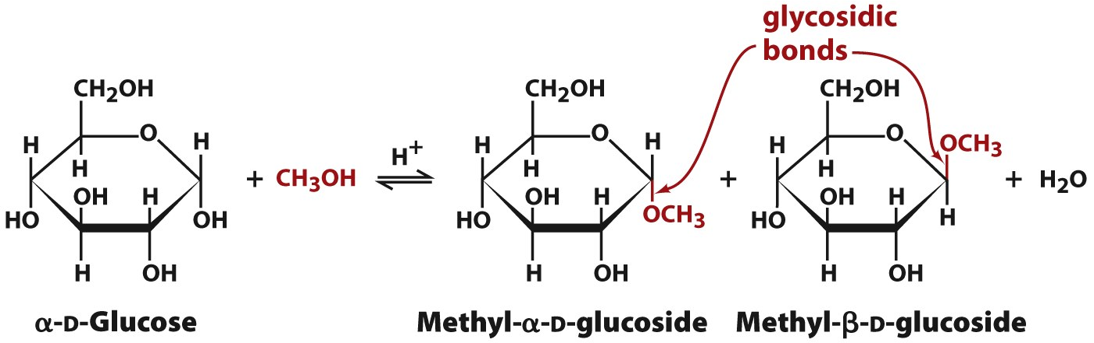
O-Glycosides: OH → OR
O-
Anomeric C atom—or hemi(acetal)ketal group—of sugars can undergo condensation with OH group from another alcohol (eg ROH), which may or may not be another sugar
Such condensation results in the formation of an “O-glycosidic” bond between anomeric C atom and alcohol O atom—the product is called “O-glycoside”
O-glycosides are extremely common in nature—eg they serve as the building blocks of disaccharides and more complex polysaccharides (see §1.2)

Slide 35
N-Glycosides: OH → N(H)R
Cytosine
OH
H
N-glycosidic
bond
OH
OH
β-D-ribose-5-phosphate
Cytidine Monophosphate (CMP)
Anomeric C atom of sugars can also undergo condensation with an –NH or -NH2 group from an amine (eg R-NH₂)
Such condensation results in the formation of an “N-glycosidic” bond between anomeric C atom and amine N atom—the product is called “N-glycoside”
N-glycosides are also common in nature—eg they serve as the building blocks of RNA and DNA in the form of (deoxy)ribonucleotides (see §4.1)

Slide 36
Exercise 1.1c
Write down reaction schemes that generate aldonic acids, uronic acids, alditols, deoxy sugars, and amino sugars
Explain why a sugar can form at least two different glycosides
Distinguish between O-glycosidic and N-glycosidic bonds?

