Slide 1
0. INTRODUCTION
§0.3 Beyond Biochemistry

Slide 2
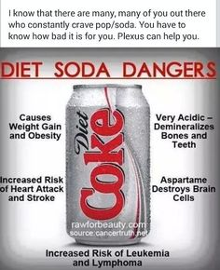
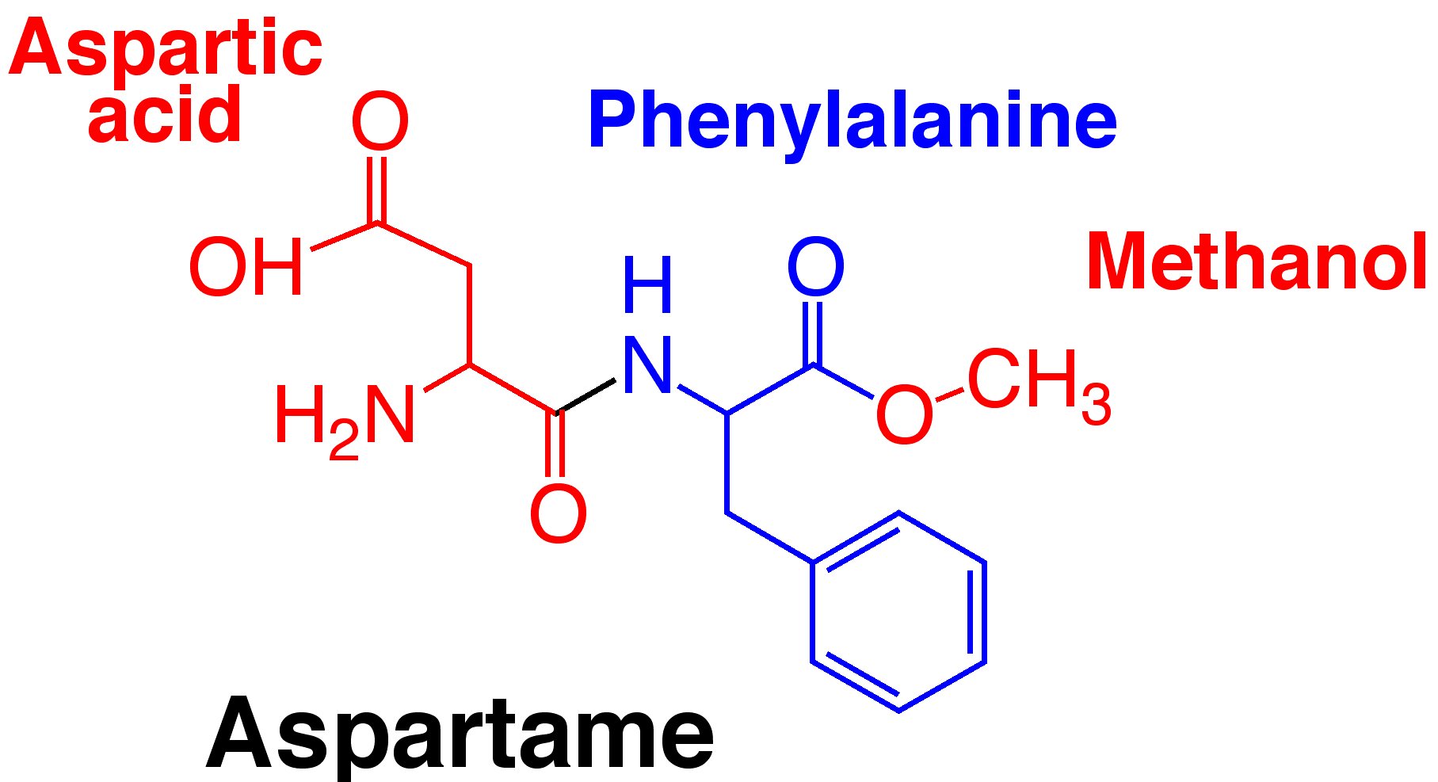
DIET COKE EXPOSED—an Alternative Fact Rather Than Alternative Soda!
Due to its calorie-free nature, diet coke (0 cal/can) is often perceived to be a better substitute for the regular calorie-rich coke (140 cal/can)
However, diet coke typically contains aspartame as an artificial sweetener
Not only aspartame is linked to serious health risks ranging from diabetes and heart disease to cancer and neurological disorders but it is also believed to enhance your natural cravings for sugary foods resulting in unnecessary weight gain—ditto for most other artificial sweeteners such as splenda
If you must sip it, the regular coke is by far the better of the two evils!

Slide 3
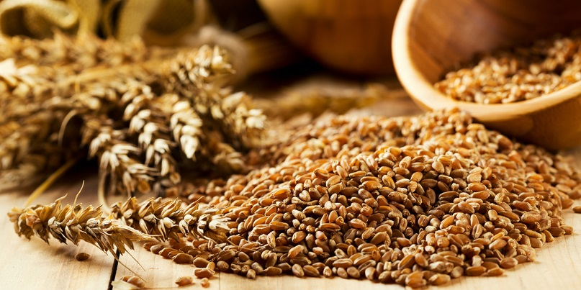
Wheat Myth Busted—Nothing But a Sales Pitch!
Although loaded with healthy carbs and dietary fiber, whole wheat also contains about 10% (w/w) gluten—an umbrella term for several proteins that confer upon wheat viscoelasticity and chewiness
Because gluten can trigger the onset of a number of metabolic disorders such as the celiac disease (CD)—an autoimmune disorder that can lead to various gastrointestinal issues such as diarrhea—but only in genetically-predisposed individuals (ie those who have an underlying genetic susceptibility that goes unnoticed until triggered by an environmental cue!)
Although only about 1% of humanity suffers from CD, the dietitians and nutritionists argue that wheat contributes to gastrointestinal problems and weight gain in all individuals—and that a wheat-free diet represents an healthier life style
Yet, a large body of data suggests that replacing wheat (and other whole grains) with other food substitutes is fraught with serious danger to health as the essential nutrients that wheat-related grains provide cannot be easily obtained from a grain-free diet
Unless you suffer from CD, stick with the old-fashioned whole grains for they bestowed upon your grandmother a disease-free life of 100 years!

Slide 4
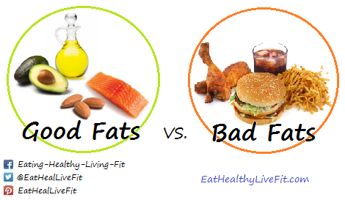
Good Fats vs Bad Fats
GOOD FATS are essential for the regulation of metabolism and include:
naturally-occurring foods that harbor cis- and unsaturated fatty acids
foods such as vegetable oil, nuts, and fish
BAD FATS can lead to heart disease and include:
processed foods that harbor trans- and saturated fatty acids
foods such as red meat, dairy products, and fried foods

Slide 5
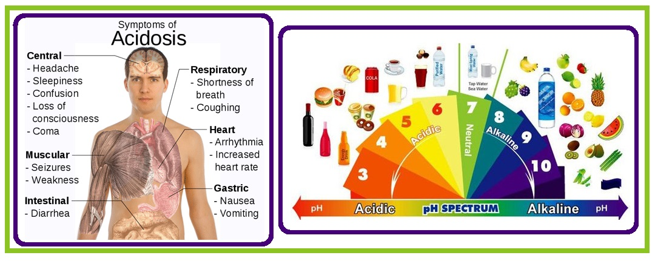
Debunking Alkaline Diet—an Alternative Fact Rather Than Alternative Medicine!
Alkaline diet postulates that the consumption of certain fruits and vegetables helps to alkalinize the body fluids to a pH of around 7.4—a pH that cellular homeostasis achieves regardless of alkaline diet!
Thus, alkaline diet is believed to offset acidosis resulting from a typical Western diet, thereby keeping diseases such as cancer at bay—indeed, many cancers cells thrive under acidic conditions!
But, the enigma is that the proponents of alkaline diet cannot explain how it helps to alkalinize the body fluids—do all foods not go through the stomach?!
If so, then all foods are churned in the stomach @ a pH of around 2! Does it really matter what the acidity/alkalinity of the intake food is? It represents a small drop in a big ocean—does it not?
What about thousands who swear to have benefited from having been on the super-scampensive alkaline diet?—nothing but a coincidence and a placebo effect—correlation does not imply causation!

Slide 6
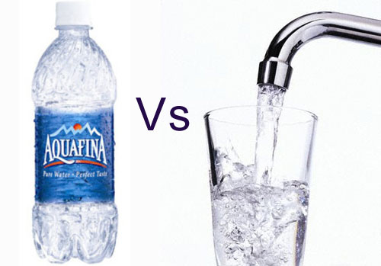
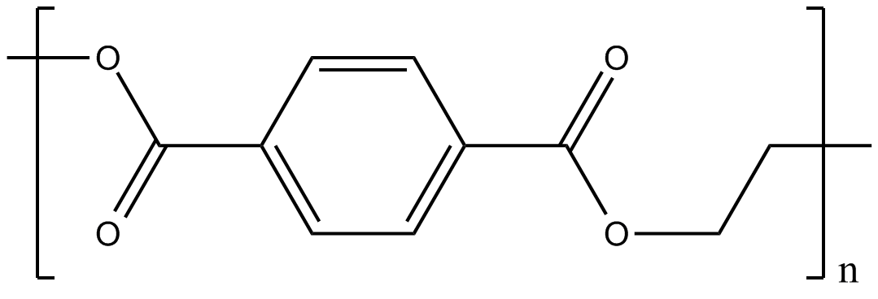
Bottled Water Exposed—a Convenience or Health Risk!
Polyethylene
Terephthalate
(PET)
Plastic water bottles are typically made from a polymer called polyethylene terephthalate (PET) in combination with a myriad of other chemicals and metals such as antimony (Sb)
During storage, transportation and exposure to heat, these nasty chemicals directly (or after decomposition) leach into the water as carcinogens and can often act as endocrine disruptors
Endocrine disruptors mimic the action of endocrine hormones such as estrogen, thereby disrupting signaling pathways, promoting cancer and other cellular defects—eg several lines of evidence suggest that sustained exposure to antimony (a metalloestrogen) contributes to the development of breast cancer
Not only tap water is FREE but it is better of the two evils—but avoid water filters as they also contain nasty carcinogenic compounds (anything that is made from plastic is malastic to health!)

