Slide 1
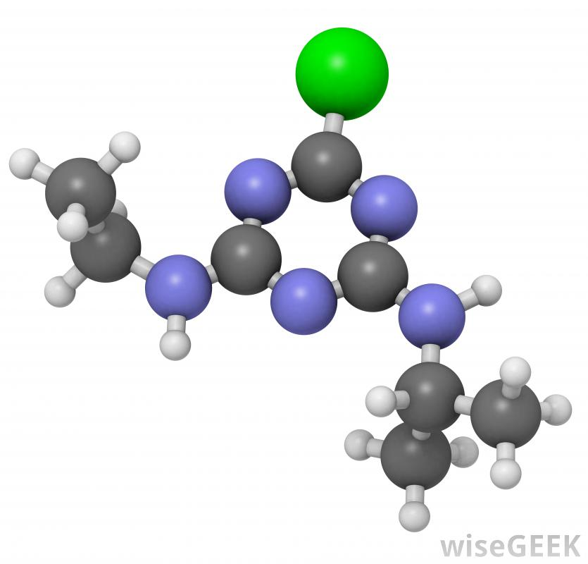
0. INTRODUCTION
§0.2 Basic Concepts

Slide 2
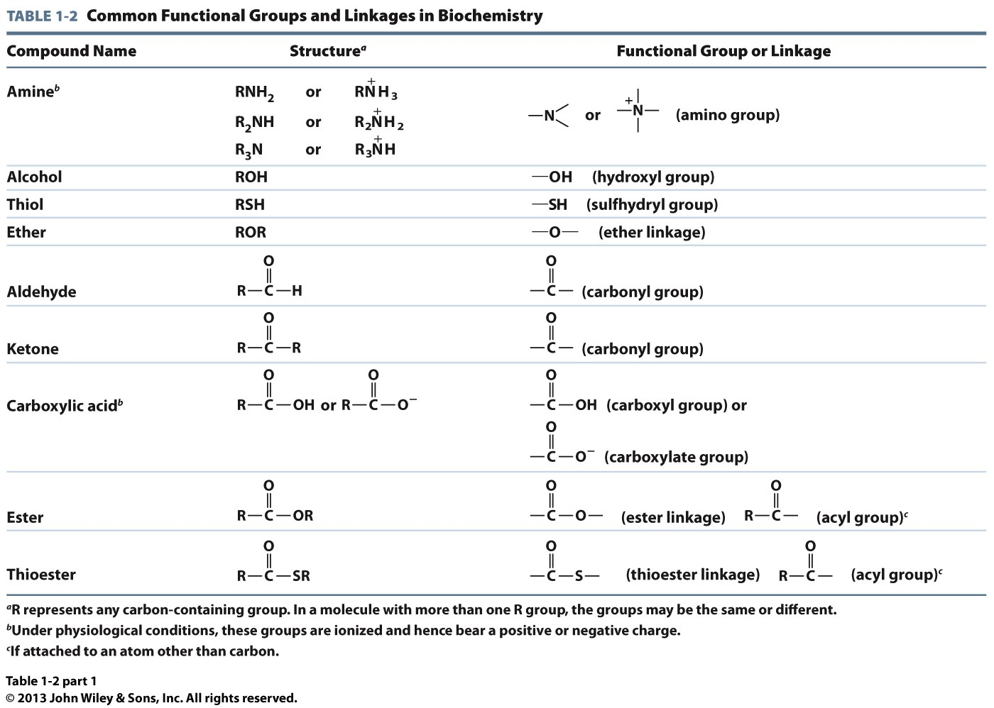
Common Functional Groups and Linkages I

Slide 3
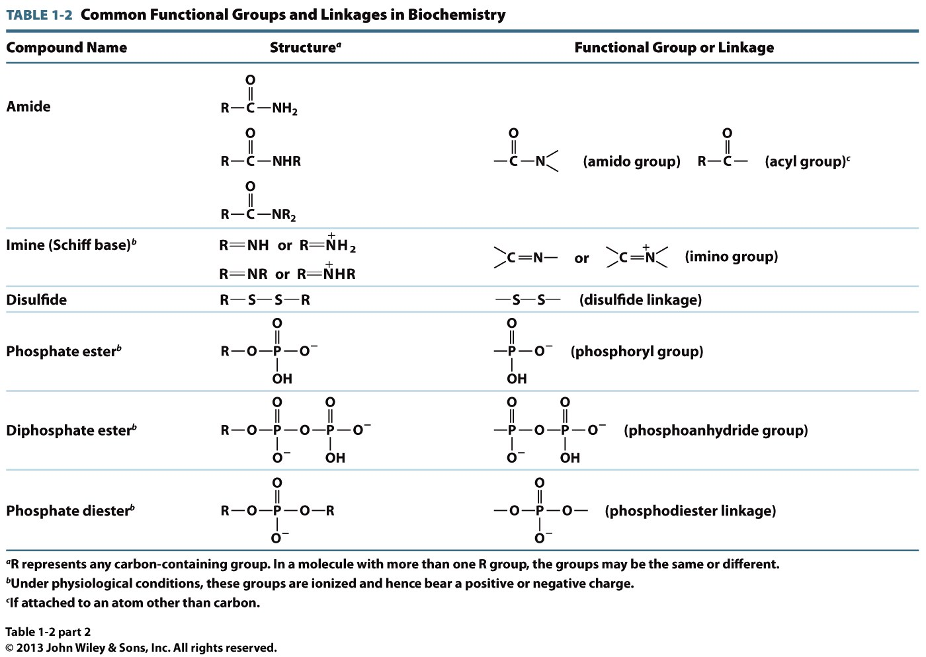
Common Functional Groups and Linkages II
(Carbamoyl)

Slide 4
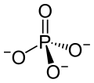
Phosphorus Compounds
Inorganic
phosphate
(PO₄³⁻)
Hydrogen
phosphate
(HPO₄²⁻)
pK = 12
H
HPO₄²⁻
PO₄³⁻ + H⁺
Phosphoryl
group
R
Under physiological conditions (pH ~ 7), inorganic phosphate (PO₄³⁻), often denoted as P_{i} in textbooks, only exists in the protonated form called hydrogen phosphate (HPO₄²⁻)—ie if a textbook calls for P_{i} as one of the reactants, it has to be in its protonated form!
Phosphate
group
R

Slide 5
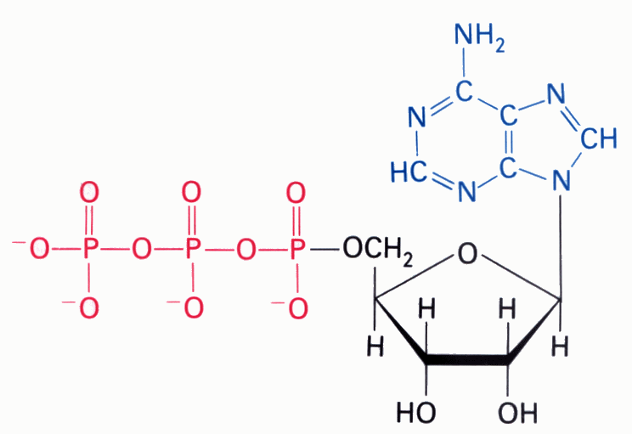
Comparison of Complex Bonds
O O
|| ||
R1—C—O—C—R2
O
||
R2—C—O—R1
Anhydride
[without hydride(H⁻)—two acyl groups bonded together via an O atom]
Ester
[acyl group bonded to an R moiety via an O atom]
O O
|| ||
—O—P—O—P—O—
| |
O⁻ O⁻
Phosphoanhydride
[two phosphoryl groups bonded together via an O atom]
O
||
⁻O—C—S—R1
Thioester
[acyl group bonded to an R via an S atom]
ATP
O
||
⁻O—P—O—R1
|
O⁻
(3)
Phosphoester
[phosphoryl group bonded to an R moiety via an O atom]
(1)
(2)
(4)
O
||
R2—O—P—O—R1
|
O⁻
Phosphoanhydride
Phosphoanhydride
Phosphoester
N-glycosidic
Phosphodiester
[phosphoryl group bonded to two R moieties via O atoms]

Slide 6
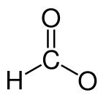
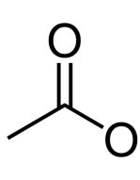
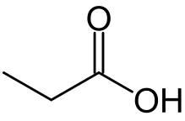
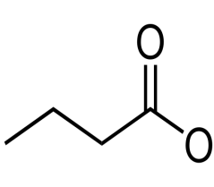
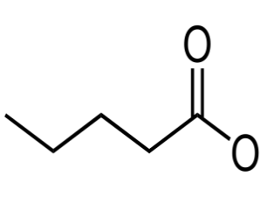
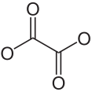
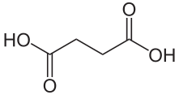
Mono- and Dicarboxylic Acids
Monocarboxylate Anions
-
-
-
-
-
-
1:1
Formate
(Methanoate)
2:1
Acetate
(Ethanoate)
3:1
Propionate
(Propanoate)
4:1
Butyrate
(Butanoate)
5:1
Valerate
(Pentanoate)
6:1
Caproate
(Hexanoate)
Dicarboxylate Dianions
-
-
-
-
-
-
-
-
2:2
Oxalate
(Ethanedioate)
3:2
Malonate
(Propanedioate)
4:2
Succinate
(Butanedioate)
5:2
Glutarate
(Pentanedioate)

Slide 7
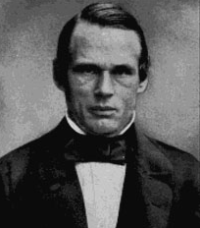
Atomic Distances
The Metric System Prefixes
Kilo 10³ Thousand
Mega 10⁶ Million
Giga 10⁹ Billion
Tera 10¹² Trillion
Peta 10¹⁵ Quadrillion
Exa 10¹⁸ Quintillion
Milli 10⁻³ Thousandth
Micro 10⁻⁶ Millionth
Nano 10⁻⁹ Billionth
Pico 10⁻¹² Trillionth
Femto 10⁻¹⁵ Quadrillionth
Atto 10⁻¹⁸ Quintillionth
Anders Ångström
(1814-1874)
In biochemistry, the atomic distances are usually expressed in the units of Angstrom (Å):
1 Å = 10⁻¹⁰ m
but 1 nm = 10⁻⁹ m
and 1 pm = 10⁻¹² m
thus 1 Å = 0.1 nm = 100 pm
Knowledge of the metric system is central to understanding biochemistry!

Slide 8
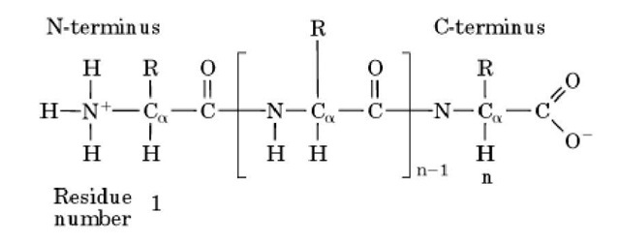
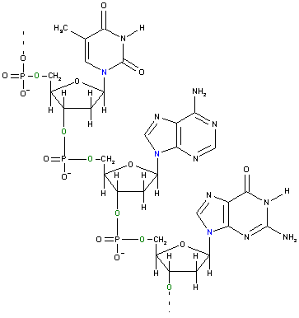
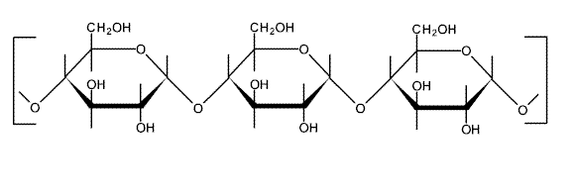
Biological Polymers
Polypeptide
Polysaccharide
Polynucleotide

Slide 9
Natural Selection
Biological molecules are subject to natural selection—thus imparting upon living organisms an inherent ability to adapt to environmental pressures
Such natural selection usually occurs at genomic level—ie mutations in the DNA sequence—but often manifests itself in the form of altered proteins and other molecules
“Adapt” and “adopt” are not synonymous:
Adapt—“to change/adjust”—eg the ability to adapt to environment is a key to success!
Adopt—“to take on/up”—eg the protein adopts a 3D fold under physiological conditions!

Slide 10
Common Latin Jargons
in vitro → “in glass” — studies conducted in a test tube
in vivo → “in living (body)” — studies carried out inside living organisms
ex vivo → “outside living (body)” — studies executed on cultured cells outside an organism
in situ → “on site” — studies performed on site (in place); eg examining an organ while it is still attached to the body after it has been sacrificed
in silico → “in silicon (computer)” — studies performed on a computer (microchips are largely comprised of silicon—a semiconductor metal)
vide infra → “look below” — see below
vide supra → “look above” —see above
ad nauseum → “to nausea (sickness)” — something that is repetitively discussed or mentioned to the point of sickness!
vis-a-vis → “face-to-face” —in regard to, in relation to

Slide 11
Hypothesis vs Theory vs Law
Hypothesis
A plausible statement/opinion/observation that needs to be tested thoroughly
—eg the enzyme is only active in the presence of Mg²⁺ ions
Theory
A principle that has been thoroughly tested and applied
—eg theory of evolution
Law
A fundamental rule that is universally true
—eg law of gravitation

